Slide 1


Substance Use, Addictions and Related Behaviours
Vaping: Grade 7/8
Notes:
**The following slides (2-4) are for teacher use only**
Image from Canva

Slide 2


Presentation Format
Guiding Questions: Big idea questions that prompt students to brainstorm and share previous knowledge or new information.
Think, Pair, Share: Opportunity for students to work with partner or group and share ideas based on a prompt.
Notes:
Images from Canva

Slide 3


Presentation Format
Videos: Students can watch a short video clip that connects with topic. Discussion can follow before or after videos.
Final Activity: Activity that concludes the presentation.
Notes:
Images from Canva

Slide 4

Curriculum Expectations - Grade 7
D1.2 - Demonstrate an understanding of linkages between mental health problems and problematic substance use, as well as between brain development and cannabis use, and identify school and community resources that can provide support for mental health concerns relating to substance use, addictions, and related behaviours.
D3.2 - Analyze the personal and societal implications of issues related to substance use, addictions, and related behaviours.
Notes:
Image from Canva

Slide 5
Curriculum Expectations - Grade 8
D1.2 - Identify situations that could lead to injury or death, and describe behaviours that can help to reduce risk.
D1.3 - Identify and describe the warning signs of problematic substance use and related behaviours for a variety of activities and substances, including cannabis, and the consequences that can occur.
D2.2 - Demonstrate the ability to assess situations for potential dangers, and apply strategies for avoid dangerous situations.
Notes:
Images from Canva

Slide 6
Substance Use, Addictions and Related Behaviours
Vaping: Grade 7/8
Notes:
**This is where the presentation officially begins**
Image from Canva

Slide 7

History of E-Cigarettes
E-cigarettes entered the market in 2006 and has been a rapidly changing product.
These devices were created to help cigarette smokers stop smoking.
Notes:
These devices were originally created as a smoking cessation aid (helps cigarette smokers stop smoking). They do not contain tobacco but often contains nicotine (addictive part found in a cigarette)
Vaping devices are another product now on the market in Canada which is similar to the JUUL in that you purchase replacement pods that contain the e-liquid. Vaping products have gained popularity in the United States and now in Canada, with a new brand of e-cigarettes called the JUUL.
Reference: US Department of Health and Human Services. (2016). E-cigarette use among youth and young adults: a report of the Surgeon General. https://www.ncbi.nlm.nih.gov/books/NBK538679/
Image from Canva

Slide 8

Guiding Question #1
Why do you think youth try vaping?
What marketing techniques are used to get the attention of youth?
Notes:
We are going to be using electronic cigarette (e-cigarette or e-cig) and vaping device interchangeably.
Questions:
Why do you think youth try electronic cigarettes, also known as vape products and vaping?
How are people, especially youth, influenced to try using vape products? → People can be influenced for a lot of different reasons (i.e., social media, family/friends, movies, peer pressure, to fit in) **refer to next slide for continuation**
Also, it is advertised to youth, using social media, fun candy flavours, etc.
Images from Canva

Slide 9
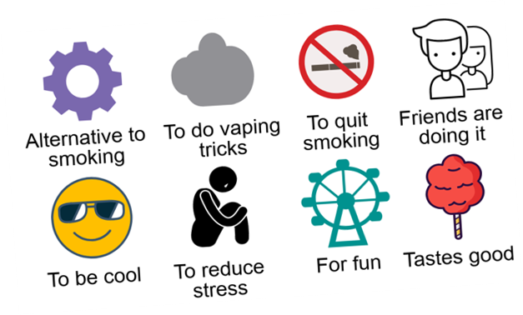
Why Do Youth Try E-Cigarettes?
Notes:
Alternative to smoking
To do vaping tricks
To quit smoking
Friends are doing it
To be cool
To reduce stress
For fun
Tastes good
Photo Reference: Wellington-Dufferin-Guelph Public Health. (2018). Vaping 101 Presentation. https://wdgpublichealth.ca/vaping-101-presentation

Slide 10

What is an E-Cigarette?
It is battery-operated.
It turns liquid chemicals, also known as e-juice, into a vapour (aerosol) that is breathed in (inhaled).
It is not a tobacco product, but may contain nicotine.
Notes:
So very briefly, what is an e-cigarette?
Using an e-cigarette is usually and commonly called vaping
An e-cigarette is battery operated device that heats a liquid into a vapour (aerosol) that is inhaled. This liquid may or may not contain nicotine and often includes flavouring in a propylene glycol base.
Vapes are not a tobacco product, but it may contain nicotine
Image from Canva

Slide 11
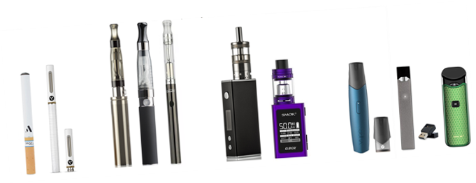
Types of Vape Products
Have you seen any of these vaping products?
Notes:
Teacher Prompt: Ask the students, do you know any of the types of vaping devices or products shown?
Electronic cigarettes – or e-cigarettes – are also called vapes, e-hookahs, vape pens, tank systems, mods, and electronic delivery systems (ENDS).
E-cigarettes are sold individually or as a kit that usually contains a rechargeable battery, a charger, and an e-liquid cartridge. The main types of e-cigarettes sold in Canada include:
Cigalike disposables: One-time use devices that look like cigarettes
Cigalikes: Devices that look like cigarettes and use replaceable, pre-filled cartridges for liquids
Advanced tank systems: Box-like or tubular devices that can be refilled with e-liquids, and have modifiable settings
The latest, more advanced models can produce more and hotter aerosol and may deliver nicotine more effectively and consistently than the first generation devices.
Vape pens: Pen-style devices that can be refilled with e-liquids, but have no modifiable settings
JUULs: a popular pod vape among youth, which looks like a USB stick and typically contains high amounts/levels of nicotine
Photo Reference: Wellington-Dufferin-Guelph Public Health. (2018). Vaping 101 Presentation. https://wdgpublichealth.ca/vaping-101-presentation

Slide 12
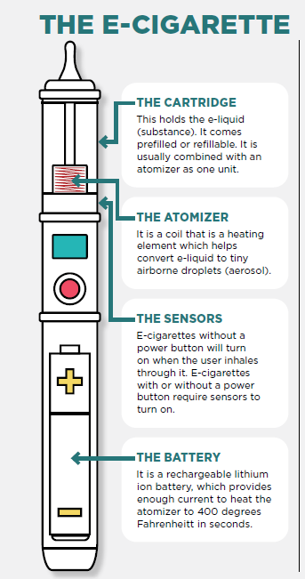
Looking Inside an E-Cigarette
Most electronic cigarettes and vaping products have four different components, including:
A cartridge (or resevoir pod)
A heating element (atomizer)
A battery (power source)
A mouthpiece
Notes:
Reference: Stanford Medicine (2021). Tobacco Prevention Toolkit: E-Cigarette and Vape Pen Crash Course. https://med.stanford.edu/tobaccopreventiontoolkit/resource-directory/crash-courses/E-cigaretteModuleCrashCourse.html
How do vaping devices work?
Most e-cigarettes consist of four different components, including:
A cartridge or reservoir pod, which holds a liquid solution (e-juice or e-liquid) containing varying amounts of nicotine, flavourings, and other chemicals
A heating element (atomizer)
A power source (usually a battery)
A mouthpiece that the person uses to inhale
In many e-cigs, puffing activates the battery-powered heating device, which vaporizes the liquid in the cartridge. The person then inhales the resulting aerosol or vapor (called vaping).
Video: https://youtu.be/vbNrlsR-pnI → This helps to go into further detail about the breakdown of a vaping device as well as the chemicals inside of it.
Reference and Photo Reference: National Institute on Drug Abuse (NIDA). (2020, January 8). Vaping Devices (Electronic Cigarettes) DrugFacts. Retrieved from https://www.drugabuse.gov/publications/drugfacts/vaping-devices-electronic-cigarettes

Slide 13
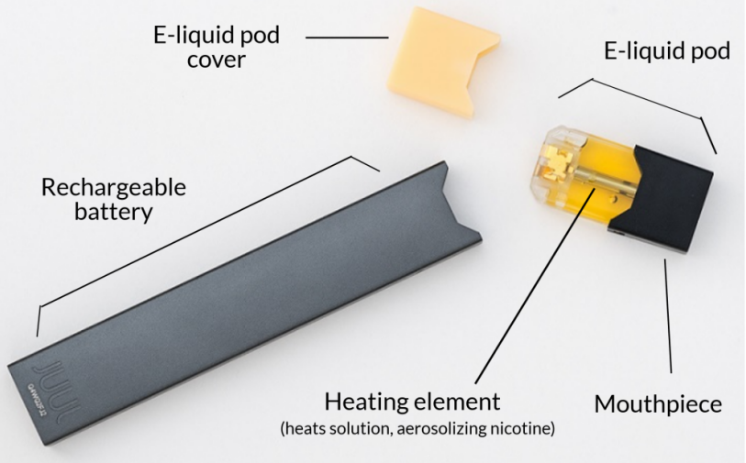
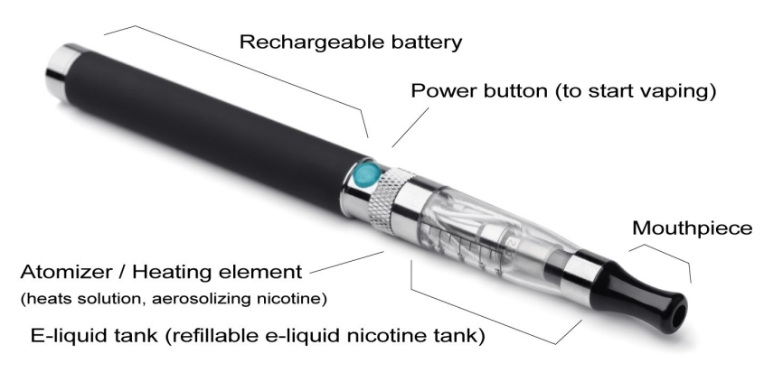
Parts of Vaping Products
JUUL E-cigarette
Vape Pen
Notes:
Point out the part that heats the e-juice liquid and the nicotine… Heating element/ atomizer
Photo Reference: King County. (2019, December 30). E-cigarettes and vapour products. https://kingcounty.gov/depts/health/tobacco/data/e-cigarettes.aspx

Slide 14

What is in the Vapour?
The e-cigarette vapour (aerosol) is a vape product that users inhale into their lungs and then exhale, which contains harmful substances, such as:
Metals
Nicotine
Flavourings
Particles
Notes:
Chemicals in E-Cigarettes - More than 80 ingredients (or compounds) have been found in e-cigarettes such as:
Ultrafine Particles: Linked to an increased risk of heart disease, lung cancer and asthma attacks and interfere with lung function
Metals: Lead, chromium, nickel, copper, tin, aluminium, and mercury have been detected and can have a variety of adverse health effects including brain damage and cancer
Flavourings: Diacetyl and acetyl propionyl which are associated with respiratory disease when inhaled (ie. popcorn lung)
Other chemicals found in e-cigs: *could be discussed depending on your class profile – might be too high literacy*
Tobacco-specific nitrosamines (TSNAs): Also found in cigarettes and are carcinogenic
Carbonyls: Contain formaldehyde, acetaldehyde, and acrolein, which are potential carcinogens
References:
American Lung Association. (2020, July 13). What’s in an E-Cigarette? https://www.lung.org/quit-smoking/e-cigarettes-vaping/whats-in-an-e-cigarette
Image from Canva

Slide 15
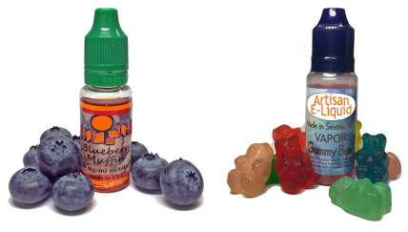
Examples of Liquids in Vapes
Notes:
E-liquid:
E-liquid is the liquid found in vaping devices, e-cigarettes, etc., that is converted into an aerosol.
It is typically a mixture of water, food grade flavouring, a choice of nicotine levels, sometimes cannabis (THC or CDB), propylene glycol (PG) or vegetable glycerin (VG).
Reference:
Centre for Disease Control and Prevention (CDC). (2020). E-cigarette, or Vaping, Products Visual Dictionary. Atlanta, GA: CDC. https://www.cdc.gov/tobacco/basic_information/e-cigarettes/pdfs/ecigarette-or-vaping-products-visual-dictionary-508.pdf (Phone on the left)
King County. (2019, December 30). E-cigarettes and vapour products. https://kingcounty.gov/depts/health/tobacco/data/e-cigarettes.aspx (Phone on the right)

Slide 16

What is Nicotine?
It is considered a drug
It is highly addictive
It can cause changes in brain chemistry
It is found in most e-juices of vaping products
Notes:
It is highly addictive since it causes changes in brain chemistry quickly and leaves the brain craving more.
Nicotine is found in tobacco and e-juice products
Data from studies of mice suggest that nicotine exposure during adolescence may have lasting adverse effects on brain development.
Image from Canva

Slide 17

Nicotine is a Stimulant
Nicotine is a drug that is considered a stimulant.
A stimulant is a drug that excites the body function, but specifically the brain and nervous systems.
It is toxic at high doses.
Notes:
It is highly addictive since it causes changes in brain chemistry quickly and leaves the brain craving more.
Nicotine is found in tobacco and e-juice products
Data from studies of mice suggest that nicotine exposure during adolescence may have lasting adverse effects on brain development.
Image from Canva

Slide 18

How Nicotine Affects a Person
When smoked, nicotine in the e-juice becomes absorbed through the lungs and into the bloodstream.
Once it has entered the bloodstream, it travels to other organs in the body, including the brain.
This increases the levels of dopamine.
Notes:
Low Literacy: When smoked, nicotine is absorbed through the lungs and into the bloodstream and to other organs in the body. It can take as little as 10 seconds for nicotine to reach the brain after it is inhaled.
Medium Literacy: Nicotine is absorbed through the skin and mucosal lining of the nose and mouth or in the lungs (through inhalation). Nicotine can reach peak levels in the bloodstream and brain rapidly.
High Literacy: The nicotine in e-liquids is readily absorbed from the lungs into the bloodstream when a person vapes an e-cigarette. Upon entering the blood, nicotine stimulates the adrenal glands to release the hormone epinephrine (adrenaline). Epinephrine stimulates the central nervous system and increases blood pressure, breathing, and heart rate. As with most addictive substances, nicotine activates the brain’s reward circuits and also increases levels of a chemical messenger in the brain called dopamine, which reinforces rewarding behaviors. Pleasure caused by nicotine’s interaction with the reward circuit motivates some people to use nicotine again and again, despite risks to their health and well-being.
References:
Ash Wales (2019, November 6). How to cope with stress without a cigarette in your hand. https://ash.wales/how-to-cope-with-stress-without-a-cigarette-in-your-hand/
National Institute on Drug Abuse (NIDA). (2020, January 8). Vaping Devices (Electronic Cigarettes) DrugFacts. Retrieved from https://www.drugabuse.gov/publications/drugfacts/vaping-devices-electronic-cigarettes
For more assistance in teaching how Nicotine affects the brain, check out Scholastic (http://headsup.scholastic.com/teachers/hownicotineaffectstheteenbrain) and the lessons, activities, and information that they have to offer.
Image from Canva

Slide 19
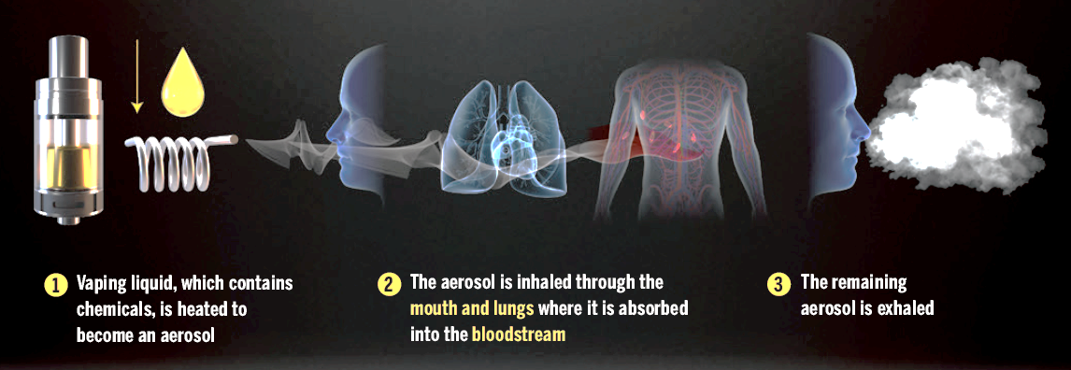
How Vaping Works
Notes:
Photo Reference: Wellington-Dufferin-Guelph Public Health. (2018). Vaping 101 Presentation. https://wdgpublichealth.ca/vaping-101-presentation

Slide 20

Video: Electronic Cigarettes and Vaping
Take notes about what you find interesting about this video.
Be prepared to share and discuss with the class.
Notes:
Video link: https://www.youtube.com/watch?app=desktop&v=9dZS_Rniak0
Also hyperlinked in the title. To access the video, click play on the video (make sure to be in present mode or the video won’t work)
Image from Canva

Slide 21
Guiding Question #2
Why do people continue to use vaping products even when they are aware of the risks?
Notes:
Knowing vaping has health impacts and multiple risks associated with it, why do you think people still use vaping products?
Earlier students were asked about reasons people are influenced to use vaping products. Now that we’ve outlined the health impacts, its important to have a conversation about why people continue to use vaping products.
-Addiction
-Looking popular
-Media
-Uninformed about health impacts
-To quit smoking
Image from Canva

Slide 22

Potential Short Term Health Effects
Light headedness
Throat irritation
Dizziness
Coughing
Increased heart rate and blood pressure
Lung inflammation
Notes:
Image from Canva

Slide 23

Impact on Lungs
The effects of aerosol exposure is unknown but some studies suggest possible lung damage.
Aerosols contain heavy metals that can damage lung tissue.
Aerosols contain cancer causing materials (carcinogens) that are released into the lungs.
Notes:
Long Term Health Effects still unknown - more research coming out that e-cigs causes damage to the lungs and lead to various pulmonary diseases.
Long-term vaping results in addiction, but there is not evidence about how addicting vaping is…
What are our lungs for? → Breathing!! A very important process, it’s so important that we do it automatically without thinking (autonomic nervous system)
Image from Canva
Reference:

Slide 24

Vaping and the Brain
Youth and young adults brains are still developing until the age of 25.
Nicotine makes it harder for youth to concentrate and learn.
Nicotine may cause a person to become addicted to other drugs.
Notes:
Reference: Centers for Disease Control and Prevention (CDC). (2021, September 20). About electronic cigarettes (e-cigarettes). https://www.cdc.gov/tobacco/basic_information/e-cigarettes/about-e-cigarettes.html
Image from Canva

Slide 25

Addiction
An addiction is an urge to do something that is hard to control or stop.
Vaping can lead to nicotine addiction and increased risk for addiction to other drugs.
Notes:
Reference: National Institute on Drug Abuse (NIDA). (2020, January 8). Vaping Devices (Electronic Cigarettes) DrugFacts. Retrieved from https://www.drugabuse.gov/publications/drugfacts/vaping-devices-electronic-cigarettes
Image from Canva

Slide 26
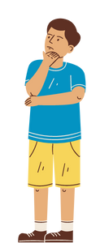
Second Hand Smoke
Vapour (or aerosols) may pose a health risk to those exposed to second-hand electronic cigarette “smoke”.
Notes:
Risks may include respiratory inflammation…
Vapour = Aerosols
Image from Canva

Slide 27
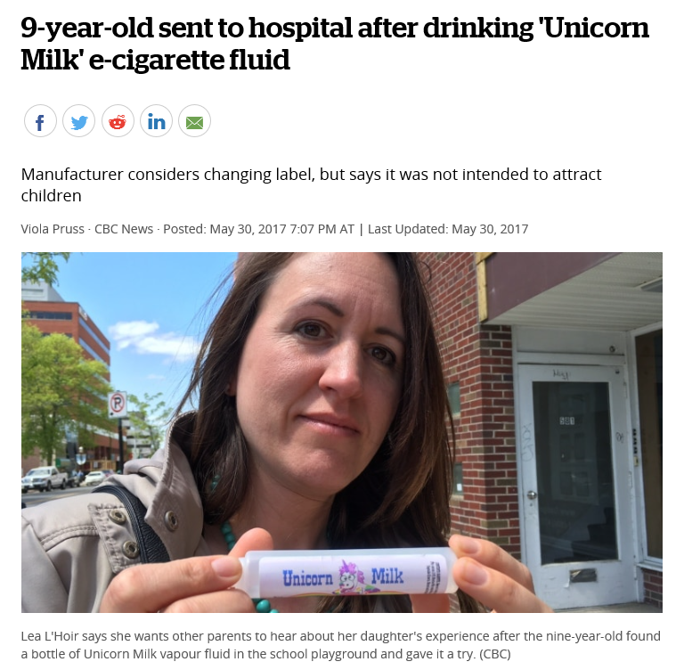
Think, Pair, Share
With a partner, discuss anything you notice from the article on the right that may be surprising.
Notes:
Possible Teacher Prompt:
Vaping products are targeted to youth through advertising (social media, fun candy flavours, popular music artists or TV actresses/actors). How so? Where have you seen advertising? (media, stores, etc.)
Now that we just talked about why students should be concerned about vaping, read the title of this article, look at the image and talk with a partner or group about the information being displayed.
Encourage prompts:
What stood out to you in this article?
When you look at this image and you see what the Unicorn Milk looks like, how can this be misleading to youth?
What are the dangers of marketing this type of product to youth?
How is the byline (Manufacturer considers changing label, but says it was not intended to attract children) inadvertently targeted towards children?
Reference: Pruss, V. (2017, May 30). CBC News: 9-year-old sent to hospital after drinking ‘Unicorn Milk’ e-cigarette fluid. https://www.cbc.ca/news/canada/new-brunswick/unicorn-milk-vapour-e-cigarettes-1.4137455
Image from Canva

Slide 28

Impacts of Vaping
Vaping is viewed as safer than smoking, yet the long term health effects are still largely unknown.
Vaping can lead to the use of other drugs.
Vaping devices have caused unintended injuries.
Notes:
Some would say it is just water vapour, but it’s not. Youth think its safer and harmless. Safer than cigarettes doesn’t mean safe.
May act as a gateway to tobacco and other drugs… causing addiction
Defective e-cigarette batteries have cause fires and explosions, some of which have resulted in serious injuries. Also, acute nicotine exposure can be toxic. Children and adults have been poisoned by swallowing, breathing, or absorbing e-cigarette liquid through their skin, eyes, or ingestion.
We are seeing people vaping in areas where smoking is not permitted, reversing the progress of tobacco control
Reference: Centers for Disease Control and Prevention (CDC). (2021, September 20). About electronic cigarettes (e-cigarettes). https://www.cdc.gov/tobacco/basic_information/e-cigarettes/about-e-cigarettes.html
Image from Canva

Slide 29

Smoke Free Ontario Act
Vaping is not allowed in schools, on school property, or at school-related events.
    First offence = Fine of $305
The legal age to buy and use vaping products in Ontario is 19.
Notes:
NO possession law exists for tobacco and e-cigarettes 🡪 only to be shared with staff and parents**)
In Ontario, e-cigarettes, tobacco and cannabis are all controlled under the Smoke Free Ontario Act.
Under this legislation, vaping is prohibited on school property and an additional 20m from the school perimeter.
Those who break this law can be charged with a $305 fine for the first offence (this can increase for multiple offences).
In terms of sale and supply, Niagara Region Public Health is responsible for the day-to-day enforcement of the SFOA. This includes obtaining compliance through education and awareness to ensure that business owners are aware of the laws that apply to them.
Officers from Niagara Region Public Health conduct regular inspections of retailers to ensure compliance with the SFOA. Officers conduct “test shopping” to test a retailers willingness to sell an electronic cigarette device to a person who is less than 19 years old.
A person who sells or supplies an e-cigarette device to a person under 19, may be subjected to a fine of $490.00. (Includes retailers, adults or youth supplying to those under 19 years)
See Health Canada for more information
https://www.canada.ca/en/health-canada/services/smoking-tobacco/vaping.html
***Ask the principal for any school-specific disciplinary measures in terms of suspensions or expulsions***
Image from Canva

Slide 30

Public Rules and Regulations
Using vaping products is not allowed in various public spaces, such as…
  Beaches
  Recreation trails
  Parks, playgrounds and sports fields
  Splash pads and outdoor pools
Notes:
The newly updated Niagara smoke and vape-free outdoor spaces bylaw now prohibits tobacco, cannabis and vaping products from being smoked or vaped in several public spaces.
Other places- Splash pads and outdoor pools
Arenas and recreation centres
Outdoor areas of municipal and regional buildings
Bus shelters
Hospital Grounds and Long-Term Care Properties
Within nine metres of an entrance or exit of a publicly accessible place, building or workplace (new)
Beaches and recreation trails are new
Image from Canva

Slide 31

Final Activity: Peer Pressure
You’re at a classmate’s house for a birthday party.
Some kids from school are pressuring you to try a Cotton Candy flavoured JUUL.
What can you do or say in responding to the pressures to try vaping?
Notes:
Teacher Prompt: How can you use decision-making and communication skills to resist pressures to try/use vaping products when you are with others?
With a partner or group, brainstorm possible answers to the question.
JUUL is a type of vape product.
Possible Options:
I need to start by thinking in advance about the positive and negative consequences of my actions. I can also avoid problems if I hang out with people who make healthy choices, who are supportive, and who don’t hassle me about not drinking and smoking. The same idea applies to choosing who I communicate with online.” “To respond to peer pressure to use substances or to difficult situations online, I may need to use my assertiveness skills to say no confidently and persuasively. When dealing with someone face to face, listening carefully and watching body language are important.” (Ontario Health and Physical Education Curriculum, 2019)
Discuss different ways and tips for saying no (refusal skills):
Say “no”. Be assertive and clear.
Walk away
Broken record – You may be asked several times - keep repeating “no”.
Say “no” different ways. For example, “I’m not interested” or “I don’t want to”
Give an excuse or explanation if you want. For example, “I don’t want to smoke weed because I don’t want to become addicted.”
Offer an alternative activity. For example, “I don’t want to smoke weed; how about we go to the mall?”
Reverse the pressure. For example, “Why are you pressuring me?”
Images from Canva

Slide 32

More Questions? Talk with Someone:
Teacher/Principal
Doctor or Health Care Provider
School Health Nurse
Parents/Guardian
Community Addictions Services of Niagara (CASON)
Kids Help Phone
Notes:
CASON → 905-684-1183 or www.cason.ca
Services for Youth - Niagara Region, Ontario → https://www.niagararegion.ca/health/schools/youth-services.aspx
PHN to be coming to classrooms to follow up and offer a question and answer discussion.
If you ever have questions/concerns, need help or know someone who needs help, you can always talk to someone. There are many options out there available to you. A young person is less likely to vape if they have one of the following support personnel mentioned above…
Image from Canva

Slide 33

Final Thoughts
Vaping can cause lung damage and affects development of the brain.
There are still many unknown long-term health effects.
Vaping can lead to addiction and other potential health problems.
The legal age to buy and use vaping products in Ontario is 19.
Notes:
Youth are encouraged not to vape.
Additional Points to Consider:
There are still many unknown long-term health effects…
Smoking tobacco and vaping products are prohibited in many places under the Smoke-Free Ontario Act
Unknown long term health effects
Harmful chemicals
Lung damage
Addiction
Affecting brain development
If you don’t smoke, don’t vape
If your in an uncomfortable situation, remember to use refusal skills or talk to someone you trust
Image from Canva

