Slide 1


Substance Use, Addictions and Related Behaviours
Vaping: Grade 4-6
Notes:
**The following slides (2-4) are for teacher use only**
Image from Canva

Slide 2


Presentation Format
Guiding Questions: Big idea questions that prompt students to brainstorm and share previous knowledge or new information.
Think, Pair, Share: Opportunity for students to work with partner or group and share ideas based on a prompt.
Notes:
Images from Canva

Slide 3


Presentation Format
Videos: Students will watch a short video clip that connects with topic. Discussion can follow before or after videos.
Final Activity: Activity that concludes the presentation.
Notes:
Images from Canva

Slide 4

Curriculum Expectations – Grade 4
D1.4 - Identify substances (e.g., nicotine, carbon monoxide, tar) found in tobacco and vaping products (e.g., cigarettes, e-cigarettes, cigars, pipe tobacco, chewing tobacco, snuff) and smoke, and describe their effects on health.
D3.2 - Describe the short- and long-term effects of first- and second-hand smoke on smokers and on people around them, and the effects of vaping.
Notes:
Image from Canva

Slide 5
Curriculum Expectations – Grade 5
D2.3 - Demonstrate the ability to apply decision-making, assertiveness, and refusal skills to deal with pressures pertaining to alcohol use or other behaviours that could later lead to addiction.
Notes:
Image from Canva

Slide 6
Curriculum Expectations – Grade 6
D1.4 - Identify people, resources, and services in the school and the community that can provide support when a person is dealing with mental health issues and choices or situations involving substance use and addictive behaviours, and describe how to access these support.
D2.4 - Use decision-making strategies and skills and an understanding of factors influencing drug use to make safe personal choices about the use of drugs such as alcohol, tobacco and cannabis, and about activities such as vaping, including the choice to abstain.
Notes:
Image from Canva

Slide 7
Substance Use, Addictions and Related Behaviours
Vaping: Grade 4-6
Notes:
**This is where the presentation officially begins**
Image from Canva

Slide 8

Guiding Question #1
What do you know about electronic cigarettes, vapes or vaping?
Notes:
Electronic Cigarettes, also called e-cigarettes, or vapes, or vaping products.
Photo Reference: Centres for Disease Control and Prevention (CDC). (2021, September 20). About electronic cigarettes (e-cigarettes). https://www.cdc.gov/tobacco/basic_information/e-cigarettes/about-e-cigarettes.html

Slide 9

History of Electronic Cigarettes
Electronic cigarettes, also known as e-cigarettes (e-cigs), and more recently referred to as vaping devices.
These products started being sold in 2006.
It has become a rapidly changing product.
Notes:
Vaping devices are another product now on the market in Canada which is similar to the JUUL in that you purchase replacement pods that contain the e-liquid.
Reference: US Department of Health and Human Services. (2016). E-cigarette use among youth and young adults: a report of the Surgeon General. https://www.ncbi.nlm.nih.gov/books/NBK538679/
Image from Canva

Slide 10
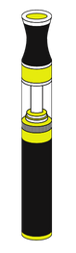
What is an Electronic Cigarette?
Smoking an electronic cigarette is commonly called vaping.
These products need batteries to work.
It turns liquid into a vapour (aerosol) that is breathed in.
It is not a tobacco product.
Notes:
So very briefly, what is an e-cigarette? We are going to be using e-cigarette and vape products interchangeably
An e-cigarette is battery operated device that heats a liquid chemicals (also known as the e-juice) into a vapour (aerosol) that is inhaled. This liquid may or may not contain nicotine and often includes flavouring in a propylene glycol base.
Vapes are not a tobacco product, but it may contain nicotine
Image from Canva

Slide 11
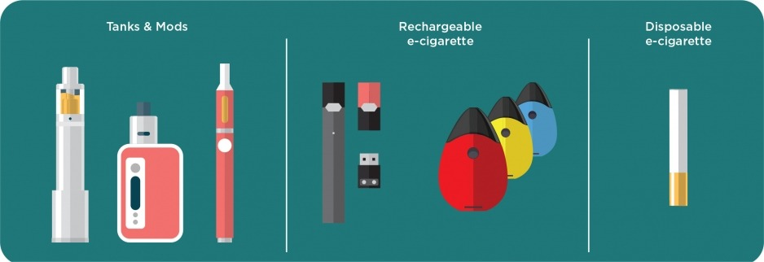
Types of Electronic Cigarettes
Notes:
Teacher Prompt: Ask the students, have you seen or heard of any of the vape products mentioned?
Some e-cigarettes are made to look like regular cigarettes, cigars, or pipes. Some resemble pens, USB sticks, and other everyday items.
E-cigarettes are sold individually or as a kit that usually contains a rechargeable battery, a charger, and an e-liquid cartridge. The main types of e-cigarettes sold in Canada include:
Cigalike disposables: One-time use devices that look like cigarettes
Cigalikes: Devices that look like cigarettes and use replaceable, pre-filled cartridges for liquids
Advanced tank systems: Box-like or tubular devices that can be refilled with e-liquids, and have modifiable settings
The latest, more advanced models can produce more and hotter aerosol and may deliver nicotine more effectively and consistently than the first generation devices.
Vape pens or pods: Pen-style devices that can be refilled with e-liquids, but have no modifiable settings
Photo Reference: National Institute on Drug Abuse (NIDA). (2020, January 8). Vaping Devices (Electronic Cigarettes) DrugFacts. Retrieved from https://www.drugabuse.gov/publications/drugfacts/vaping-devices-electronic-cigarettes

Slide 12
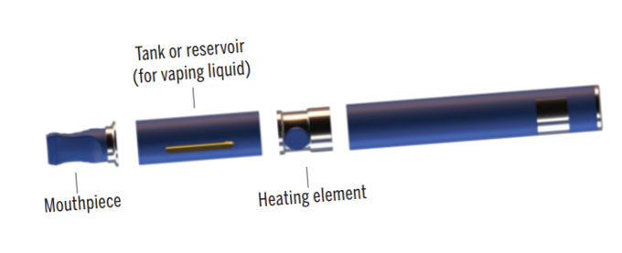
Looking Inside an Electronic Cigarette
Notes:
E-cigarettes vary widely in design and appearance, but all operate in a similar way. There are four main components:
A mouth piece
A cartridge or tank that carries the liquid
A heating element
A battery
Photo Reference: Reference: Wellington-Dufferin-Guelph Public Health. (2018). Vaping 101 Presentation. https://wdgpublichealth.ca/vaping-101-presentation

Slide 13
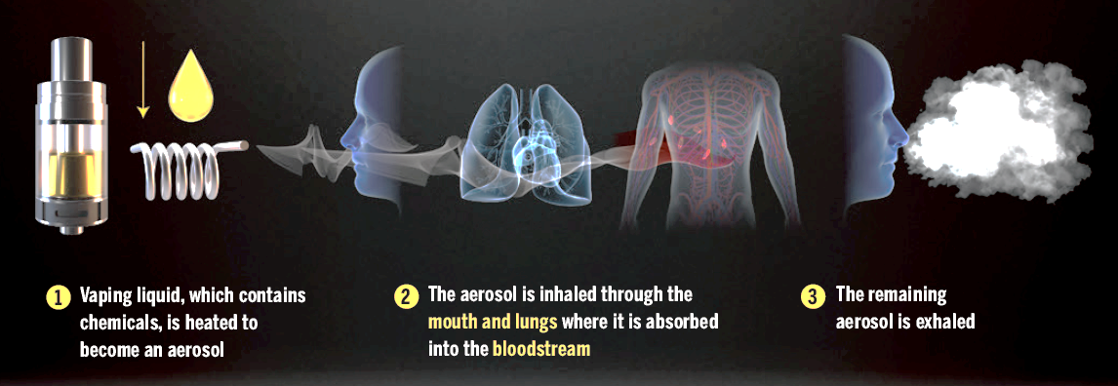
How Electronic Cigarettes Work
Step 1: Using the mouthpiece of the electronic cigarette, the device heats up a liquid to make a vapour (aerosol).
Step 2: The person breathes in the vapour (aerosol) through their mouth and into the lungs.
Step 3: The person then breathes out any left over vapour (aerosol).
Notes:
Step 1: Upon placing your mouth on the mouthpiece of an electronic cigarette, the vaping liquid is heated to become an aerosol (vapour).
Step 2: Once the person begins pulling or inhaling from the e-cigarette, the aerosol is inhaled through the mouth and lungs where it then becomes absorbed into the bloodstream.
Step 3: The remaining aerosol is exhaled.
Photo Reference: Wellington-Dufferin-Guelph Public Health. (2018). Vaping 101 Presentation. https://wdgpublichealth.ca/vaping-101-presentation

Slide 14

What is the Vapour in an Electronic Cigarette?
More than 80 chemicals are found in e-juices that cause negative health effects, such as:
Nicotine
Metals
Flavourings
Notes:
Vapour = Aerosol
Chemicals in E-Cigarettes - More than 80 chemical ingredients (or compounds) have been found in e-cigarettes such as:
Nicotine
Metals: Lead, chromium, nickel, tin, copper, aluminium, and mercury have been detected and can have a variety of adverse health effects including brain damage and cancer
Flavourings: Linked to serious lung disease - Diacetyl and acetyl propionyl which are associated with respiratory disease when inhaled (ie. popcorn lung)
Ultrafine Particles: Inhaled deep into the lungs - Linked to an increased risk of heart disease, lung cancer and asthma attacks and interfere with lung function
Other chemicals (*could be discussed depending on your class profile – might be too high literacy*)
Cancer-causing chemicals
Tobacco-specific nitrosamines (TSNAs): Also found in cigarettes and are carcinogenic
Carbonyls: Contain formaldehyde, acetaldehyde, and acrolein, which are potential carcinogens
Reference: American Lung Association. (2020, July 13). What’s in an E-Cigarette? https://www.lung.org/quit-smoking/e-cigarettes-vaping/whats-in-an-e-cigarette
Image from Canva

Slide 15

What is Nicotine?
It is considered a drug
It is highly addictive
It can cause changes to the brain
It is found in many e-juices
Notes:
Image from Canva

Slide 16

Nicotine
Nicotine is a drug that is considered a stimulant.
A stimulant is any drugs that excites the body function, but specifically the brain and nervous systems.
It is toxic at high doses.
Notes:
Image from Canva

Slide 17

Guiding Question #2
True or False:
Electronic cigarettes were created to help people stop smoking cigarettes?
Notes:
Answer: True – It is a tool designed to help smokers stop smoking!
Can use for some student engagement during presentations.
These devices were originally created as a smoking cessation aid (helps cigarette smokers stop smoking). They do not contain tobacco but often contains nicotine (addictive part found in a cigarette)
Photo Reference: Centers for Disease Control and Prevention (CDC). (2021, September 20). About electronic cigarettes (e-cigarettes). https://www.cdc.gov/tobacco/basic_information/e-cigarettes/about-e-cigarettes.html
Pink Circle with Question Mark – Image from Canva

Slide 18

Potential Short Term Effects
Light headedness
Throat irritation
Dizziness
Coughing
Increased heart rate and blood pressure
Lung inflammation
Notes:
Image from Canva

Slide 19
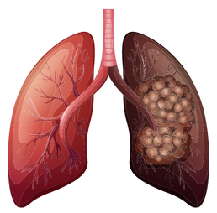
Potential Long Term Effects
Research on the long-term health effects of frequent vapour (aerosol) exposure is unknown but some studies suggest possible lung damage.
Notes:
Long Term Health Effects still unknown- more research coming out that e-cigs cause damage to the lungs and association with lead to various pulmonary diseases.
Unknown long term health effects
Harmful chemicals
Lung damage
Addiction
Affecting brain development
Reference: Centers for Disease Control and Prevention (CDC). (2021, September 20). About electronic cigarettes (e-cigarettes). https://www.cdc.gov/tobacco/basic_information/e-cigarettes/about-e-cigarettes.html
Image from Canva

Slide 20

Addiction
An addiction is an urge to do something that is hard to control or stop.
Notes:
Ask: What is an addiction?
Long-term vaping may result in addiction but evidence of how addictive they are is not yet available.
Image from Canva

Slide 21

Impact on Lungs
Electronic cigarette vapour (aerosols) can contain heavy metals that can damage lung tissue.
There are cancer causing materials that can be released into your lungs.
Notes:
What are our lungs for? → Breathing!! A very important process, it’s so important that we do it automatically without thinking (autonomic nervous system)
Image from Canva

Slide 22

Vaping and the Brain
Nicotine can harm brain development in adolescents and young adults.
Nicotine makes it harder for youth to learn.
Constant use of nicotine may cause other health issues for people.
Notes:
Youth and young adults brains are still developing into the early to mid-20s, until about the age of 25 → Nicotine can harm adolescent and young adults brain development.
Long-term vaping results in addiction, but there is not evidence about how addicting vaping is…
Image from Canva

Slide 23

Think, Pair, Share
Knowing that electronic cigarettes are unsafe, why do you think people choose to use them?
Notes:
Knowing that vaping products are unsafe, why do you think people, specifically youth (adolescents, children, young adults), try them OR continue to use them?
Choose to Use → Influences (i.e., social media, peers); Pressures
Continued Use → Many e-cigarettes and vaping devices that use e-juices contain NICOTINE, which is a highly addictive drug.

Slide 24

Video: TearDown
Take notes about what you find interesting about this video.
Be prepared to share and discuss with the class.
Notes:
Video link: https://www.youtube.com/watch?app=desktop&v=MfQ6pKVkkl4
Also hyperlinked in the title. To access the video, click play on the video (make sure to be in present mode or the video won’t work)
Image from Canva

Slide 25

Final Activity: Influenced by Friends
Time to make a decision…
You are at the park with some friends when someone finds an electronic cigarette on one of the benches.
What can you say to someone if they ask you to try vaping?
Notes:
What can you say to someone if they ask you to try vaping? With a partner or a group, think of ideas on how to make correct and smart decisions and share with the class.
Teacher Prompt: Help encourage students to think of and identify refusal strategies and decision-making skills…
Teach students that Smoking tobacco, cannabis and vaping products is not allowed in various public spaces like playgrounds/parks.
Discuss different ways and tips for saying no (refusal skills):
Say “no”. Be assertive and clear.
Walk away
Broken record – You may be asked several times - keep repeating “no”.
Say “no” different ways. For example, “I’m not interested” or “I don’t want to”
Give an excuse or explanation if you want. For example, “I don’t want to smoke weed because I don’t want to become addicted.”
Offer an alternative activity. For example, “I don’t want to smoke weed; how about we go to the mall?”
Reverse the pressure. For example, “Why are you pressuring me?”
Some peers may try to influence you to do drugs, or to start vaping, by saying it’s cool to do them, or sometimes you may just want to be part of a crowd that’s into those things. To avoid this kind of influence, you have to be a strong individual, think about what you really want and what you value, and make up your own mind about things. Even if someone tells you ‘everyone is doing it’, your decisions are your own, and so are the consequences. But peers can be a positive influence too. Hanging out with friends who don’t use drugs and don’t smoke or vape can keep you from starting…
Images from Canva

Slide 26

How Can Adults Help?
Adults can help youth make safe decisions when thinking about trying electronic cigarettes or vaping products.
Notes:
Adults have the ability to influence youths decisions about vaping…
One suggestion for families would be to establish clear family rules regarding e-cigarettes/vaping/vape products. A parents’ opinion matters. If a parent feels that vaping is wrong, their child is far less likely to use it.
Image from Canva

Slide 27

Resources and Services
There are many resources and services in the school and community to help a person who wants to quit vaping, including:
Canadian Mental Health Association (CMHA)
Centre for Addiction and Mental Health (CAMH)
Community Addictions Services of Niagara (CASON)
Drug Free Kids Canada
Notes:
CASON → 905-684-1183 or www.cason.ca
CMHA → https://ontario.cmha.ca/addictions/
CAMH → https://www.camh.ca//en/your-care/programs-and-services and https://www.camh.ca/en/your-care/programs-and-services/youth-addiction--concurrent-disorders-service
Drug Free Kids Canada → https://drugfreekidscanada.org/
Niagara Region Services → https://www.niagararegion.ca/health/substances/tobacco/quitting-smoking.aspx
Heart Niagara → heartniagara.com or 905-358-5552
Other: Alternatives for Youth – substance use and mental health services for 12 to 25 year olds and their families → https://ay.on.ca/other-resources/ and https://ay.on.ca/

Slide 28

More Questions? Talk with Someone:
Teacher/Principal
Doctor or Health Care Provider
Parents/Guardians
School Health Nurse
Community Addictions Services of Niagara (CASON)
Kids Help Phone
Notes:
CASON → 905-684-1183 or www.cason.ca
Services for Youth - Niagara Region, Ontario → https://www.niagararegion.ca/health/schools/youth-services.aspx
PHN to be coming to classrooms to follow up and offer a question and answer discussion.
If you ever have questions/concerns, need help or know someone who needs help, you can always talk to someone. There are many options out there available to you. A young person is less likely to use vape if they have one of the following support personnel mentioned above…
Image from Canva

Slide 29

Final Thoughts
Youth are encouraged to avoid vaping.
Electronic cigarettes can cause lung damage and negatively affects the brain.
Electronic cigarettes can contain harmful ingredients.
Vaping can lead to other potential health problems.
Notes:
Additional Points to Consider:
There are still many unknown long-term health effects…
Smoking tobacco and vaping products are prohibited in many places under the Smoke-Free Ontario Act
If you don’t smoke, don’t vape
If your in an uncomfortable situation, remember to use refusal skills or talk to someone you trust
Image from Canva

