Slide 1
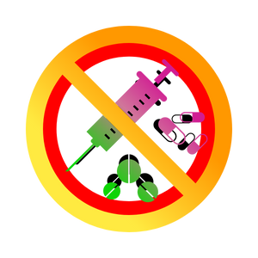
Substance Use, Addictions and Related Behaviours
Substance Use – Grade 8
Notes:
Trigger Warning: Explain to students that you will be discussing the topic of susbtance use, addictions and related behaviours, and that the topic may contain information that might be sensitive to them or bring up unwanted/ unprovoked trauma and/or emotion. Remind them that it is ok for them to take a break and leave the class if needed.
**The following slides (2-4) are for teacher use only**
Image from Canva

Slide 2


Presentation Format
Guiding Questions: Big idea questions that students can brainstorm and share previous knowledge or new information with.
Think, Pair, Share: Opportunity for students to work with partner or group and share ideas based on a prompt.
Notes:
Images from Canva

Slide 3


Presentation Format
Videos: Students will watch a short video clip that connects with topic. Discussion can follow before or after videos.
Final Activity: Activity that concludes the presentation.
Notes:
Images from Canva

Slide 4

Curriculum Expectations - Grade 8
D1.2 - Identify situations that could lead to injury or death, and describe behaviours that can help to reduce risk.
D1.3 - Identify and describe the warning signs of problematic substance use and related behaviours for a variety of activities and substances, including cannabis, and the consequences that can occur.
D2.2 - Demonstrate the ability to assess situations for potential dangers, and apply strategies for avoiding dangerous situations.
Notes:
Image from Canva

Slide 5
Substance Use, Addictions and Related Behaviours
Substance Use – Grade 8
Notes:
**This is where the presentation officially begins**
Image from Canva

Slide 6
Guiding Question #1
What do you think the term substance use disorder means?
Notes:
Turn to your seating buddy either across from you or beside you and talk about the following question.
Possible Answers:
A disorder from using susbtances such as drugs
A problem someone has from using drugs
An addiction to drugs/substances
Mental disorder that affects a person’s brain and behaviour
Image from Canva

Slide 7
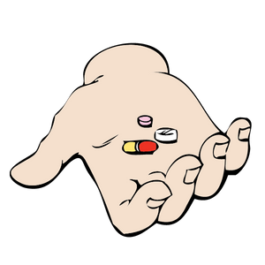
Definition of a Drug
“A drug is a substance, other than food, which changes the way a person thinks, feels and acts.
Notes:
A drug can enter the body by being ingested, smoked, injected, inhaled or absorbed (e.g. under the tongue or through on the skin).
When discussing the subject of substance misuse, the focus is on the use of drugs…
Canada. Department of Justice Canada. Controlled Drugs and Substances Act. Ottawa, ON:
Department of Justice, 1996. Available online at <http://laws.justice.gc.ca/en/C-38.8/>.
Definitions from https://www.edu.gov.mb.ca/k12/cur/physhlth/frame_found_gr11/rm/module_e_lesson_1.pdf
For different types of drugs, check out → Alcohol and Drug Foundation (ADF) https://adf.org.au/drug-facts/
Image from Canva

Slide 8
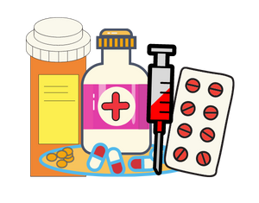
Substances – Drugs
Prescription drugs
Designer drugs
Stimulants
Sedatives
Hallucinogens
Depressants
Alcohol
Tobacco
Vaping
Cannabis
Notes:
Legal drugs can be prescribed by doctors or health care providers and are sold in stores. Are known as over-the-counter (OTC) and prescription (Rx) drugs. This can include alcohol, nicotine, and caffeine, which are all legal drugs.
Illegal drugs refer to drugs that are not prescribed by a licensed medical professional, such as a doctor. The use of these drugs is considered illegal under the Controlled Drugs and Substances Act (Department of Justice Canada).
Canada. Department of Justice Canada. Controlled Drugs and Substances Act. Ottawa, ON:
Department of Justice, 1996. Available online at <http://laws.justice.gc.ca/en/C-38.8/>.
Definitions from https://www.edu.gov.mb.ca/k12/cur/physhlth/frame_found_gr11/rm/module_e_lesson_1.pdf
Image from Canva

Slide 9
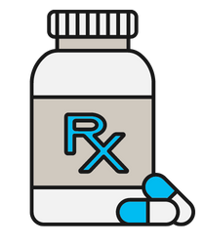
Prescription Drugs
The non-medical use of prescription drugs is taking and using someone else's prescribed medications.
This can be just as dangerous as using illegal drugs.
Never take someone else’s medications!
Notes:
Examples: Pain Killers, ADHD Medication, Sleeping Pills
The non-medical use of prescription drugs is taking other people’s prescription medication to get high. This is done without guidance from a doctor or pharmacist.
Drugs, including prescription drugs, have unwanted and potentially dangerous side effects (eg. decreased breathing). Taking prescription drugs that are not prescribed to you can be just as dangerous as using illegal/illicit drugs.
Prescription painkillers (eg. Fentanyl, Percocet, OxyContin, Tylenol #3) are highly addictive.
Image from Canva

Slide 10
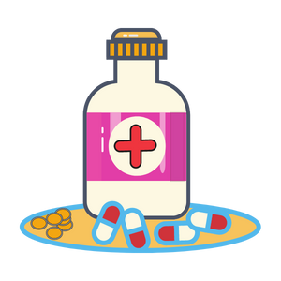
Designer Drugs
These are man-made illegal drugs that aren't regulated.
You don’t know what is in it…
One example is Date Rape Drug.
Notes:
Examples: Rohypnol, Ecstasy, PCP, GHB, LSD, Ketamine
Sometimes referred to as a “club drug” because of their use at clubs and raves.
May also be referred to as a rape drug – date rape drug because they can be added to a drink, without changing the colour or taste, and cause quick intoxication.
Never leave your drink alone!!
Image from Canva

Slide 11

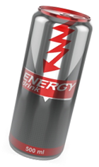
Stimulants
Speeds up the function of the central nervous system.
Drug user is more aware of their environment.
Using these drugs may also cause changes in behaviour; restlessness, and dizziness.
Notes:
Examples: Caffeine, Nicotine, Steroids, Cocaine, Methamphetamine
Reference: Better Health Channel. (2017, December 18). How drugs affect your body. https://www.betterhealth.vic.gov.au/health/healthyliving/How-drugs-affect-your-body
Photo References:
Energy Bottle – Shutterstock_124511944 → https://www.shutterstock.com/image-illustration/energy-drink-can-on-white-background-124511944
Coffee Cup - Image from Canva

Slide 12
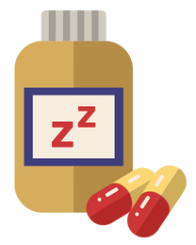
Sedatives
Slows down the body and brain function.
Drug user is less aware of their environment.
Using these drugs may also cause drowsiness.
Notes:
Examples: Opioids, Heroin, Tranquillizers
Opioids are a type of medication that relieve pain… This type of drug is one of the most commonly found and used in Canada, especially for opioid-related overdoses and deaths.
References:
Drug Free Kids Canada (2022). 60% of those who use illegal drugs are 15 to 24 years old. https://www.drugfreekidscanada.org/prevention/drug-spotlights/illegal-drugs/
Government of Canada. (2021, December). Opioid- and Stimulant-related Harms in Canada. https://health-infobase.canada.ca/substance-related-harms/opioids-stimulants/
Image from Canva.

Slide 13
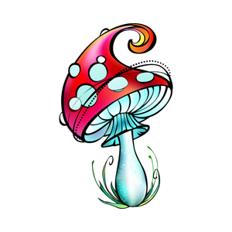
Hallucinogens
These drugs disrupt a person’s ability to think and communicate clearly, or to even recognize reality.
Side effects include distorted awareness and perception.
  This can result in dangerous behaviour.
Notes:
Examples: Solvent (gas), Ecstasy (MDMA), Psychedelics (Mushrooms, LSD)
Distorted awareness and perception – seeing or hearing things that aren’t actually there.
Individuals experience with hallucinogens is often unpredictable, which can put them at risk for injury.
Sometimes individuals may experience pleasant sensations and heightened awareness; while other times individuals may experience “bad trips” that include terrifying thoughts, anxiety and/or paranoia.
The same individual could have completely different experiences with each use.
Reference: Better Health Channel. (2017, December 18). How drugs affect your body. https://www.betterhealth.vic.gov.au/health/healthyliving/How-drugs-affect-your-body
Image from Canva

Slide 14
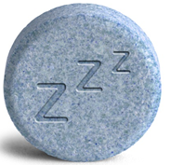
Depressants
Depressants slow down the functions of the central nervous system.
Drug user is less aware of their environment.
These types of drugs have a relaxing effect, can slow brain function and physical function.
Notes:
Examples: Alcohol, Tranquillizers, Narcotic Analgesic, Sedative Hypnotics
Reference: Better Health Channel. (2017, December 18). How drugs affect your body. https://www.betterhealth.vic.gov.au/health/healthyliving/How-drugs-affect-your-body
Photo Reference: Shutterstock_213243685
https://www.shutterstock.com/image-photo/blue-sleeping-pill-three-z-isolated-213243685

Slide 15
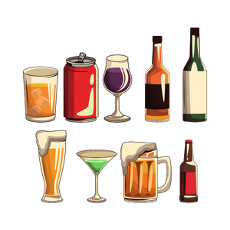
Alcohol
Alcohol is a depressant.
Enters the bloodstream and affects brain function.
Decreases coordination, blurs vision and slows reaction time.
Alcohol can be addictive for some individuals.
Notes:
Increases risk taking behaviours and leads to poor decision making abilities (i.e. risky sexual activity, dangerous activities that may cause injury).
These effects of alcohol are also what make it dangerous to drive (or use any type of motor vehicle) after drinking.
Decreases coordination, blurs vision and slows reaction time - increases risk of injury.
Alcohol use during pregnancy may result in fetal alcohol spectrum disorder (FASD) in the infant. This causes physical, cognitive, emotional and behavioural developmental disabilities in the baby.
Long term consequences may included damage to organs such as brain, liver, pancreas and stomach. The risk of cancer is also increased.
Image from Canva

Slide 16
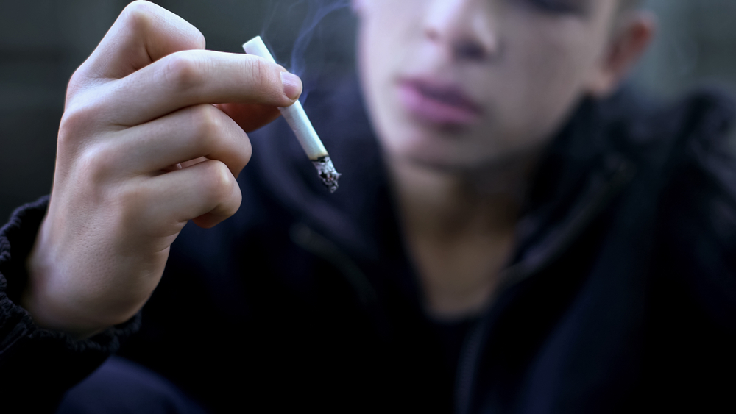
Tobacco
Tobacco products are often smoked in the form of cigarettes/cigars or in vaping devices.
There are smokeless products like chewing tobacco.
Tobacco products always contain nicotine, which is an addictive drug.
Notes:
Tobacco can be smoked in the form of cigarettes, cigars, cigarillos, hookah (consists of a glass base that is partially filled with water)
Tobacco also comes in smokeless tobacco products which are typically broken down into two categories: chewing tobacco and snuff/snus (pronounced “snoose”)
Chewing tobacco is shredded, twisted, or bricked loose leaf tobacco. It is places in the mouth, between the cheek and lower lip. It is occasionally chewed. The resulting tobacco juices/saliva is typically spit out.
**New** Snuff/snus is fine-grain tobacco. Snuff can also be places between the gum and cheek or lower lip, while snus to typically placed between the gum and upper lip. Snuff/snus does not need to be spit out.
Nicotine is the drug in tobacco that is addictive
**This should be a review** Legal age to purchase tobacco products is 19 years of age and older
Photo Reference: Shutterstock_1294742095
Bad Habits Teenager Smoking Cigarette Pretending Stock Photo (Edit Now) 1294742095 (shutterstock.com) → https://www.shutterstock.com/image-photo/bad-habits-teenager-smoking-cigarette-pretending-1294742095

Slide 17
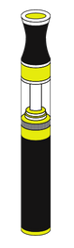
Vaping
Types of vaping products include electronic cigarettes (e-cigs), vape pens, and JUULs.
Vaping devices have a mouthpiece, battery, heating element and cartridge.
Vaping happens when a person inhales the vapour from the device through the mouth into the lungs and then is exhaled.
Notes:
This should be a review from the vaping PowerPoint presentation, if already taught.
Electronic cigarettes – commonly referred to as e-cigarettes or “vapes”
Use a battery, heating element and liquid containing cartridge (e-liquid or e-juice) to create an aerosol or vapour.
The liquid cartridge is filled with an e-juice that creates an aerosol (vapour). The cartridges come in different flavours which may be appealing to young people.
Vaping liquids typically contains a mixture f water, food grade flavouring, levels of nicotine, cannabis (THC or CBD), and propylene glycol (PG) or vegetable glycerin (VG).
In Canada, e-cigarettes without nicotine are considered legal; however, Health Canada warns that they have not been fully checked for safety or quality. In fact, some cartridges that have been labeled as nicotine-free actually contain nicotine. Different cartridges may contain different amounts of nicotine. E-cigarettes containing nicotine are readily available in Canada and online.
Electronic cigarettes may be perceived as being less harmful then cigarettes, but there are still risks. Many cartridges contain nicotine and the aerosol contains other chemicals that may be harmful.
Images from Canva

Slide 18

Cannabis
Cannabis, also known as pot and weed, comes in many different forms.
Cannabis is most commonly smoked in joints and bongs, but can also be ingested as edibles (brownies).
Smoke from cannabis can contain chemicals that cause cancer (carcinogens).
Notes:
Refer to the Niagara Region Public Health teaching tool on Cannabis for a more in-depth PowerPoint.
Cannabis comes from a cannabis sativa plant and contains the chemical THC, which is a mind altering ingredient extracted from the plant. It can be consumed in many forms, including a joint, from a bong or vape, pipe, in food (edibles) or beverages, creams/oils, etc.
What does it do to your body? – increased appetite, loss of coordination, decreased concentration, hallucinations, memory loss, lung disease, addiction… Marijuana is addictive, especially for those who start using at a younger age, which increases their risk for addiction.
When eating or drinking cannabis, it can take up to:
2 hours for you to start to feel the effects
4 hours for you to feel the full effects
12 hours for acute effects to subside
However, cannabis impairment can last for more than 24 hours after use, well after the other effects have faded.
(OSDUHS, 2017) → Stress that less than one quarter (19%) of students in grades 7-12 report using marijuana throughout the year. This means that about 80% of students do not use cannabis.
Reference: Government of Canada (2021, September 3). Talking with teenagers about drugs. https://www.canada.ca/en/health-canada/services/substance-use/talking-about-drugs/talking-with-teenagers-about-drugs.html
Image from Canva

Slide 19

Dangers of Substance Use
Notes:
Image from Canva

Slide 20
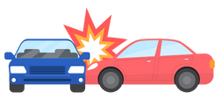
Consequences of Drugs and Alcohol
Substance use disorder
Addiction
Overdose/Poisoning
Vehicle crashes
Legal problems
Financial problems
Poor academics
Violence
Decreased athletic performance
Notes:
Poisoning can be related to alcohol, cannabis or vaping.
Death resulting from:
injuries/accidents
overdose
alcohol poisoning
Vehicle Crashes
Motor Vehicle (i.e. bicycle, car, boat, ATV)
15% of all students (Gr 7-12) report being a passenger with driver who has been drinking (OSDUHS, 2015).
12% of students reported being a passenger with a driver who had been using drugs (OSDUHS, 2015)
Impairment, speed and driver error are the main reasons for vehicle crashes.
Other/More Injuries
Railroad, Pools, Falls
More Fights
Decreased Judgement
Decreased Sensitivity
Sexual Assault – The person who is using substances:
Won’t take “no” as an answer
Takes advantage of an individual who is passed out
(no consent)
Decreased Athletic Performance
Extra Weight
Hangovers
Decreased Motor Skills (eye, hand, brain coordination)
Other examples might include:
Inability to make good decisions, Injury, death, or legal charges as a result of accidents or violence while impaired, Fetal Alcohol Spectrum Disorder (FASD) in children as a result of alcohol abuse by the mother during pregnancy
Image from Canva

Slide 21
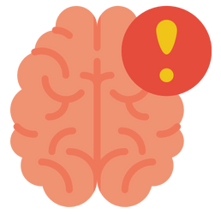
Think, Pair, Share
What are examples of mental health problems that are connected to problems with substance use?
Notes:
Turn to your seating buddy either across from you or beside you and talk about the following question.
Substances could include alcohol, tobacco, vaping, cannabis, drugs, etc.
Examples are:
-Depression
-Eating disorders
-Anxiety disorders
-Bipolar disorders
-Schizophrenia
Images from Canva

Slide 22
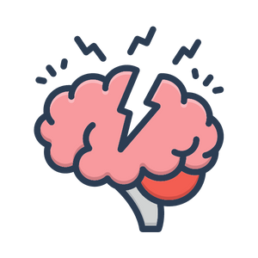
Mental Health and Substance Use
Using substances daily can lead to dependence, disorder or addiction.
There is a direct link between mental health problems and addiction.
Problematic substance use and mental illness are closely connected.
Notes:
Research suggests that those who start using drugs/alcohol at a younger age are at increased risk for addiction.
Suggest to students that they can look for these signs in a friend they may be concerned has mental health issues:
Frequently sad, depressed, anxious or rebellious
Difficulty paying attention
Problems with eating, sleeping, or getting along at school
Being addicted to substances
Image from Canva

Slide 23

Warning Signs of
Substance Use Disorder
Changes in behaviour.
Gradual withdrawal from social circles.
Drop in academics and grades.
Giving up on extracurricular activities.
Loss of interest in normal activities.
Notes:
Ask students if they can think of or know of (or seen) any other warning signs of substance abuse…
Common signs to watch for in someone who may have a substance use problem, disorder, or addiction:
Failing to fulfill responsibilities
Work
Home
School
Giving up important social, occupational or recreational activities
Image from Canva

Slide 24
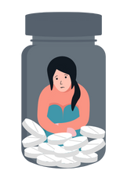
Addiction
Addiction can cause serious harm to your physical and mental health.
The 4Cs of addiction:
Craving
Loss of Control over the amount or frequency of use
Compulsion to use
Use despite the Consequences
Notes:
Review (jr/int): Addiction is a term used to describe a behaviour that is hard to control or stop.
Drug use can vary widely. Many people never try drugs, while some experiment with drugs and others use them regularly or even become addicted.
All drugs have negative effects – some of those effects are felt after trying a drug even once, while others occur as people use the drugs repeatedly.
You never know how a drug is going to react with your body and so experimenting with any type of drug can be dangerous.
Some young people start off in the experimental stage and wind up using drugs regularly, which leads to dependency and addiction.
Once a person develops an addiction to a drug, he or she feels controlled by the drug and needs the drug to function.
Image from Canva

Slide 25
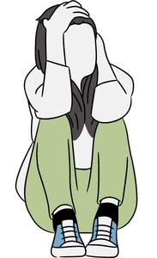
Signs of Addiction
Changes in personality and behaviour.
Bloodshot eyes and frequent bloody noses.
Shakes, tremors, or slurred speech.
Changes in daily routines.
Lack of concern for personal hygiene.
Unusual need for money.
Changes in friends and activities.
Notes:
People who have an addiction will consume drugs often and in large quantities over a long period of time… Most of the time, they aren’t able to cut down, quit or control their use
Changes in personality and behaviour may look like a lack of motivation, irritability, and agitation.
Unusual need for money tends to cause financial problems in the long-run.
Other “look-fors” that might not be right in front of us:
The person keeps taking a drug after it’s no longer needed for a health problem.
The person needs more and more of a substance to get the same effects (i.e., “tolerance”)
The person is still using substances/drugs even though it causes bad things to happen in their life, like trouble with friends, family, work, school, or the law.
The person has lost interest in things they once liked to do.
The person has begun having challenges doing normal daily things (such as cooking or working).
The person drives or does dangerous things when on the drug/substance.
The person is borrowing or stealing money to pay for substances/drugs.
The person is sleeping/eating too much or too little compared to what they used to.
The person looks diferent → bloodshot eyes, bad breath, shakes or tremors, frequent bloody noses, may have gained/lost weight.
The person has a new set of friends with whom they do drugs…
Reference: Rodgman, C. (2021, January 27). WebMD: Signs of Drug Addiction. https://www.webmd.com/mental-health/addiction/signs-of-drug-addiction
Image from Canva

Slide 26

Video: Addiction and the Brain – For Kids!
What is an Addiction?
What does this do to our brain?
Notes:
Video link: http://www.youtube.com/watch?v=s0bqT_hxMwI
Also hyperlinked in the title. To access the video, you will need to open the hyperlink/video link in a separate Internet browser.
Teacher Prompt: What did you find interesting while watching the video?
Image from Canva

Slide 27
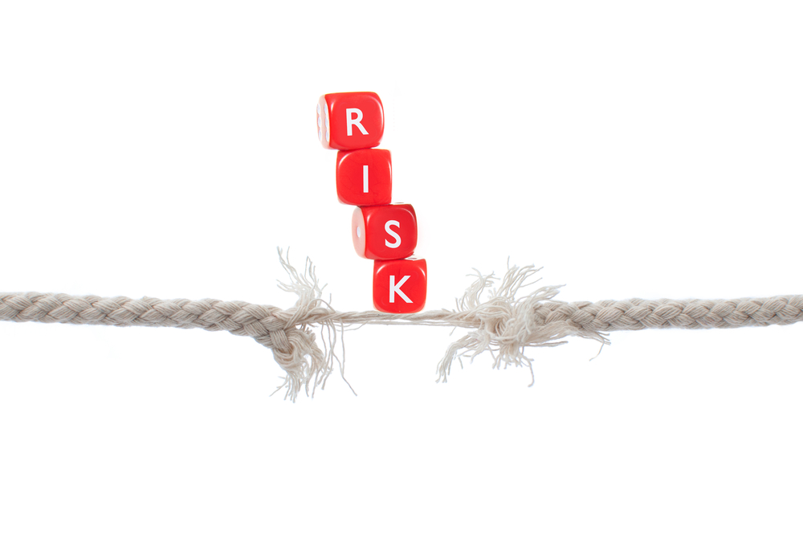
Assessing Situations for Potential Dangers
Notes:
Photo Reference: Shutterstock_103686428
Risk Stock Photo (Edit Now) 103686428 (shutterstock.com) → https://www.shutterstock.com/image-photo/risk-103686428

Slide 28
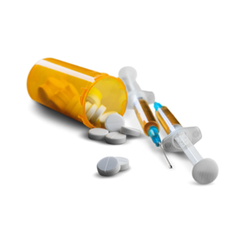
Drug Overdose
Signs of a drug overdose:
Nausea/vomiting
Severe stomach pain/abdominal cramps
Diarrhea
Chest pain
Dizziness
Loss of balance/ coordination
Drowsiness and confusion
Agitation
Notes:
Reference: Better Health Channel. (2021, August 23). Drug overdose. https://www.betterhealth.vic.gov.au/health/healthyliving/drug-overdose

Slide 29

Alcohol Poisoning
Signs of alcohol poisoning:
Cold/clammy
Slow breathing
Vomiting
Confusion
Shakiness
Slow and Weak pulse
Unconsciousness (passed out)
Notes:
Alcohol Poisoning can be fatal and is a medical emergency.
Binge drinking is defined as:
5 or more standard drinks on one occasion for males
4 or more standard drinks on one occasion for females
Binge drinking may result in a “hangover” the follow day. Symptoms include shakiness, nausea, headache, etc.
Alcohol poisoning can also lead to loss of consciousness and vomiting as the body tries to get rid of the excess alcohol.
Choking on vomit (while “passed out”) can result in death.
Image from Canva

Slide 30
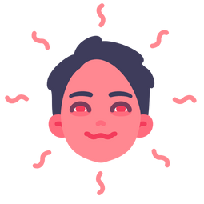
Cannabis Poisoning
Symptoms of cannabis poisoning:
Chest pain
Rapid heartbeat
Nausea/vomiting
Severe anxiety and/or panic attack.
Notes:
Consuming or inhaling too much cannabis at one time can be potentially dangerous.
Cannabis poisoning is not generally known to be fatal. It can, however, be very unpleasant and potentially dangerous, sometimes requiring emergency medical attention and, in some cases, hospitalization. Children and pets are at greater risk of cannabis poisoning. The higher the THC in the cannabis product, the more likely you are to possibly experience adverse side effects, such as cannabis poisoning.
Physical signs of cannabis impairment are red eyes, strong potent small (like skunk), dry mouth, rapid heart rate. Behavioural signs of cannabis impairment can include delayed reaction time, paranoia, unfocused, poor coordination, lack of judgement.
If you consume or inhale cannabis and experience harmful side effects stop using it and get medical attention immediately.
Reference: Government of Canada. (2021, March 11). Cannabis and your health. https://www.canada.ca/en/services/health/campaigns/cannabis/health-effects.html
Image from Canva

Slide 31
Guiding Question #2
What are some tips to reduce risks and prioritize safety during potentially unsafe situations?
Notes:
How to take care of yourself when using substances - Kids Help Phone → https://kidshelpphone.ca/get-info/how-to-take-care-of-yourself-when-using-substances/#:~:text=try%20a%20small%20amount%20first%20%E2%80%94%20substances%20can,to%20you%20keep%20a%20Naloxone%20kit%20close%20by
Expectations: apply strategies for avoiding dangerous situations
Image from Canva

Slide 32
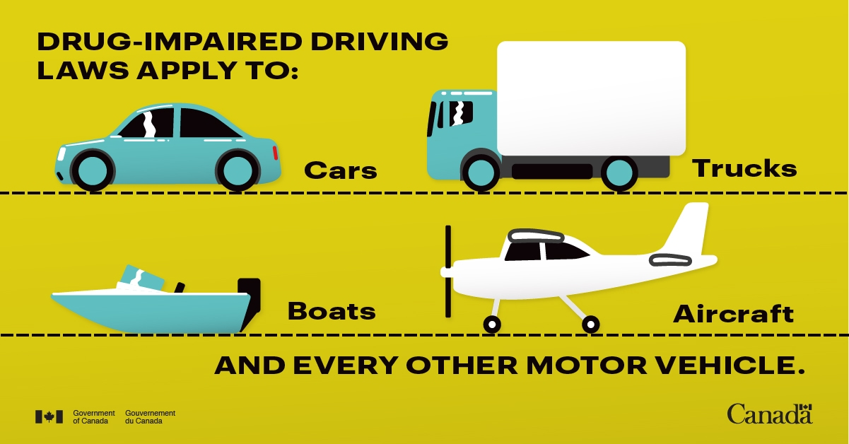
Driving Impaired
Drug-impaired driving and driving under the influence of alcohol is illegal.
Driving under the influence of drugs or alcohol has consequences.
Driving high or drunk is dangerous.
Notes:
Photo Reference: Government of Canada. (2021, November 18). Don’t Drive High. https://www.canada.ca/en/campaign/don-t-drive-high.html

Slide 33

Safe Suggestions for Travel
Plan to get home safely! Here are some safer options for getting home rather than driving under the influence:
Have a designated driver
Call a friend or family member
Call a cab or ride-share
Take public transit
Stay over (if a possibility)
Last resort - walk home (never alone)
Notes:
**Under the influence means alcohol, cannabis, or other drugs**
The Last Report – Walk Home → Is only if wherever you are is in close proximity to home or wherever you are residing. Also, never walk alone if you are under the influence of cannabis. Because of the side-effects it could impair your judgement and decision making. If you choose to walk home, it should be with a trusted friend who isn’t under the influence of any substance (i.e., alcohol, cannabis, other drugs).
Image from Canva

Slide 34
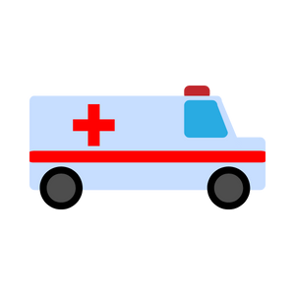
Emergency Situations
If someone passes out after using any substances, try to wake them up. If they don’t respond, do the following:
Check for a pulse
Make sure the person is breathing
Use the Bacchus Maneuver
Stay with the person and call 911
Notify parents or guardians as soon as possible
Never leave the person alone!
Notes:
Even if the person is not unconscious, but is impaired, they must not be left alone because this increases the risk for injuries!
Do not force anything by mouth (no food, etc) to prevent choking… If possible and the person is conscious, sit them up and try to get them to willingly drink water
Do not let the person sleep it off. They would be dead in the morning…
Image from Canva

Slide 35

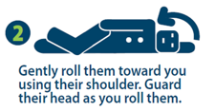
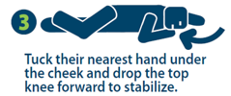

Bacchus Maneuver
If someone loses consciousness after drinking or using drugs, the Bacchus maneuver should be used.
Notes:
If someone loses consciousness after drinking and/or using drugs, the Bacchus maneuver should be used.
Option: students can practice this skill on each other.
NRPH Image

Slide 36
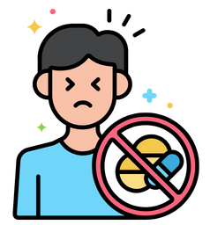
When to Get Help
If notice the following signs in someone who has used substances, you need to get help immediately.
Being unresponsive, but awake
Limp body
Seizures
Slow or erratic pulse
Difficulty breathing
Choking
Blue fingernails or lips
Pale or clammy face
Loss of consciousness
Notes:
The following are signs/symptoms of an overdose.
Be alert – These signs can be for any substance, but mainly targeted at those who have used drugs and alcohol.
Reference: Better Health Channel. (2021, August 23). Drug overdose. https://www.betterhealth.vic.gov.au/health/healthyliving/drug-overdose

Slide 37
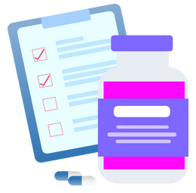
First Aid for a Suspected Overdose
If you think someone is going through an overdose:
Stay calm.
Call 911 for an ambulance.
If the person is unconscious but breathing, place them gently on their side in the recovery position.
Continue checking their condition until help arrives.
Do not try to make the person vomit.
Do not give them anything to eat or drink.
Notes:
Ensure the persons airways remains open by tilting the head back and lifting the chin. (This can help them to breathe an stop them from choking if they vomit).
Make sure you stay with the person at all times – do not leave them alone.
Consider first aid and naloxone training for an overdose response. Naloxone training is for a specific drug overdose though (opioids), so don’t confuse this as being training for all drug overdoses.
Reference: Better Health Channel. (2021, August 23). Drug overdose. https://www.betterhealth.vic.gov.au/health/healthyliving/drug-overdose
Image from Canva

Slide 38

Legislation
The legal age to buy, use, and possess tobacco, alcohol and cannabis in Ontario is 19.
Anyone in the possession of illegal substances (i.e., cocaine, ecstasy, mushrooms) will be charged.
Youth supplying any type of substance (i.e., drugs) to those under 19 years - is not permitted.
Notes:
Supplying tobacco, cannabis, alcohol products, or drugs (cocaine, ecstasy, mushrooms, meth, etc.) to anyone, especially youth under 19, is not allowed.
In Ontario, e-cigarettes, tobacco and cannabis are all controlled under the Smoke Free Ontario Act.
A person who sells or supplies an e-cigarette device to a person under 19, may be subjected to a fine of $490.00. (Includes retailers, adults or youth supplying to those under 19 years)
Officers from Niagara Region Public Health conduct regular inspections of retailers to ensure compliance with the SFOA. Officers conduct “test shopping” to test a retailers willingness to sell an electronic cigarette device to a person who is less than 19 years old.
See Health Canada for more information
https://www.canada.ca/en/health-canada/services/smoking-tobacco/vaping.html
***Ask the principal for any school-specific disciplinary measures in terms of suspensions or expulsions***
Image from Canva

Slide 39

Public Rules and Regulations
Smoking tobacco, cannabis and vaping products is prohibited in various public spaces, such as…
  Beaches
  Recreation trials
  Parks, playgrounds and sports fields
  Splash pads and outdoor pools
Notes:
The newly updated Niagara smoke and vape-free outdoor spaces bylaw now prohibits tobacco, cannabis and vaping products from being smoked or vaped in several public spaces including:
- Beaches (new)
- Recreation trails (new)
- Within nine metres of an entrance or exit of a publicly accessible place, building or workplace (new)
- Parks, playgrounds and sports fields
- Splash pads and outdoor pools
- Arenas and recreation centres
- Outdoor areas of municipal and regional buildings
Bus shelters
Image from Canva

Slide 40
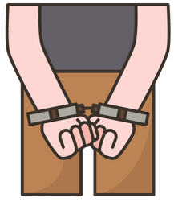
Controlled Drugs and Substances Act
The government makes rules about what drugs are illegal in a law on controlled substances.
The use of certain drugs is illegal, unless prescribed by a doctor or medical professional.
Also, the act of selling prescription drugs is illegal.
Notes:
Commonly used illegal drugs in Canada include:
MDMA (Molly, Ecstasy, E)
Marijuana (Pot, Weed, Blunts)
Acid (LSD)
Mushrooms (Psilocybin)
DMT
Methamphetamines
Cocaine
Poppers (Nitrites)
Speed (Crystal Meth)
GHB (Gamma Hydroxybutyrate)
Heroine
Special K (Ketamine)
Reference: Algonquin College. (n.d.). Umrbella Project: Drugs in Canada. https://www.algonquincollege.com/umbrellaproject/drugs-in-canada/
Reference: Drug Free Kids (DFK). (2022). 60% of those who use illegal drugs are 15 to 24 years old.
https://www.drugfreekidscanada.org/prevention/drug-spotlights/illegal-drugs/
Image from Canva

Slide 41
Final Activity: Staying Safe
You’re at a friend’s house with some classmates from school for the year-end graduation party. You look around and notice that there are kids you don’t recognize.
A few of them are sitting in a room sharing a small bag of pills. When you ask “what's in the bag?”, someone responds “ecstasy, do you want to try?”
What can you do or say when being offered drugs?
Notes:
Discuss different ways and tips for saying no:
Say “no”. Be assertive and clear.
Walk away
Broken record – You may be asked several times - keep repeating “no”.
Say “no” different ways. For example, “I’m not interested” or “I don’t want to”
Give an excuse or explanation if you want. For example, “I don’t want to smoke weed because I don’t want to become addicted.”
Offer an alternative activity. For example, “I don’t want to smoke weed; how about we go to the mall?”
Reverse the pressure. For example, “Why are you pressuring me?”
Consolidation: With a partner, in a group, or on your own, brainstorm and write down how you can become educated on the dangers of substance use disorders, addictions and related behaviours. Share with the class when finished.
Reference: Dowshen, S. (2018, May). Nemours Teen Health – MDMA (Ecstasy). https://kidshealth.org/en/teens/ecstasy.html#:~:text=Ecstasy%20(3%2C%204%2Dmethylenedioxy,of%20making%20someone%20feel%20high.
Image from Canva

Slide 42

More Questions? Talk with Someone:
Teacher/Principal
Doctor or Health Care Provider
Parents/Guardians
School Health Nurse
Community Addictions Services of Niagara (CASON)
Kids Help Phone
Notes:
Services for Youth - Niagara Region, Ontario → https://www.niagararegion.ca/health/schools/youth-services.aspx
Drug Free Kids Canada → https://www.drugfreekidscanada.org/prevention/get-help-resources/
Pathstone Crisis Services (1-800-263-4944)
Al-Anon/Alateen (if you are bothered by someone else’s drinking) 905-328-1677 or 1-888-425-2666
CASON → 905-684-1183 or www.cason.ca
Kids Help Phone → (1-800-668-6868) or https://kidshelpphone.ca/
Mental Health Helpline → (1-866-531-2600) or https://www.connexontario.ca/en-ca/
PHN to be coming to classrooms to follow up and offer a question and answer discussion.
If you ever have questions/concerns, need help or know someone who needs help, you can always talk to someone. There are many options out there available to you. A young person is less likely to use drugs if they have one of the following support personnel mentioned above…
Image from Canva

Slide 43

Final Thoughts
Prolonged use of substances may cause mental health problems, substance use disorders, and addiction.
It is illegal under the age of 19 to use, buy, or sell tobacco, cannabis, alcohol, or illegal substances.
Alcohol or cannabis poisoning, or a drug overdose can be fatal.
Notes:
*Begin with the following prompt*: Using drugs has serious health effects, both short- and long-term. Then follow with the bullet points.
If your in an uncomfortable situation, remember to use refusal skills or talk to someone you trust
Image from Canva

