Slide 1
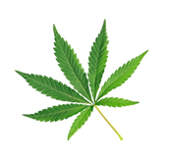
Substance Use, Addictions and Related Behaviour
Cannabis: Grades 7/8
Notes:
**The following slides (2-6) are for teacher use only**
Image from Canva

Slide 2
Presentation Format
Guiding Questions: Big idea questions that students can brainstorm and share previous knowledge or new information with.
Think, Pair, Share: Opportunity for students to work with partner or group and share ideas based on a prompt.
Notes:
Images from Canva

Slide 3
Presentation Format
Videos: Students will watch a short video clip that connects with topic. Discussion can follow before or after videos.
Final Activity: Activity that concludes the presentation.
Notes:
Images from Canva

Slide 4
Curriculum Expectations - Grade 7
D1.2 - Demonstrate an understanding of linkages between mental health problems and problematic substance use, as well as between brain development and cannabis use, and identify school and community resources that can provide support for mental health concerns relating to substance use, addictions, and related behaviours.
D3.2 - Analyse the personal and societal implications of issues related to substance use, addictions, and related behaviours.
Notes:
Image from Canva

Slide 5
Curriculum Expectations - Grade 8
D1.2 - Identify situations that could lead to injury or death, and describe behaviours that can help to reduce risk.
D1.3 - Identify and describe the warning signs of problematic substance use and related behaviours for a variety of activities and substances, including cannabis, and the consequences that can occur.
D2.2 - Demonstrate the ability to assess situations for potential dangers, and apply strategies for avoid dangerous situations.
Notes:
Image from Canva

Slide 6
Substance Use, Addictions and Related Behaviour
Cannabis: Grades 7/8
Notes:
**This is where the presentation officially begins**
Image from Canva

Slide 7
Guiding Question #1
Personal Implications:
How can using cannabis impact you personally?
Societal Implications:
How do you think cannabis could impact a society?
Notes:
Turn to your table partner and discuss the following prompts…
Personal:
Cannabis Selling – if underage you could get caught, fined and/or go to jail then have a juvenile record;
Cannabis Use – if underage you could get fined
Societal:
Cannabis →
If used within a prohibited public place (i.e., beach, school-property, etc), there could be a large fine
If other people are using it, it may encourage others to also use it
Driving high (impairment) –which leads to potential serious situations, could cause a dangerous accident
Age restrictions
No person may sell or provide cannabis to any person under the age of 18. There are 2 criminal offences related to providing cannabis to youth, with maximum penalties of 14 years in jail:
•giving or selling cannabis to youth
•using a youth to commit a cannabis-related offence
Cannabis Legalization and Regulation (justice.gc.ca)
Image from Canva

Slide 8
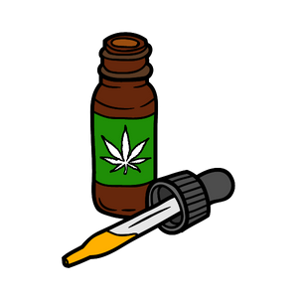
What is Cannabis? - Review
The most common form of cannabis is the dried flowers and leaves of the cannabis sativa plant.
Other forms: bud, joints, oils, edibles
Other common names: marijuana, pot, dope, weed, grass, hash, Mary Jane, reefer, bud.
Cannabis is a psychoactive substance.
Notes:
Ask the students: Are there any other names that you have heard of that are not on this list?
Cannabis is a psychoactive substance.
The effect of cannabis on your body depends on a number of things: how much you use, how often and how long you use it, how you consume it [smoke, vape, drink, eat, or other], your mood and existing mental health, your environment, your age, whether you’ve taken other drugs, and your medical condition and history.
Image from Canva

Slide 9
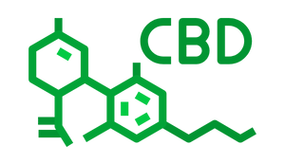
Cannabinoids
The chemicals found in a cannabis plant are called cannabinoids.
Two of the more commonly known chemicals in cannabis are THC and CBD.
Notes:
The two most commonly known cannabinoids found in cannabis are THC (Tetrahydrocannabinol) and CBD (Cannabidiol).
THC is responsible for changing your mood and state. It is responsible for giving the body a “high”. The level of THC can affect the body –the higher the level, the more harm it can cause to the body, both physically and mentally.
THC is a common short form for Tetrahydrocannabinol
CBD does not produce a high or intoxication and can be used as a treatment for people that suffer with chronic pain conditions (such as arthritis and cancer-related symptoms).
CBD is a common short form for Cannabidiol
Reference: Government of Canada. (2018, October 17.). About cannabis. https://www.canada.ca/en/health-canada/services/drugs-medication/cannabis/about.html
Image from Canva

Slide 10
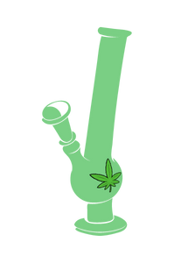
Smoking - Review
Cannabis is most commonly smoked in a:
Joint, pipe or bong
Spliff - Cannabis is mixed with tobacco and rolled in a paper that is similar to cigarette paper
Blunt - Cannabis is rolled in cigar paper
Notes:
Learned in Junior (Grades 4-6):
Joint - Cannabis rolled in a paper similar to cigarette paper
Water pipe or bong - Smoke is drawn through water before inhalation
Image from Canva

Slide 11
Food and Drinks
Cannabis can be made into edible products such as brownies, gummies, tea, butter.
It can take up to 4 hours to feel the “high” affect.
This can lead to overconsumption
Notes:
The amount of THC will vary in each edible product… it depends on the amount of cannabis extract added. Individuals will use more then recommended because they don’t necessarily feel the effects at first, which will cause them to eat more looking for the effects…
Image from Canva

Slide 12
Vaporizing
This is another common form of inhalation using a vaporizer or vaping device.
Dried Cannabis
Liquid Cannabis
The effects will vary depending on whether dried or liquid cannabis is used.
Notes:
Image from Canva

Slide 13
Dabbing
Encouraged Method of “Dabbing”
This refers to the practice of breathing in very hot vapour from heating cannabis concentrates.
Examples: hash, wax, tinctures and oils
These contain a high concentration of THC.
Notes:
NEW → Wasn't discussed in the junior cannabis PowerPoint
Encouraged method of “dabbing” → refer to the graphic… it’s a type of dance move
Image from Canva

Slide 14
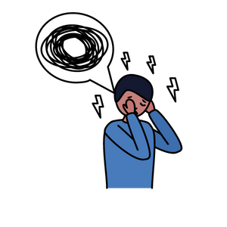
Potential Short Term Effects
Loss of coordination and delayed reaction time
Decreased concentration
Feelings of anxiety, fear, and panic
Increased hunger/appetite
Increased heart rate
Altered sense of time
Relaxed/ increased sociability
Feeling happy (euphoric)
Notes:
Refer to the Core Knowledge Content for the following information…
Teachers need to identify that there are both negative and positive short term effects of cannabis use. Usage and effects will vary from person to person.
Short-term effects of cannabis include:
· Feeling happy (euphoria)
· Relaxation
· Increased sociability
· Heightened sensation
· Problems with memory and learning
· Distorted perception (sights, sounds, time, touch)
· Slows down reaction time
· Trouble with thinking and problem solving
· Body tremors
· Loss of motor coordination
· Increased heart rate
· Anxiety
· Can trigger psychotic episodes
Image from Canva

Slide 15
Potential Long Term Effects
Cannabis smoke is harmful to the lungs and can cause breathing problems.
Cannabis use can lead to mental health problems and addiction.
1 in 6 people who start using cannabis as a teenager will develop an addiction (Health Canada, 2021)
Notes:
Potential health benefits from cannabis use have not been well studied and should be discussed with health care professionals. Refer to Government of Canada (2021, September 3). Talking with teenagers about drugs. https://www.canada.ca/en/health-canada/services/substance-use/talking-about-drugs/talking-with-teenagers-about-drugs.html for great tips for talking with teens and youth about drugs, like cannabis.
1 in 6 people who start using cannabis as a teenager will develop an addiction (reference) → [16] Volkow ND, Baler RD, Compton WM, Weiss SR. Adverse health effects of marijuana use. N Engl J Med 2014 Jun 5;370(23):2219-27.
References:
Health Canada (2021, March 11). Government of Canada: Cannabis and your health. https://www.canada.ca/en/services/health/campaigns/cannabis/health-effects.html#a7
Health Canada (2021, July 2). Government of Canada: Addiction to cannabis. https://www.canada.ca/en/health-canada/services/drugs-medication/cannabis/health-effects/addiction.html
Refer to the Core Knowledge Content for the following information…
Potential Long Term Effects:
Using cannabis regularly (daily or almost daily) and over a long time (several months or years) can:
•Hurt the lungs and make it harder to breathe
•Cannabis smoke contains many of the same harmful substances as tobacco smoke.
•Like smoking cigarettes, smoking cannabis can damage your lungs
•It can also make someone more likely to experience mental health problems (depression, anxiety, psychosis, and schizophrenia)
•Contrary to popular belief, marijuana is addictive. Research suggests that those who start using at a younger age are at increased risk for addiction.
Harm to the lungs and makes it harder to breathe:
Cannabis smoke contains many of the same harmful substances as tobacco smoke. Smoking cannabis deposits tar in the lungs, decreases oxygen available to the cells, causes coughing, and increases workload on the heart. It can result in chronic coughing, bronchitis and other respiratory issues. When smoked, cannabis contains 35 known carcinogens (substances capable of causing cancer in living tissue). Similar to tobacco, second hand smoke is a potential health harm. It is recommended that all individuals, especially high-risk groups avoid cannabis smoke exposure. High-risk groups include children and youth, pregnant women, older adults, individuals with asthma, individuals with chronic obstructive pulmonary disease, and individuals with heart conditions.
Mental health:
Using cannabis regularly and continuously over time makes you more likely to experience anxiety, depression, psychosis, and schizophrenia. This is especially true for those who start using at a young age, use frequently, and/or have a personal or family history of psychosis and/or schizophrenia.
Addiction:
Cannabis can be habit-forming (addictive). In general, 5-9% of cannabis users will develop dependence on cannabis. However, this number increases to 17% for individuals who started using cannabis during adolescence.
*The impact of using cannabis can be more serious in youth than adults*

Slide 16
Addiction
An addiction is an urge to do something that is hard to control or stop.
Notes:
Image from Canva

Slide 17
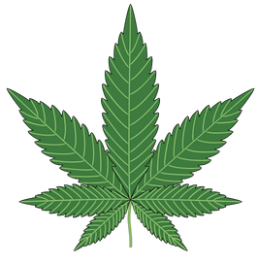
Think, Pair, Share
What do you think is the appeal of smoking cannabis?
Notes:
Turn to your seating buddy either across from you or beside you and talk about the following question.
What is the appeal of smoking weed? Why do youth try/use cannabis/marijuana? What do you think is the most popular form of using cannabis for your age group?
Images from Canva

Slide 18
Appeal to Youth
Reasons youth try or use cannabis are often because they think:
It is going to be fun
It is something new to try
It might help them fit in and be cool
It will help with stress and anxiety
Notes:
The most common reason given for using cannabis is for the enjoyment of it- the feeling of getting high is relaxing for some. Some youth are curious about the experience and want to try it for themselves- they think that it will help them fit in and be cool.
However, we know that youth tend to want to spend time with those that have similar interests. So, although some youth use cannabis because they feel pressured by their friends to do so, much of the time those who want to use cannabis choose to hang out with friends that are using cannabis already. Still, others use it in an attempt to cope with stress, tension, anxiety and other mental health issues. Maybe things at home are difficult and they feel there is no other way to deal with the situation. Some youth use it in an attempt to help them sleep better. On occasion, it might be prescribed as a pain reliever.
**Important**: One thing to discuss with this grade level is that cannabis can be medically prescribed by a doctor/health care professional for many diseases, disorders and ailments. For more information check out: Government of Canada. (2020, October 28). Medical use of cannabis. https://www.canada.ca/en/health-canada/topics/cannabis-for-medical-purposes.html
Photo Reference: Shutterstock_2016854864
School Teenagers Consuming Drugs Alcohol Tobacco Stock Photo (Edit Now) 2016854864 (shutterstock.com) → https://www.shutterstock.com/image-photo/school-teenagers-consuming-drugs-alcohol-tobacco-2016854864

Slide 19
Reasons Youth Avoid Using Cannabis
Reasons youth do not use cannabis include:
It can negatively affect their health
There is a fear of judgement
It’s against the law
They are not interested
They could get hurt while under the influence of cannabis
It will impact their performance with school, their job, or in sports
Notes:
Stress that less than one quarter (19%) of students in grades 7-12 report using marijuana in the last year. This means that about 80% of students do not use cannabis. (OSDUHS, 2017)
There are a variety of reasons youth choose not to use cannabis. Some fear the health consequences of using cannabis. They may not like the thought of being high or the thought of feeling ‘out of control’. Some youth are afraid of the fact that they might hurt themselves or someone else as a result of being high.
Others who do not use, or stop using after trying, do so because they lose interest or don’t enjoy the feeling of being high. Still others don’t use because of the legal consequences for using under age, or the risk of it interfering with their schooling, job, and extra-curricular activities like sports. Also, some don’t want to risk being labeled as a drug user.
Image from Canva

Slide 20
Guiding Question #2
People can be addicted to many things. Can you think of any addictions that you may have seen in the media or in society?
Notes:
Encourage children to think about the types of addictions that they’ve been exposed to (i.e., food, gambling, video games)
People can be addicted to many things. Can you think of any addictions that you may have seen in the media or in society?
Images from Canva

Slide 21
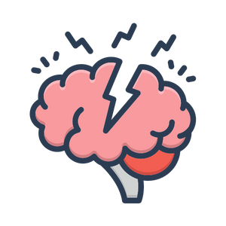
Mental Health and Substance Use
There is a direct link between mental health problems and problematic substance use.
Using cannabis often can result in dependence or addiction.
Notes:
Frequent and prolonged use of cannabis containing THC can contribute to mental health problems over time. Daily or near-daily use increases the risk of dependence and may bring on or worsen disorders related to anxiety and depression…
No matter how you use cannabis, there are short- and long-term risks… The only way to avoid the risks is to not use cannabis at all
https://www.canada.ca/en/services/health/campaigns/cannabis/health-effects.html#a7
Image from Canva

Slide 22
Signs of Problematic Cannabis Use
The following are signs to be aware of if you think a friend, family member or peer may be addicted to cannabis:
Failing to show up and fulfill responsibilities at:
Work
Home
School
Giving up important social, personal or recreational activities.
Notes:
Some students who use cannabis often might show some warning signs of problematic substance use, such as missing class, changes in mood, failing to show up to work, not fulfilling responsibilities at home, giving up on social or extracurricular activities, and more.
Reference: Health Canada (2021, July 2). Government of Canada: Addiction to cannabis. https://www.canada.ca/en/health-canada/services/drugs-medication/cannabis/health-effects/addiction.html

Slide 23
Mental Health Risks
Those who use cannabis often might experience:
Mild or temporary symptoms of anxiety
Paranoia and delusional beliefs
Higher risk of suicide, depression, and anxiety
Potential permanent brain damage
Cannabis-induced psychosis
People who use cannabis before the age of 16, have a higher chance of developing schizophrenia or psychosis (Ministry of Health, 2021)
Notes:
Ministry of Health (2021, September 23). Government of Ontario: Health effects of cannabis. https://www.ontario.ca/page/health-effects-cannabis

Slide 24
Why Does This Matter?
Cannabis can be harmful to mental and physical health.
The risks of cannabis-related harms are increased when used:
Frequently
At a young age
In large amounts
In combination with other drugs
Products with high amounts of THC can also increase risks.
Notes:
Image from Canva

Slide 25
Video:Talking About Weed…And Your Brain
While watching the video, listen and try to answer the following question:
Why is using cannabis at a young age harmful?
What does it do to our brains?
Notes:
To access video you must be in present mode to play OR open the hyperlink in a separate Internet browser.
Video link: https://youtu.be/AxYyxYJM434
Also hyperlinked in the title.
After the video is finished, ask: what did you find interesting when watching this video?
Cannabis can be harmful to your mental and physical health, including the development of the brain… Youth are particularly vulnerable because their brains are still growing.
Cannabis can be harmful to the development of your brain because the brain continues to develop until around the age of 25.
Brain development: Adolescents may be at higher risk for negative effects associated with cannabis use because their brains are still developing; a process that continues until the mid-20s. Young users are also at increased risk for poor academic performance, injuries and/or other substance use problems. Because youth are at higher risk for negative health effects, Canada’s lower-risk cannabis use guidelines (2017) recommend abstaining from cannabis use. For those who choose to use cannabis despite known health risks, it is important to know that the negative effects can be reduced by delaying initiation of cannabis use.
Using cannabis when you’re younger can increase the risk of problems with your health, education and social life. The impact can be more serious in youth than adults because the teenage brain is still in construction until mid 20s. The brain isn’t fully developed until around the age of 25.
Some of the damages caused by cannabis are irreversible.
Image from Canva

Slide 26
Guiding Question #3
What types of situations, after using cannabis, do you think are dangerous and would lead to injury or death?
Notes:
Turn to your seating buddy either across from you or beside you and talk about the following question.
This question is to get them thinking about dangerous situations when weed/marijuana/cannabis is involved, and that they need to identify and assess what to do in these potential situations…
Image from Canva

Slide 27
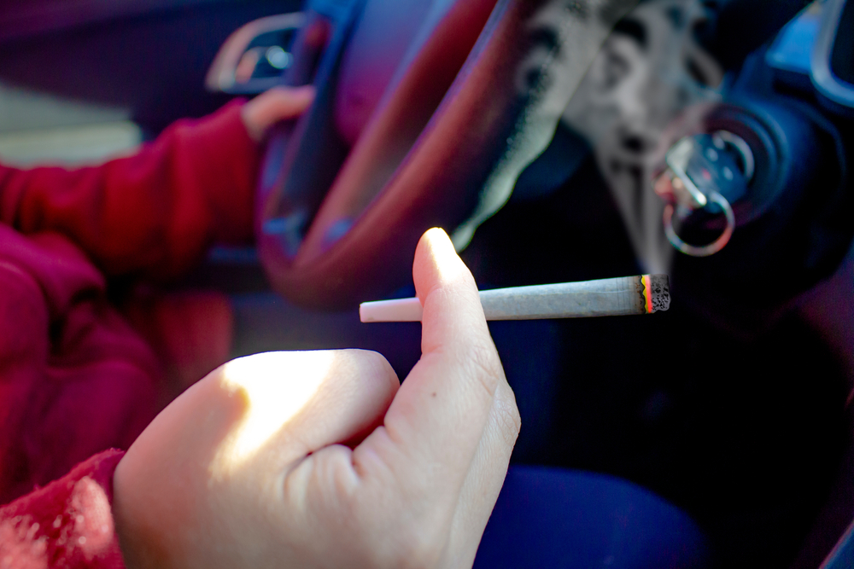
Assessing Potential Situations
Using cannabis can increase the risk of accidents that lead to injury or death during some activities.
Examples:
Driving
Skiing
Biking
Swimming
Notes:
How Cannabis affects your ability to drive
When you drive a vehicle, you need to be alert and focused. Consuming even small amounts of cannabis affects your ability to react and increases your chance of being in a crash. Drugs impair your ability to drive by:
affecting motor skills/abilities;
slowing reaction time;
impairing short term memory and concentration;
causing drivers to vary speed and to wander; and
reducing the ability to make decisions quickly or handle unexpected events.
Cannabis is not the only drug that affects your ability to drive. Other drugs, including cocaine or even prescribed drugs, such as opioids also pose a significant risk to your safety and the safety of your passengers, other drivers, cyclists, and pedestrians. Over-the-counter medications may also impair your ability to drive.
https://madd.ca/pages/impaired-driving/overview/cannabis-and-driving/
https://www.canada.ca/en/health-canada/services/drugs-medication/cannabis/health-effects/impairment-safety-risk.html
Photo Reference: Shutterstock_1842307048
Person Cannabis Joint Smoking Driving Concept Stock Photo (Edit Now) 1842307048 (shutterstock.com) → https://www.shutterstock.com/image-photo/person-cannabis-joint-smoking-driving-concept-1842307048

Slide 28
Knowing the Signs of Cannabis Impairment
Physical effects when someone uses cannabis:
Red eyes
Dry mouth and throat
Drowsiness or restlessness
Increase in appetite and heart rate
Decrease in blood pressure, balance and stability
Notes:
Behavioural Signs:
Delayed reaction time
Paranoia
Unfocused stares
Poor coordination
Impaired judgement
Other signs to look for:
Irritated respiratory system (from smoking)
Drowsiness or restlessness will depend on the amount consumed and the individual(s) response
Cannabis | CAMH → https://www.camh.ca/en/health-info/mental-illness-and-addiction-index/cannabis
Get help with substance use: https://www.canada.ca/en/health-canada/services/substance-use/get-help-problematic-substance-use.html
Image from Canva

Slide 29
Don’t drive high.
Notes:
Photo Reference: Government of Canada. (2021, November 18). Don’t Drive Higher. https://www.canada.ca/en/campaign/don-t-drive-high.html

Slide 30
Legislation
The legal age to buy, use, possess and grow cannabis in Ontario is 19.
Same for the sale of tobacco and alcohol.
In Ontario, cannabis, tobacco and electronic cigarettes are controlled under the Smoke Free Ontario Act.
Notes:
(NO possession law exists for tobacco and e-cigarettes → only to be shared with staff and parents**)
In Ontario, e-cigarettes, tobacco and cannabis are all controlled under the Smoke Free Ontario Act.
Officers from Niagara Region Public Health conduct regular inspections of retailers to ensure compliance with the SFOA. Officers conduct “test shopping” to test a retailers willingness to sell an electronic cigarette device to a person who is less than 19 years old.
See Health Canada for more information
https://www.canada.ca/en/health-canada/services/smoking-tobacco/vaping.html
***Ask the principal for any school-specific disciplinary measures in terms of suspensions or expulsions***
Image from Canva

Slide 31
Smoke Free Ontario Act
Cannabis is not allowed in schools, on school property, at school-related activities, or within 20m of the school perimeter.
Fine = $305 for first offence.
It is illegal to supply cannabis products to those under 19 years.
Fine = $490 for first offence.
Notes:
Under this legislation, smoking, including vaping and cannabis products is prohibited on school property and an additional 20m from the school perimeter. Those who break this law can be charged with a $305 fine for the first offence (this can increase for multiple offences).
In terms of sale and supply, Niagara Region Public Health is responsible for the day-to-day enforcement of the SFOA. This includes obtaining compliance through education and awareness to ensure that business owners are aware of the laws that apply to them.
Officers from Niagara Region Public Health conduct regular inspections of retailers to ensure compliance with the SFOA. Officers conduct “test shopping” to test a retailers willingness to sell to a person who is less than 19 years old.
A person who sells or supplies to a person under 19, may be subjected to a fine of $490.00. (Includes retailers, adults or youth supplying to those under 19 years)
See Health Canada for more information
https://www.canada.ca/en/health-canada/services/smoking-tobacco/vaping.html
***Ask the principal for any school-specific disciplinary measures in terms of suspensions or expulsions***

Slide 32
Public Rules and Regulations
Cannabis is prohibited in most public spaces, including…
Beaches
Recreation trails
Parks, playgrounds and sports fields
Splash pads and outdoor pools
Notes:
The newly updated Niagara smoke and vape-free outdoor spaces bylaw now prohibits tobacco, cannabis and vaping products from being smoked or vaped in several public spaces including:
Beaches (new)
Recreation trails (new)
Within nine metres of an entrance or exit of a publicly accessible place, building or workplace (new)
Parks, playgrounds and sports fields
Splash pads and outdoor pools
Arenas and recreation centres
Outdoor areas of municipal and regional buildings
Bus shelters
Image from Canva

Slide 33
Final Activity: Refusal Skills Scenario
You are at the park with a bunch of friends from school. You notice that they are all smoking marijuana.
One of your peers offers you a joint.
What could you do or say in this situation to refuse?
Notes:
Discuss different ways and tips for saying no:
Say “no”. Be assertive and clear.
Walk away
Broken record – You may be asked several times - keep repeating “no”.
Say “no” different ways. For example, “I’m not interested” or “I don’t want to”
Give an excuse or explanation if you want. For example, “I don’t want to smoke weed because I don’t want to become addicted.”
Offer an alternative activity. For example, “I don’t want to smoke weed; how about we go to the mall?”
Reverse the pressure. For example, “Why are you pressuring me?”
Images from Canva

Slide 34
More Questions? Talk With Someone:
Teacher/Principal
Doctor or Health Care Provider
Parents/Guardians
School Health Nurse
Community Addictions Services of Niagara (CASON)
Kids Help Phone
Notes:
CASON → 905-684-1183 or www.cason.ca
Services for Youth - Niagara Region, Ontario → https://www.niagararegion.ca/health/schools/youth-services.aspx
PHN to be coming to classrooms to follow up and offer a question and answer discussion.
If you ever have questions/concerns, need help or know someone who needs help, you can always talk to someone. There are many options out there available to you. A young person is less likely to use cannabis if they have one of the following support personnel mentioned above…
Image from Canva

Slide 35
Final Thoughts
Cannabis has serious health effects, especially on development of the brain and ones’ mental health.
The only way to avoid the negative short- and long-term risks is to not use cannabis at all.
It is against the law to buy, use, and sell cannabis in Ontario under the age of 19.
Notes:
If you’re in an uncomfortable situation, remember to use refusal skills or talk to someone you trust
NRPH Image

