Slide 1
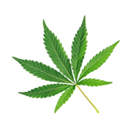
Substance Use, Addictions and Related Behaviour
Cannabis: Grades 4-6
Notes:
**The following slides (2-6) are for teacher use only**
Image from Canva

Slide 2
Presentation Format
Guiding Questions: Big idea questions that students can brainstorm and share previous knowledge or new information with.
Think, Pair, Share: Opportunity for students to work with partner or group and share ideas based on a prompt.
Notes:
Images from Canva

Slide 3
Presentation Format
Videos: Students will watch a short video clip that connects with topic. Discussion can follow before or after videos.
Final Activity: Activity that concludes the presentation.
Notes:
Images from Canva

Slide 4
Curriculum Expectations - Grade 5
D2.3 - Demonstrate the ability to apply decision-making, assertiveness, and refusal skills to deal with pressures pertaining to alcohol use or other behaviours that could later lead to addiction.
D3.3 - Identify personal and social factors that can affect a person’s decision to drink alcohol or use cannabis at different points in their life.
Notes:
Image from Canva

Slide 5
Curriculum Expectations - Grade 6
D1.4 - Identify people, resources, and services in the school and the community that can provide support when a person is dealing with mental health issues and choices or situations involving substance use and addictive behaviours, and describe how to access these support.
D2.4 - Use decision-making strategies and skills and an understanding of factors influencing drug use to make safe personal choices about the use of drugs such as alcohol, tobacco and cannabis, and about activities such as vaping, including the choice to abstain.
Notes:
Image from Canva

Slide 6
Substance Use, Addictions and Related Behaviour
Cannabis: Grades 4-6
Notes:
**This is where the presentation officially begins**
Image from Canva

Slide 7
Guiding Question #1
What do you know about Cannabis?
Notes:
Image from Canva

Slide 8
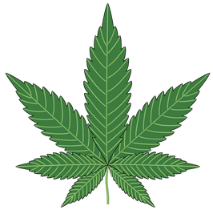
What is Cannabis?
Cannabis is a product that comes from a Cannabis plant.
Cannabis comes in many forms, including dried flowers and leaves; extracts, such as oil and edibles.
Other names: marijuana, pot, weed.
Contains chemicals called cannabinoids:
THC or CBD
Notes:
Ask the students: Are there any other names that you have heard of that are not on this list?
Cannabis plant = Sativa Plant
Briefly explain that there is a chemical that is extracted from the plant called cannabinoids. The two most commonly known cannabinoids found in cannabis are THC (Tetrahydrocannabinol) and CBD (Cannabidiol).
THC is responsible for changing your mood and state. It is responsible for giving the body a “high”. The level of THC can affect the body –the higher the level, the more harm it can cause to the body, both physically and mentally.
CBD does not produce a high or intoxication and can be used as a treatment for people that suffer with chronic pain conditions (such as arthritis and cancer-related symptoms).
Cannabis is a psychoactive substance. The effect of cannabis on your body depends on a number of things: how much you use, how often and how long you use it, how you consume it [smoke, vape, drink, eat, or other], your mood and existing mental health, your environment, your age, whether you’ve taken other drugs, and your medical condition and history.
Image from Canva

Slide 9
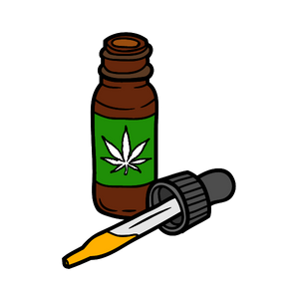
How is Cannabis Used?
Inhaled as smoke
Joints and Pipes
Consumed by adding it to food or beverages
Herbal teas
Butter
Brownies
Tea
Added in creams or oils
Notes:
Cannabis is most commonly smoked as a cigarette or joint. However, vaporizing and vaping is another way people use cannabis which involves breathing in dried/liquid cannabis vapours through a vaporizer or vaping device.
Image from Canva

Slide 10
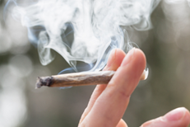
Smoking
Cannabis is most commonly smoked as a
Joint – Cannabis rolled in a paper similar to cigarette paper
Water pipe or bong – Smoke is drawn through water before inhalation
Notes:
Photo Reference: Shutterstock_592173896
https://www.shutterstock.com/image-photo/cigarette-handmade-cannabis-592173896

Slide 11
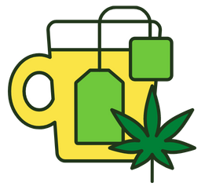
Food and Drinks
Cannabis can be made into edible products such as tea and butter, as well as foods.
It can take up to 4 hours to feel the “high” effect.
The amount of THC varies in each edible product.
Notes:
Sometimes when people use edibles the effects can take up to 4 hours to feel the “high”, this may cause the person to think that the drug isn’t working and leads to an overcomption of the edible. Also, the amount of THC varies in each edible as well as the effects may depend on the amount of cannabis extract added.
Image from Canva

Slide 12
Guiding Question #2
How can cannabis affect your health?
Do you think cannabis has positive or negative effects?
Notes:
Cannabis can have positive and negative effects.
Turn to your seating buddy either across from you or beside you and talk about the following question.
Possible Response:
Cannabis can change the way you see and feel things – distances can seem shorter or longer than they really are, and things that are serious can seem funny. Larger amounts can lead to feelings of losing control, panic, or confusion. Physical effects include red eyes, dry mouth, a higher heart rate, and a feeling of hunger. Using cannabis often and over the long term can lead to being physically dependent on it, and it can also have adverse effects on brain development and mental health. After people stop using cannabis, they can experience withdrawal symptoms, which can include feeling irritable, anxious, or nauseated, not having an appetite, or not being able to sleep well.
However, cannabis can have positive effects to for some individuals, especially those who are prescribed it by a medical health professiona;/doctor.
**Important**: One thing to discuss with this grade level is that cannabis can be medically prescribed by a doctor/health care professional for many diseases, disorders and ailments. One way cannabis is used when prescribed is with creams/oils. For more information check out: Government of Canada. (2020, October 28). Medical use of cannabis. https://www.canada.ca/en/health-canada/topics/cannabis-for-medical-purposes.html
Image from Canva

Slide 13
Potential Short Term Effects
Loss of coordination
Delayed reaction time
Decreased concentration
Increased heart rate
Relaxed/ increased sociability
Feeling happy (euphoric)
Feelings of anxiety, fear, and panic
Notes:
Note that many of these effects can impact you while playing sports or doing other activities.
Side Note: Because of all of these effects, it is dangerous to drive or ride a bike after using cannabis.
Short-term effects of cannabis include:
Feeling happy (euphoria)
Relaxation
Increased sociability
Heightened sensation
Problems with memory and learning
Distorted perception (sights, sounds, time, touch)
Slows down reaction time
Trouble with thinking and problem solving
Body tremors
Loss of motor coordination
Increased heart rate
Anxiety
Can trigger psychotic episodes
Increased hunger/appetite
Altered sense of time
Remind students that these are potential effects and that those who try cannabis, the reactions and the way the body processes it will be different for every individual.
Photo Reference: Shutterstock_1902686608
Education Learning Concept Portrait Tired Bored Stock Photo (Edit Now) 1902686608 (shutterstock.com) → https://www.shutterstock.com/image-photo/education-learning-concept-portrait-tired-bored-1902686608

Slide 14
Potential Long Term Effects
Smoking cannabis is harmful to the lungs
It can cause problems with breathing
Smoke from cannabis contains harmful substances
It affects mental health and wellbeing
(depression, anxiety, psychosis, others)
There is a possibility of becoming addicted…
The effects from using cannabis can be more serious in youth than in adults.
Notes:
Cannabis smoke contains carcinogens (cancer causing chemicals)→ Risk of developing Cancer
Using cannabis regularly (daily or almost daily) and over a long time (several months or years) can:
Hurt the lungs and make it harder to breathe
Cannabis smoke contains many of the same harmful substances as tobacco smoke.
Like smoking cigarettes, smoking cannabis can damage your lungs
**The impact of using cannabis can be more serious in youths than adults**
1 in 10 adults who use cannabis will develop an addiction to it (Health Canada, 2021).
Reference: Health Canada (2021, March 11). Government of Canada: Cannabis and your health. https://www.canada.ca/en/services/health/campaigns/cannabis/health-effects.html#a7

Slide 15
Potential Health Effects
No matter how you use cannabis, there are always potential short- and long-term health risks.
Cannabis can cause negative effects to mental and physical health, including the development of your brain.
Notes:
Refer to Government of Canada (2021, September 3). Talking with teenagers about drugs. https://www.canada.ca/en/health-canada/services/substance-use/talking-about-drugs/talking-with-teenagers-about-drugs.html for great tips for talking with teens and youth about drugs, like cannabis.
Starting to use Cannabis at an early age, frequently and in large amount can be harmful… Brains are still developing until the age of 25, so adolescence and youth are particularly vulnerable.
However, the overall potential health benefits from cannabis use have not been well studied and should be discussed with health care professionals.
Image from Canva

Slide 16
Why Does This Matter?
Cannabis use can have impacts on your ability to learn.
It can cause problems with concentration and attention, remembering things, and making decisions.
It can affect your academic performance and grades.
Notes:
Cannabis can have school-related challenges....
Image from Canva

Slide 17
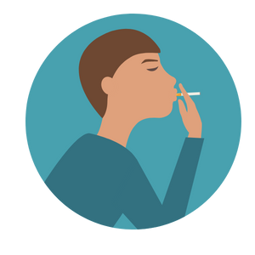
Think, Pair, Share
Why do you think someone would want to try or use cannabis?
Notes:
Talk with a friend or your table group about the following prompt!
Teacher Prompt: What are some examples of things that might influence someone to smoke (specifically cannabis) or not to smoke?
Follow up discussion: If you had a friend who was thinking about using drugs because they see the older kids using them, what could you tell them to do instead?
Images from Canva

Slide 18
Peer Influences
It can sometimes be difficult to say no to friends or peers without offending them or feeling singled out…
Notes:
Image from Canva

Slide 19
Personal Factors
Enjoyment and pleasure
Experimenting
Fitting in with Peers
Stress and Coping
Notes:
**Refer to the Cannabis Core Knowledge Content**
Individual motives for cannabis use:
Enjoyment and pleasure: The most common reasons given by youth for cannabis use include general enjoyment, being social, getting ‘high’, and to relax.
Experimentation: First time cannabis use among youth is often the result of experimentation and curiosity. Young people who indicate that experimentation is the primary motivator may discontinue use after trying cannabis, tend to use less frequently, and are less prone to developing substance use disorders compared to individuals who use cannabis for coping and recreational purposes.
Conformity (Fitting in with Peers): Youth are motivated to use cannabis for the purpose of ‘fitting in’ with peers. Research indicates that youth are drawn to network with peers that have the same desires and interests. Therefore, youth who are interested in cannabis use are more likely to connect with those that are interested in or are already using cannabis.
Coping: Youth state that they use cannabis for the purpose of stress and tension reduction. Youth who use cannabis primarily as a coping technique tend to have worse mental health, and experience more distress and stressful life events than their peers who use cannabis for recreational or social reasons.
Image from Canva

Slide 20
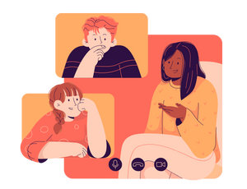
Societal Factors
Family and parental network
Peer pressure
Social Norms
Media
Notes:
**Refer to the Cannabis Core Knowledge Content**
Critical Thinking Question: How realistic are the messages we see in the media about using cannabis?
Social factors influencing cannabis use:
Family and parental network: Factors such as family structure (i.e., divorce, separation, single parent), and family quality and management practices (i.e., supervision, communication, parenting style, parental substance use) are major contributing factors to cannabis use among youth. In Canada, adolescents with a disrupted family status are approximately 65% more likely to use cannabis than youth from intact families.
Youth from dysfunctional families often have more stress in their lives and are more prone to adopting poor coping strategies when faced with stress, especially if there is a lack of family support. Furthermore, if adults in their lives are using cannabis to deal with stress, youth can be influenced to expect stress-relieving properties from cannabis.
Peer network: Peer pressure and peer preference need to be considered when discussing how peer networks influence cannabis use. Peer pressure assumes that youth are being pressured into engaging in cannabis use. Peer preference suggests that individuals with an interest in using cannabis seek friends who support this choice. Therefore, peer networks may create a more conducive space for youth to do what they already want to do.
Social norms: There are 5 indicators that signal the normalization of recreational and occasional cannabis use:
1. Increasing access and availability
2. Increasing prevalence of use
3. Increasing tolerant attitudes towards people who use cannabis
4. Cultural accommodation
5. Policies of legalization and regulation of cannabis markets
Since social acceptance of cannabis use is increasing more generally in North America, norms around appropriate cannabis use need to be promoted. Appropriate cannabis use norms should cover the topics of cannabis use and driving, mindfulness of appropriate times and places for use, respecting the rights of others (specifically non-users) and always storing cannabis responsibly.
Critical Thinking Question (Possible Response):
On shows and in movies, you see people having fun, being sociable, doing cool things while drinking or using cannabis, or drinking and smoking because they feel stressed. You do not often see images in the media of someone who has passed out or who has caused a car crash or who is in an abusive relationship because of alcohol or cannabis. I can think of other ways to manage stress – such as talking to a friend or throwing a ball for my dog.
Image from Canva

Slide 21
How Can Adults Help?
Adults can help youth make safe decisions when thinking about trying cannabis or using cannabis products.
Notes:
Adults have the ability to influence youths decisions about cannabis use...
One suggestion for families would be to establish clear family rules regarding cannabis/marijuana. A parents’ opinion matters. If a parent feels that cannabis use is wrong, their child is far less likely to use it.
Image from Canva

Slide 22
Video: How Marijuana Affects Your Developing Brain
Take notes as you follow along the video. We will then share and discuss as a class.
What did you find interesting when watching this video?
Notes:
To access video you must be in present mode to play OR open the hyperlink in a separate Internet browser.
Video link: http://www.youtube.com/watch?v=1Luw2tiMuLk
Also hyperlinked in the title.
In the video, it discusses the Endocannabinoid system, as well as THC and how the endocannabinoid systems work with using cannabis… remind students that they aren’t require to know all of the information presented.
Teacher Tip:
Watch the video on your own first, write down the major important points you got from the video, then use them to prompt students after the class watches altogether
Image from Canva

Slide 23
Legislation
The legal age to buy, use, possess and grow cannabis in Ontario is 19.
This is the same for the sale of tobacco and alcohol.
In Ontario, cannabis, tobacco and electronic cigarettes are controlled under the Smoke Free Ontario Act.
Notes:
The newly updated Niagara smoke and vape-free outdoor spaces bylaw now prohibits tobacco, cannabis and vaping products from being smoked or vaped in several public spaces including:
- Beaches (new)
- Recreation trails (new)
- Within nine metres of an entrance or exit of a publicly accessible place, building or workplace (new)
- Parks, playgrounds and sports fields
- Splash pads and outdoor pools
- Arenas and recreation centres
- Outdoor areas of municipal and regional buildings
Bus shelters
Image from Canva

Slide 24
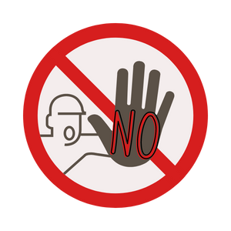
Final Activity: Refusal Skills Scenario
A friend approaches you and offers you marijuana.
How do you respond to your friend?
What could you do or say to get out of this situation? How do you refuse?
Notes:
Exit Task
Discuss different ways and tips for saying no (refusal skills):
Say “no”. Be assertive and clear.
Walk away
Broken record – You may be asked several times - keep repeating “no”.
Say “no” different ways. For example, “I’m not interested” or “I don’t want to”
Give an excuse or explanation if you want. For example, “I don’t want to smoke weed because I don’t want to become addicted.”
Offer an alternative activity. For example, “I don’t want to smoke weed; how about we go to the mall?”
Reverse the pressure. For example, “Why are you pressuring me?”
Some peers may try to influence you to do drugs, or to start smoking or vaping, by saying it’s cool to do them, or sometimes you may just want to be part of a crowd that’s into those things. To avoid this kind of influence, you have to be a strong individual, think about what you really want and what you value, and make up your own mind about things. Even if someone tells you ‘everyone is doing it’, your decisions are your own, and so are the consequences. But peers can be a positive influence too. Hanging out with friends who don’t use drugs and don’t smoke or vape can keep you from starting
Images from Canva

Slide 25
More Questions? Talk With Someone:
Teacher/Principal
Doctor or Health Care Provider
Parents/Guardians
School Health Nurse
Community Addictions Services of Niagara (CASON)
Kids Help Phone
Notes:
CASON → 905-684-1183 or www.cason.ca
Services for Youth - Niagara Region, Ontario → https://www.niagararegion.ca/health/schools/youth-services.aspx
PHN to be coming to classrooms to follow up and offer a question and answer discussion.
If you ever have questions/concerns, need help or know someone who needs help, you can always talk to someone. There are many options out there available to you. A young person is less likely to use cannabis if they have one of the following support personnel mentioned above…
Image from Canva

Slide 26
Final Thoughts
Using cannabis has short- and long-term health effects.
It is illegal under the age of 19 to use, buy, or sell marijuana poducts.
Notes:
If your in an uncomfortable situation, remember to use refusal skills or talk to someone you trust
NRPH Image

