Slide 1
Active School Travel Grades 4 to 6

Slide 2
Game Set-up
The class should be divided in to 4 to 5 equal teams.
The teacher will keep score or chose 1 student to keep track of points for each team.
There are 4 categories with 5 questions under each category. Point values range from 10 points to 50 points.
The teacher can pick the first category and value to start the game.

Slide 3
From this point the team who correctly identifies the answer will choose the next category and value until the board is complete or time has ended.
The teacher will then click on that point value on the grid and read the clue from the trivia game.
The teacher will determine which student put their hand up first when the question is asked, as well as the second student who raised their hand in case the question is answered incorrectly.

Slide 4
If the student answers the question correctly, their team will get the points. They will then choose the next category and point value.
If the student answers the question incorrectly, no points are taken off but the next eligible student (from another team) who put up their hand up second will be allowed to answer the question.
If they answer the question correctly, their team will be awarded the points. If they are unsuccessful the teacher will provide answer with explanation.

Slide 5
Active School Travel - Trivia
LET’S GET PHYSICAL!
MENTAL WELLNESS
SAVING OUR PLANET
SAFETY FIRST
10
10
10
10
20
20
20
20
30
30
30
30
40
40
40
40
50
50
50
50
Summary Video
Notes:
IMPORTANT: In order for the game to work properly, you must click on the colour when the “hand” shows, not the arrow (around the perimeter of the coloured square)

Slide 6
Physical Activity: 10
True or False: Walking to school increases your alertness and attention during your school day
Answer: True
Physical activity plays an important part in developing parts of the brain that help us learn.
Back

Slide 7
Physical Activity: 20
What are two ways you can actively travel to school?
Answer:
Bike
Rollerblade
Walk
Run
Scooter
Skateboard
Back

Slide 8
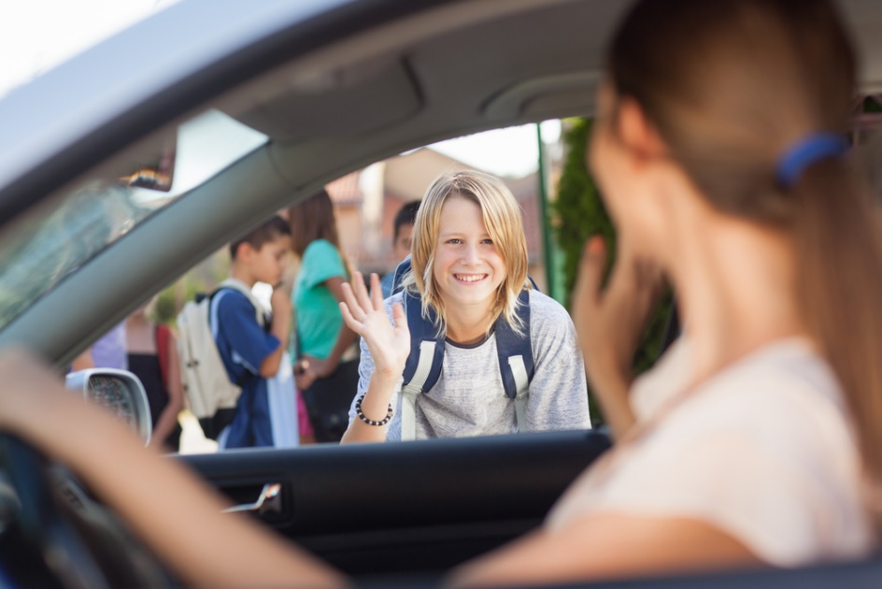
Physical Activity: 30
True or False: Getting dropped off at school is much faster than biking
Answer: False
Distances of up to 5 km are travelled more quickly, door to door, by bicycle than by car
Back

Slide 9
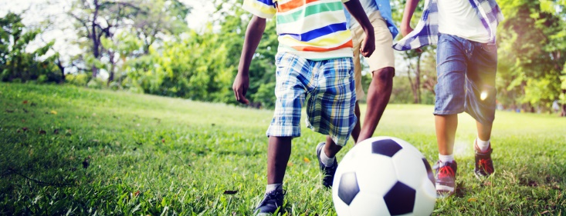
Physical Activity: 40
How many minutes of physical activity is recommended daily?
Answer: 60 minutes
Doing daily physical activity can help be part of a healthy, productive life.
There are many ways to put DPA into your day. What are some examples?
Back

Slide 10
Physical Activity: 50
What percentage of Canadian young people ages 5-17 are getting the recommended amount of physical activity?
a.) 10%
b.) 35%
c.) 70%
d.) 95%
Answer: b.) 35%
Physical activity means moderate-to-vigorous-physical-activity. These are activities that cause you to sweat and breathe harder or be out of breath.
Back

Slide 11
Mental Wellness: 10
True or False: Being physically active can help you sleep better at night
Answer: True
Physical activity increases your body temperature, this can keep your mind calm and lead to a more restful sleep
Back

Slide 12
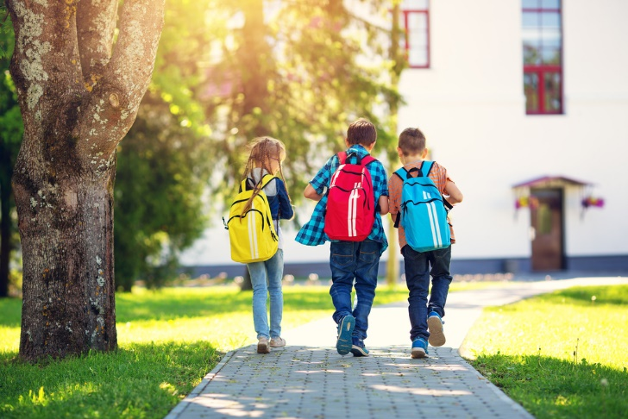
Mental Wellness: 20
Fresh air and physical activity makes people…
a.) Sad
b.) Tired
c.) Happy or energized
d.) Grumpy
Answer: c.) Happy or energized
Physical activity helps our brain and spinal cord release more “feel good” chemicals
Back

Slide 13
Mental Wellness: 30
True or False: Physical activity such as skateboarding and rollerblading to school can lower stress
Answer: True
Increasing your heart rate can lower stress by triggering your body to make stress fighting chemicals. This can help improve your mood.
Back

Slide 14
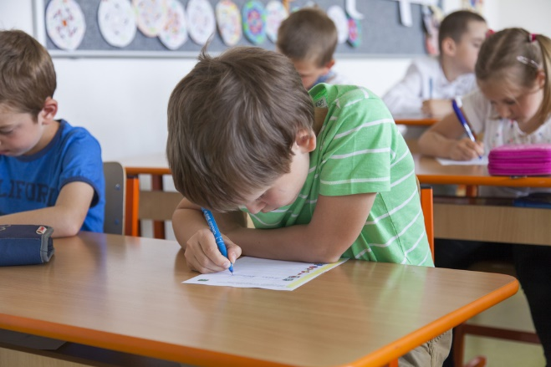
Mental Wellness: 40
Students that are physically active often…
Fail tests
Get higher test marks
Can’t remember things
All of the above
Answer: b) Get higher test marks
Physical activity boosts our brain power in many ways like creating new brain cells, strengthening memory, improving creativity and mental energy
Back

Slide 15
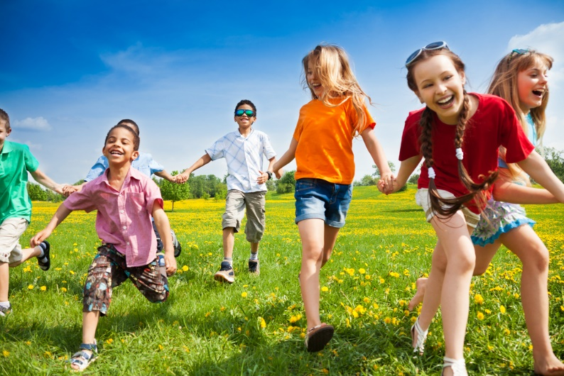
Mental Wellness: 50
Describe how being active with your friends makes you feel.
Answer:
Happy
Confident
Feel good about myself (self-esteem)
One of the many benefits of physical activity is that it boosts your mind, body and spirit
Back

Slide 16
Environmental: 10
True or False: Getting dropped off at school increases air pollution
Answer: True
The average drive to school and back produces 800 grams of carbon dioxide (CO2) into the air – enough to inflate over 60 balloons!
Back

Slide 17
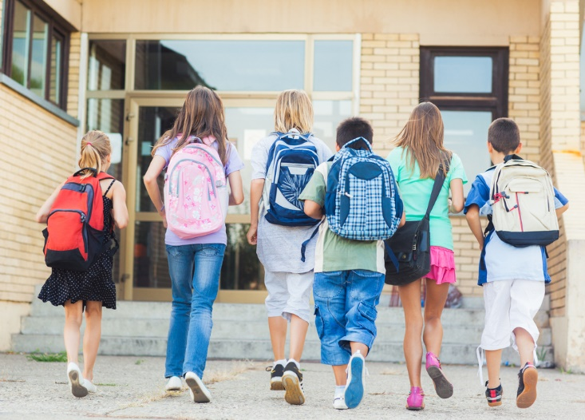
Environmental: 20
What are some environmental benefits of Active School Travel?
a.) Cleaner air
b.) Less traffic noise
c.) Fewer road accidents
d.) All of the above
Answer: d.) All of the above
Studies show that many car trips are quite short, less than 2kms, which makes walking a better choice to reducing pollution
Back

Slide 18
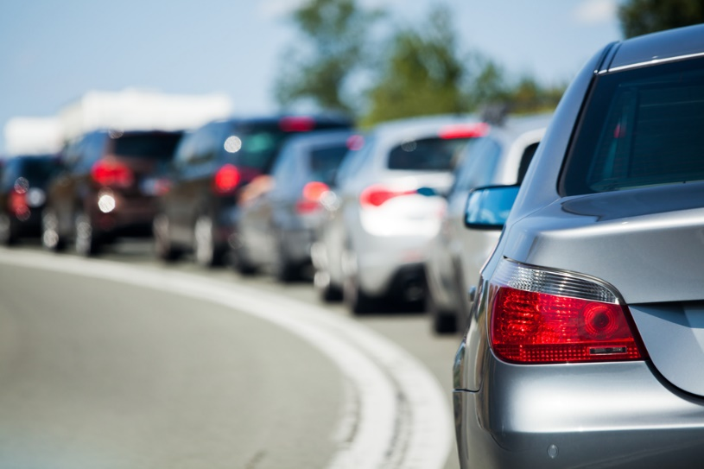
Environmental: 30
True or False: Traffic noise is the most common and widespread type of noise pollution
Answer: True
Walking instead of driving helps reduce the traffic and the noise levels as well as having positive effects on our health
Back

Slide 19
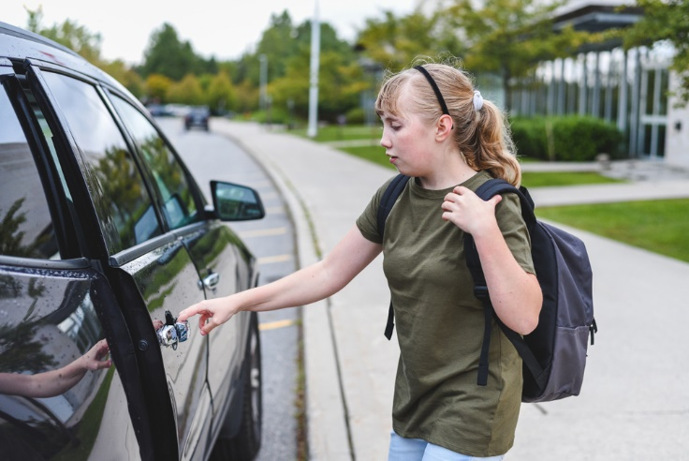
Environmental: 40
True or False: Driving more and walking less is one way we can all help lower our effect on global warming
Answer: False
The average family’s transport makes about 6 tons of greenhouse gas each year mostly caused by using their car.
This is almost the weight of an African elephant!
Back

Slide 20
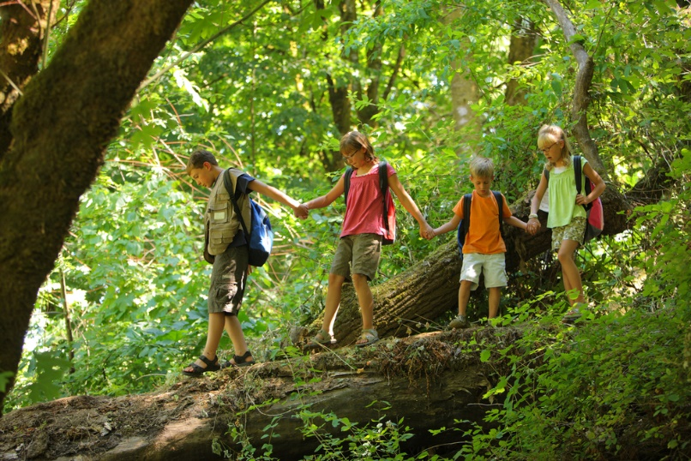
Environmental: 50
Describe how walking to school can help you learn more about the nature
Answer:
Learn about trees, flowers in the area
Observe animals and insects in their natural habitat
You can also learn more about what is in your neighbourhood i.e. parks, playgrounds and trails
Back

Slide 21
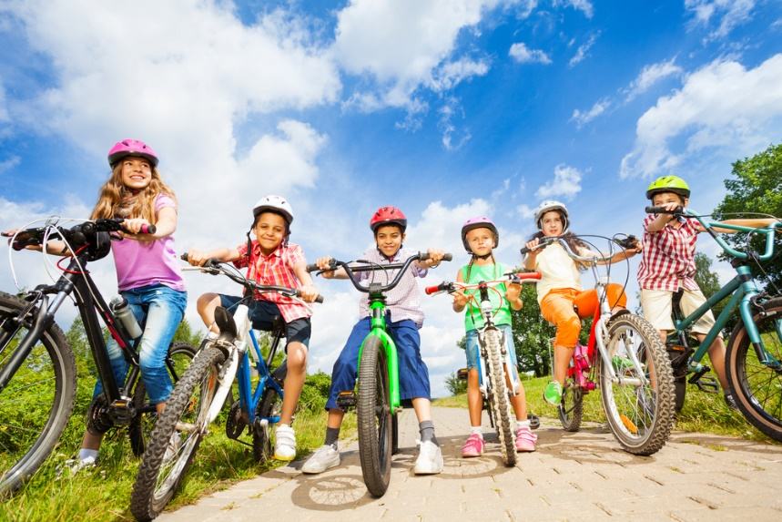
Pedestrian & Road Safety: 10
What is the number one safety rule when riding your bike?
Answer: Always wear your helmet
Bike helmets can prevent almost all head injuries when used properly
Back

Slide 22
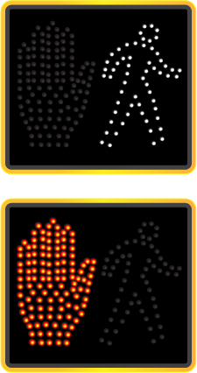
Pedestrian & Road Safety: 20
You get to the crosswalk and the light has just changed from the walk signal to the flashing hand signal. What do you do?
a.) Walk across…you still have time
b.) Stay, wait until the next walk signal
c.) Run across before the signal stops flashing
d.) Hit the crosswalk button again to make the flashing signal stop
Answer: b.) Stay, wait until the next walk signal
It is better to wait until you have lots of time to cross the street safely
Back

Slide 23
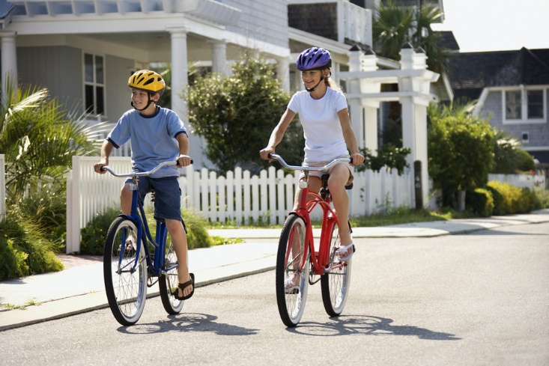
Pedestrian & Road Safety: 30
At what age is it recommended that you are able to ride your bike on the road?
a.) 8 years
b.) 12 years
c.) 16 years
d.) 10 years
Answer: d.) 10 years
Children under 10 years old should not ride their bike on the road. Children over 10 years old need to show that they can ride on the road safely by practicing with an adult
Back

Slide 24
Pedestrian & Road Safety: 40
True or False: The safest place to cross the street is between two parked cars
Answer: False
It is safer to cross the street at the designated crosswalk
Back
Notes:
Always stop at stop signs and traffic lights. Look in all directions before crossing the road. Always walk your bike across the street and railway tracks.

Slide 25
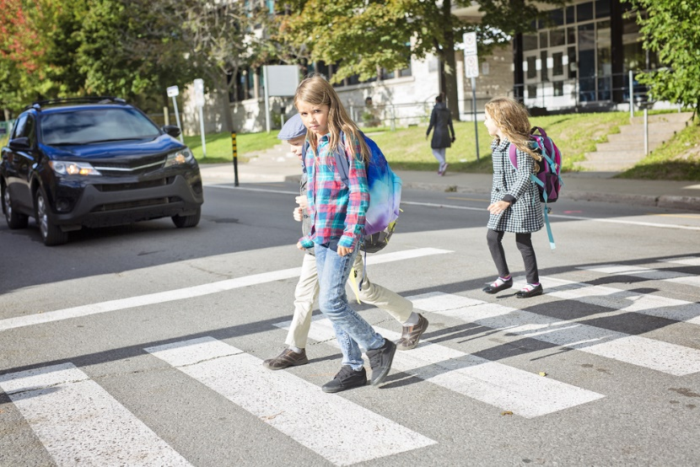
Pedestrian & Road Safety: 50
Describe what you look for and listen for when crossing the street
Answer:
Cars approaching
Other cyclists and pedestrians
Animals
Looking for car light, crosswalk signals, etc.
Always look left, right, left, and behind you before crossing the street
Back

Slide 26
Bonus Question!
What does NSTS stand for?
National Student Travel Services
Nature Services & Transport Shuttle
National Student Transport System
Niagara Student Transportation Services
Answer: d.) Niagara Student Transportation Services
NSTS provides the big yellow carpools for students to and from school, and also supports Active School Travel in local elementary schools.
Back

Slide 27
Summary Video
Notes:
https://www.youtube.com/watch?v=r59_rzKuAMA

