Slide 1
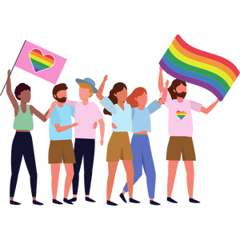
Stereotypes and Assumptions
Junior: Grade 6
Notes:
**The following slides (1-6) are for teacher use only**
Today we are here to talk about Stereotypes and Assumptions that are commonly made about gender and sex.
Note: based on the identities of students in the class, avoid using examples that could trigger a student.
The speaker’s notes are also intended for teacher use only. The notes include general information, background knowledge, questions and/or prompts. The information included in these notes should not be read word for word. Teacher’s should review the notes before using the presentation to become familiar with the content, as it is to supplement what is on the slide.
Important Disclaimer: It might be important to tell students that during this presentation they are not required to disclose their gender identity, as that is personal information. It is up to them and when/if they feel comfortable to do so.
Image from Canva
Last Updated: January 2023

Slide 2
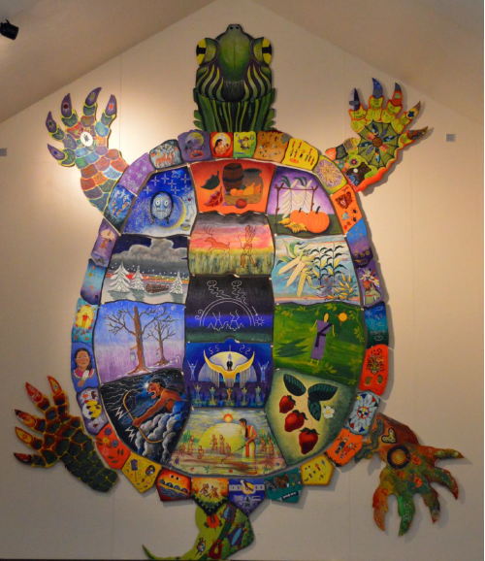
Land Acknowledgement
Notes:
Niagara Region is situated on treaty land. This land is steeped in the rich history of the First Nations such as the Hatiwendaronk (Hat-i-wen-DA-ronk), the Haudenosaunee (Hoe-den-no-SHOW-nee), and the Anishinaabe (Ah-nish-ih-NAH-bey), including the Mississauga's of the Credit First Nation. There are many First Nations, Métis, and Inuit peoples from across Turtle Island that live and work in Niagara today. The Regional Municipality of Niagara stands with all Indigenous peoples, past and present, in promoting the wise stewardship of the lands on which we live.
*Disclaimer: In the Spirit of Truth and Reconciliation, Niagara Region Public Health acknowledges that people are gathered on the customary and traditional lands of the Indigenous Peoples of this territory. We recognize that the land on which you are situated will vary depending on where you are located in Ontario. It is advised that you reach out to your school’s principal or school board for the school-specific treaty land. If you have already done a land acknowledgement on the same day you are presenting this lesson, you are welcome to skip this slide. However, it is always encouraged to complete a land acknowledgement before continuing on with this presentation.*
Information about the image on the left:
There are seven objects that have been purposely selected and included in the design of the artwork: an Inukshuk, an eagle feather, two drums, a Métis sash, an embroidered flower, and wampum belt. Each object reflects the diversity of First Nations, Métis and Inuit in North America. The iconic stone monument, the Inukshuk, is used as a marker identifying important sites and as a navigational tool to communicate direction. The eagle feather is significant to the spiritual beliefs of some Métis and First Nations peoples. Its symbolism includes honour, wisdom, and courage among many others. It is considered an honour to be given an eagle feather. The two drums include the Inuit drum and the Métis and First Nations drum. The drum is symbolic of the heartbeat of Mother Earth and is often played at various traditional gatherings and ceremonies. The embroidered flower is woven into many traditional garments and various objects through beadwork, painting, or etchings. It is also considered one of Canada’s first art forms. The Métis sash was once a tool of the voyageurs and fur traders. It is also a symbol of knowledge and the relationship between the Métis, the First Nations, and Europeans. At the top of the poster are four lines reminiscent of the traditional beaded wampum belt. There are many types of wampum belts with different significant meanings, including agreements made between two groups/nations, knowledge sharing, and storytelling. The four lines in this wampum belt represent the equality and diversity of the four peoples (First Nations, Metis, Inuit, and European settlers) and to acknowledge the journey of living together peacefully (ETFO, 2022).
For more information on Indigenous Education and First Nations, Metis and Inuit (FNMI), check out the following resources:
https://www.otffeo.on.ca/en/learning/indigenous-education
https://www.etfo.ca/socialjusticeunion/first-nation,-metis-and-inuit-(fnmi)
Photo References:
Image on the Left: Elementary Teacher Federation of Ontario (ETFO). (2022). ETFO Land Acnowledgements. https://www.etfo.ca/about-us/governance/etfo-land-acknowledgement
Image on the Right: Creating Our Way Forward: Recommendations for Improving Niagara Region Public Health & Emergency Services’ Indigenous Engagement (2019). https://www.niagararegion.ca/health/equity/pdf/indigenous-engagement-report.pdf
Mural of Turtle Island → Cover photo: Oneida nation artist, Sharon Sarnowski (deceased) This is a picture taken of the mural in the Boardroom of the Oneida Tribal Council office, Oneida, Wisconsin.

Slide 3
Presentation Format
Guiding Questions: Big idea questions that prompt students to brainstorm and share previous knowledge or new information.
Think, Pair, Share: Opportunity for students to work with partner or group and share ideas based on a prompt.
Notes:
Images from Canva

Slide 4
Presentation Format
Videos: Students can watch a short video clip that connects with topic. Discussion can follow before or after videos.
Final Activity: Activity that concludes the presentation.
Notes:
Images from Canva

Slide 5
Curriculum Expectations - Grade 6
D3.3 assess the effects of stereotypes and assumptions regarding gender roles and expectations, sexual orientation, race, ethnicity, culture, mental health, and abilities on an individual’s self-concept, social inclusion, and relationships with others, and propose appropriate ways of responding to and changing harmful assumptions and stereotypes that can lead to destructive social attitudes including homophobia and racism.
Notes:
Image from Canva

Slide 6
Stereotypes and Assumptions
Junior: Grade 6
Notes:
**This is where the presentation officially begins**
Image from Canva

Slide 7
Learning Objectives
At the end of this presentation, you will understand the effects of stereotypes and assumptions. You will also:
Challenge harmful assumptions that might lead to negative attitudes in our society
Understand that everyone has differences and this makes them unique
Create an environment that is safe and inclusive for your peers
Notes:
General Information
The information we are going to talk about today is important for many reasons.
We want to ensure that you learn that everyone is unique and the things that make you unique is what makes you interesting and special.
We want you to feel good about your body, how it is changing, and how you approach different types of relationships you may have with people.
It is important that everyone feels safe, accepted and supported at school and understand that differences are ok. This will help to reduce bullying and feelings of loneliness or isolation.
Background Knowledge
Students will learn and understand about themselves and their bodies as they grow and mature
Students need to understand that everyone has different qualities that make up their self-concept; this makes them unique
There needs to be an emphasis on feeling safe, included and accepted in the school community
Empathetic towards others…

Slide 8
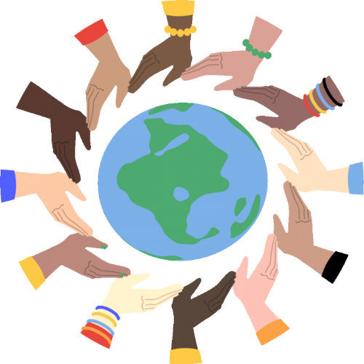
Making Decisions About Your Health
Notes:
General Information
When it comes to your health, there are many decisions you will have to make throughout your life as you mature and grow. Making decisions about your health is important and knowing about the different types of stereotypes and assumptions is good to know because homophobia, transphobia, biphobia, racism, discrimination, prejudice, and many other forms of hate can impact a person’s well-being.
When deciding what is best for you and your health, you should understand and be well informed about the choices available. It is important that information comes from a trusted source that is current and accurate.
There is a lot of great information available on the internet and social media, but sometimes there is a lot of misinformation as well, this is why we recommend talking to a trusted adult, as they can offer information to help you make the best decisions for you and your health.
Images from Canva

Slide 9
Things to Remember
It’s okay…
If you feel embarrassed or uncomfortable
To ask questions
To not already know about this
For us to learn about each others identities, orientations, and experiences
Notes:
General Information
4 Okay’s
Today we’re going to be talking about what makes us different, and what makes us the same. We understand that for some of you, this may be the first time you’re learning about this topic, and for others this may be something you know a lot about. It may feel uncomfortable to talk about your body and your sexuality with your parents or friends, but it’s important we all understand gender and sexual diversity so we can be supportive and respectful of others.
So let’s review the 4 OK’s. It is perfectly OK:
If you feel embarrassed or uncomfortable. The only way for us to overcome this uncomfortable feeling is to learn and grow. We can often feel uncomfortable about things we don’t fully understand. But if we take the time to learn about a topic and understand it, we become more educated and comfortable. Which creates a supportive environment for everyone!
It’s okay to be curious and to ask questions.
It’s okay if you don’t know this information already. We’re all going to learn this together.
And… It is okay for us to know about each other’s bodies and experiences. This helps us to understand one another better, and be respectful of each individual person regardless of our similarities and differences.
Images from Canva

Slide 10
Guiding Question #1
What do you notice about this image?
Notes:
Teacher Prompt
“What do you notice about this image?”
Elicit/Guiding Answers:
Everyone’s shirts are different colours
Everyone has different colour and/or style of hair
Each person has a different style of shirt
Some people have brown/black/dark hair, some people have blonde/ginger/orange hair
They are all the same height
They look like they are all the same build
One person is wearing a hat
The person in the orange shirt has stripes
The person in the green is wearing a sweater
Some people look to be female/male (this is a stereotype) – some students might say this, which is fine… eventually we want to address that you cannot determine a person’s gender based on what they look like!
After about 5 minutes, bring students back and get them to volunteer/explain what they said to their peer/friend. After discussing a few differences/similarities, proceed with the following:
Teacher Prompt: “What are some of the qualities that make each of us different? What qualities do you believe make you ‘you’?”
Next, ask students to close their eyes and picture in their head:
A dancer
A hockey player
A wrestler
A nurse
A doctor
A lawyer
A fire fighter
A teacher
After visualizing…
Prompt students as necessary to think about the imagined person’s race, self-concept, gender identity/expression, age, level of ability, etc. Revisit the image and ask the students – “Looking at the image, has anything changed for you from what you originally discussed with a peer or your friend?”
Share with students that sometimes people can be discriminated against because of biased assumptions or negative stereotypes about their social identities. These stereotypes or assumptions might be around gender roles and expectations in society or around an individual’s sexual orientation, gender expression, religion, race, ethnicity or culture, mental health, or abilities.
Gender is a social construct that is greatly influenced by culture. Socially constructed roles, behaviours, activities, and attributes seen as typical of one gender or another can vary greatly across different societies and groups.***
(Adapted from OPHEA Lesson Plans (Grade 6) – Making Healthy Choices in Relationships: Stereotype Effect - https://teachingtools.ophea.net/lesson-plans/hpe/grade-6/making-healthy-choices-relationships/stereotype-effects/pdf
Variation: Using the guiding questions, encourage the class to think of some answers and write a list on the board (i.e., whiteboard, smartboard, paper, etc)
Reference:
Sex & U (2022). LGBTTQ+: Gender Identity. https://www.sexandu.ca/lgbttq/gender-identity/
Images from Canva

Slide 11
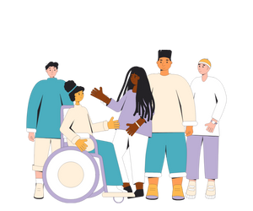
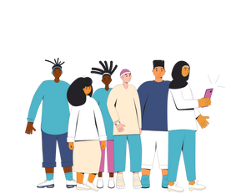
Diversity is all the ways we are different from each other…
We see diversity in:
Race
Religion
Culture
Ability
Families
Status
Sex
Gender
Notes:
Teacher Prompt:
“What is Diversity? What does the term diversity mean to you?” Ask students take a few seconds to think to themselves…
Diversity can mean many things to each of us. It’s important that each definition reflects our ability to accept and celebrate each other. Diversity is all the ways we are different from each other. It includes things like race, religion, culture, physical ability, mental ability, family make-up, socio-economic status and sexual and gender diversity.
Images from Canva

Slide 12
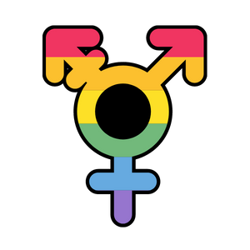
Review of Sex Assigned at Birth
Sex: A term that refers to a person’s internal and external genitals that they are born with
Penis = Male/ Boy
Vagina = Female/ Girl
Intersex: A term for people who do not fit the definition of female or male because they don’t have certain sex characteristics (i.e., Genitals, hormones, chromosomes)
Notes:
Background Knowledge:
Sex: Most people are born with a body that is clearly either male or female. So, for example, when a boy has a penis and testicles, we can say that his sex is male, and when a girl has a vagina and a uterus, we can say that her sex is female. In other words, sex refers exclusively to biological features: chromosomes, hormones, and internal and external anatomy (Sex & U)
Sex (S). At birth, infants are commonly assigned a sex. This is usually based on the appearance of their external anatomy, and is often confused with gender. However, a person’s sex is actually a combination of bodily characteristics including chromosomes, hormones, internal and external reproductive organs, and secondary sex characteristics. As a result, there are many more sexes than just male and female, just like there are many more genders than just male and female, as well (It Gets Better)
Intersex: Intersex is a term that refers to people who display a variation in sex characteristics at birth that does not allow for distinct identification as either male or female. Sex characteristics that vary include chromosomes, hormones, reproductive organs, and/or genitals. An intersex person will adopt a gender identity that best reflects how they feel, the same way non-intersex people do.
Adjective. Someone who, due to a variety of factors, has reproductive or sexual anatomy that do not seem to fit the typical definitions for the female or male sex. Some people who are intersex may identify with the gender assigned to them at birth, while many others do not (It Gets Better)
References:
It Gets Better Project. (2022). LGBTQ+ Glossary. https://itgetsbetter.org/blog/lesson/glossary/
Sex & U (2022). LGBTTQ+: Gender Identity. https://www.sexandu.ca/lgbttq/gender-identity/

Slide 13
Sexual Orientation
Sexual orientation is a term for an attraction, desire, or affection for another person. It can be:
Physical
Emotional
Romantic
Sexual
Spiritual
Notes:
General Information
Sexual Orientation
Everyone has a sexual orientation. Sexual orientation refers to a person’s emotional, physical and sexual attraction to others. Each person’s sexual orientation is a part of who they are. Some people know at a very early age what their sexual orientation is, and others may not. A person’s sexual orientation might stay the same over their whole life, or it may change. It can be fluid and may or may not reflect sexual behaviors.
Don’ts:
Do not make assumptions about someone's sexual orientation… You cannot know by looking at them. By not making assumptions, it is a way of showing respect and honouring diversity.
Background Knowledge
Sexual orientation (or attraction) is a term for the emotional, physical, romantic, sexual, and spiritual attraction, desire, or affection for another person. Examples of sexual orientations include but are not limited to: asexual, heterosexual, bisexual, gay, or lesbian. Sexual orientation is much more accurately viewed as an attraction continuum that involves a range of gender identities, expressions, and biological sexes.”
Physical attraction: is when we feel attracted to another person based on their physical appearance.
Emotional attraction: is the strong emotions we feel towards another person.
Reference:
OPHEA. (n.d.). Developing a Positive Self-Concept. https://teachingtools.ophea.net/lesson-plans/hpe/grade-8/understanding-healthy-development/developing-positive-self-concept
Teaching Sexual Health (2022}. Sexual & Gender Diversity: Words You May Hear. https://teachingsexualhealth.ca/parents/information-by-topic/sexual-diversity/
Image from Canva

Slide 14
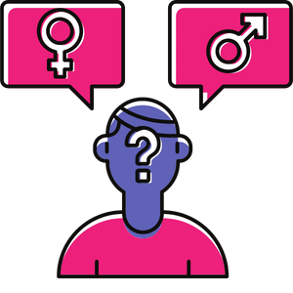
Gender Identity
A person will identify as female, male, both, or neither, regardless of your sex assigned at birth
Gender identity might be the same or different from the sex you were assigned at birth
Notes:
General Information
“Gender Identity is how a person identifies based on their intrinsic sense of self with respect to being female, male, a combination of both, or neither, regardless of their biological sex.”
Internal and individual experience of gender is your feeling of being male (boy or man) female (girl or woman), both, neither, or somewhere else along the gender spectrum. A person’s gender identity may be the same as or different from the sex they were assigned at birth.
*Note for Teacher: You might have to review what sex assigned at birth and gender are, in case they didn’t learn it in the previous school year*
Background Information
Sex assigned at birth: Generally, Doctors will assign a newborn’s sex as either male or female based on the baby’s genitals (external organs and internal reproductive organs). Once a sex is assigned, people often presume the child’s gender to be the same (i.e., assigned female at birth = female).
Gender Identity
As we discussed, gender identity is separate from the physical body parts and mechanisms that one is born with. Although historically gender has been associated with specific biological components, we have learned that this is not always the case.
People’s perceptions of gender are often influenced by masculine and feminine stereotypes that our society establishes. Gender stereotypes are always evolving and changing, and vary based on place, time and between different cultures. We know that the way a person chooses to express themselves, activities a person enjoys, and colours a person likes, for example, do not determine their gender, and vice versa.
For additional information explaining the difference between sex and gender, check out the following video: https://www.youtube.com/watch?v=PzGauky20tc
Reference:
OPHEA. (n.d.). Developing a Positive Self-Concept. https://teachingtools.ophea.net/lesson-plans/hpe/grade-8/understanding-healthy-development/developing-positive-self-concept
Sex & U (2022). LGBTTQ+: Gender Identity. https://www.sexandu.ca/lgbttq/gender-identity/
Teaching Sexual Health (2022}. Sexual & Gender Diversity: Words You May Hear. https://teachingsexualhealth.ca/parents/information-by-topic/sexual-diversity/
Image from Canva

Slide 15
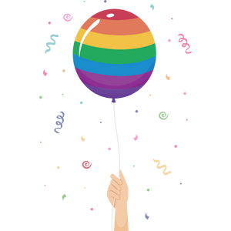
Gender Expression
Known as how you present yourself to the world around you. It can be expressed through:
Names
Clothing
Hairstyle/ Hair cuts
Voice
Body characteristics
Pronouns
Notes:
General Information
Gender expression refers to the way an individual expresses their gender identity (e.g., in the way they dress, the length and style of their hair, the way they act or speak, the pitch of their voice, and in their choice of whether or not to wear makeup.) Understandings of gender expression are culturally specific and change over time.
Background Knowledge:
Gender Expression
Gender expression is about how someone presents themselves to the world around them, which is expressed through things such as names, pronouns, clothing, haircuts, behaviour, voice, body characteristics, and more. For example, some men wear makeup, some women have facial hair, and some gender non-conforming individuals might switch up their gender expression from time to time.
“Gender nonconforming” refers to people who do not follow other people's ideas or stereotypes about how they should look or act based on the female or male sex they were assigned at birth.
A person’s gender expression does not have to stay the same, it can change over time. No one should feel as though they have to express themselves according to a box that society puts them in. Always remember, you can’t assume someone’s gender identity or pronouns by looking at them.
https://itgetsbetter.org/blog/lesson/glossary/
Reference:
OPHEA. (n.d.). Developing a Positive Self-Concept. https://teachingtools.ophea.net/lesson-plans/hpe/grade-8/understanding-healthy-development/developing-positive-self-concept
Teaching Sexual Health (2022}. Sexual & Gender Diversity: Words You May Hear. https://teachingsexualhealth.ca/parents/information-by-topic/sexual-diversity/
Image from Canva

Slide 16
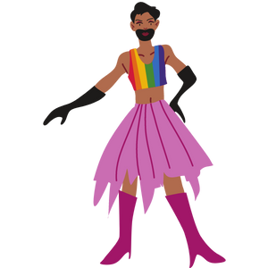
Gender Creative
Gender creative is when a person expresses their gender differently from what society may expect
For example, a person who identifies as a boy wears dresses
Society’s expectations for gender changes all the time
Notes:
Background Knowledge
Society’s expectations for gender constantly change and vary in different cultures and at different times in history. What people expect a gender to look like, is always changing. Gender expectations are different now than they were a 100 years ago, and may be different among different cultures.
Gender Creative:
Being gender creative is what makes you, ‘you’!
For example, a boy who wants to wear dresses might be considered “gender-creative”
References:
Caring for Kids (2021, March). Gender Identity. https://caringforkids.cps.ca/handouts/behavior-and-development/gender-identity
Image from Canva

Slide 17
Think, Pair, Share
Find a partner and take time to discuss the acronym: 2SLGBTQIA+
Then come back to the group and share what you talked about.
Notes:
Teacher Prompt
“Find a partner and discuss the acronym/term 2SLGBTQIA+. Try and figure out what each of the letters/numbers mean.”
After the students have done this, ask them to come back to the group and share what they talked about. This term will be discussed further over the next few slides.
Images from Canva

Slide 18
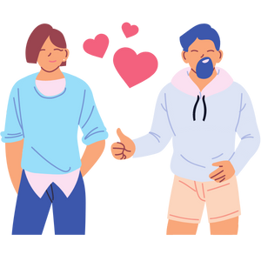
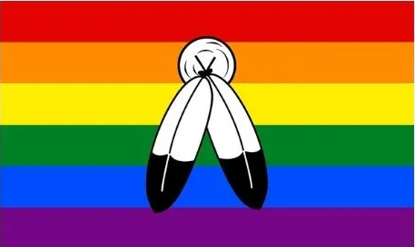
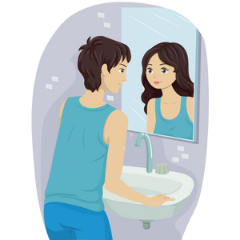
2SLGBTQIA+
It is an acronym that stands for…
Notes:
General Information
Many of you may have heard the term LGBTQ or LGBTQ2S+. This term reflects the genders and sexualities that are not cisgender and heterosexual.
2SLGBTQIA+ includes 2-spirited, Lesbian, Gay, Bisexual, Transgender, Queer or Questioning, Intersex and Asexual individuals. Here are some definitions to help you understand these terms.
2-Spirited: A term used by some Indigenous people who identify as having both a masculine and a feminine spirit, and is used by some Indigenous people to describe their sexual, gender and/or spiritual identity. In some Indigenous cultures, it is considered a gift to be two spirited.
Lesbian: A female who is physically and/or emotionally attracted to other females
Gay/Homosexual: A person who is physically and emotionally attracted to someone of the same sex or gender. The word gay can refer to both male and females. However, this term is most often used for a male who has attraction to males.
Bisexual: A person who is attracted physically and/or emotionally to people of the same sex, as well as people of the opposite sex.
Transgender: A person whose self-identified gender identity is not the same as the sex assigned at birth.
Queer: Historically, a negative term for LGBTQ2S+ people that has been reclaimed by the community as a term for any one who is not cis gender and/or heterosexual. That’s why you will sometimes hear the LGBTQ2S+ community referred to as the queer community.
Intersex: A term used for conditions in which a person is born with a reproductive or sexual anatomy that doesn’t seem to fit the usual definitions of female or male.
Asexual: A person who experiences little or no sexual attraction. They may or may not feel emotionally or romantically attracted to others.
Questioning: A person who is unsure or is exploring their sexual orientation or gender identity.
Background Knowledge
“LGBTQ2S+/LGBTQ*/LGBTQ+/GLBT/LGBTQ2/LGBTTQQIA: Acronyms that refer to the collection of sexual and gender identities including lesbian, gay, bisexual, transgender, two-spirit, queer, questioning, intersex and asexual. The asterisk (*) or plus sign (+) show that there are other identities included that aren’t in the acronym. These acronyms mean the same as ‘sexual and gender minorities’.” (Teaching Sexual Health, 2022).
Reference:
Teaching Sexual Health (2022}. Sexual & Gender Diversity: Words You May Hear. https://teachingsexualhealth.ca/parents/information-by-topic/sexual-diversity/
Queer in the World (2021). What Is The Two-Spirit Pride Flag, And What Does It Stand For? https://queerintheworld.com/two-spirit-pride-flag/
Images from Canva

Slide 19
Guiding Question #2
Could a person feel pressured to act a certain way because of the way they look?
Notes:
Teacher Prompt
“Have you ever felt like you are expected to act a certain way because of your appearance. Could a person feel pressured to act a certain way because of their appearance?”
After students have tried answering the guiding question, ask students to identify what it might feel like to be excluded because of their appearance.
Encourage students to see that experiences of being excluded can have a negative impact, regardless of their self-identity (e.g., “I identify as a girl, the boys in the class don’t let me play soccer with them”).
After the discussion on “gender expectations”, ask the students: “What happens when people make assumptions and expect you to ask a certain way because of the way you look?”
People have occasionally felt pressure to act or look a certain way based on their gender. This pressure can make people unhappy, if they are being asked to be or act in a way that does not match who they really are. Today people have more freedom than ever to express themselves in ways that feel true to who they are, regardless of their gender.
Highlight how others’ exclusionary behaviours/attitudes can have a negative impact on a person’s sense of self, self-esteem, and/or self-concept.
It is important to always respect others' identities. All students should feel safe at school and deserve a positive school climate that is inclusive and accepting, regardless of race, ancestry, place of origin/ ethnic origin, citizenship, sex, sexual orientation, gender identity, gender expression, age, family status or disability.
We cannot make assumptions about someone’s sexual orientation, based on someone’s gender identity or expression, Just like… we cannot make an assumption about someone’s race or religion based on the colour of their skin.
Emphasize the importance of respecting one another’s identities regardless of whether or not we understand the details of the identity.
Encourage students to find ways to learn more about their peers, such as asking questions.
Adapted activity from…
Reference:
OPHEA. (n.d.). Stereotype Effects. https://teachingtools.ophea.net/lesson-plans/hpe/grade-6/making-healthy-choices-relationships/stereotype-effects
Image from Canva

Slide 20
What are Assumptions?
An assumption:
Is something that is believed to be true without proof
May cause people to exclude others who are seen as “different”
Might make people who do not fit societal norms feel confused or bad about themselves
Can you think of any assumptions that you might make?
Notes:
Teacher Prompt
“Can you think of any assumptions that you might make, or have made in the past?”
As discussed in the previous slide, people have occasionally felt pressure to act or look a certain way based on their gender or appearance (i.e., gender expectations). When someone makes an assumption about a person, it can damage their self-concept/ self-esteem, and have a negative impact on their emotional, mental, physical health, and overall well-being.
Optional Making Assumptions Activity:
Example: John was sitting with two classmates at recess. During conversation, John notices that the two classmates were making comments about the way a Grade 5 student was dressed today. The two classmates made the assumption that the Grade 5 student named Robert “must be gay” because he wore a rainbow, sparkly shirt to school today.
What would you say/do if you were John in this scenario?
Discuss potential responses with class.
**Note: Appropriate ways of responding to and changing harmful assumptions and stereotypes that can lead to destructive social attitudes including homophobia and racism will be discussed on Slide 27**

Slide 21
Understanding Stereotypes, Prejudice and Discrimination
Everyone has different beliefs, experiences, abilities, appearances and more.
However, certain people and groups are more likely to experience stereotypes, prejudice and discrimination.
Notes:
General Information
Stereotypes are about how we THINK
Prejudice is about how we FEEL
Discrimination is about how we BEHAVE
The concepts of stereotypes, prejudice, and discrimination provide some important terminology:
stereotyping happens when we view or judge an individual based on generalizations we make about their group
prejudice is holding a judgmental attitude and negative feelings toward a person, based solely on membership in the group
discrimination is treating someone differently because of their membership in the group
Stereotypes, prejudice and discrimination often come from:
inequalities in society
ideas learned about other people/groups from family members, friends and/or the media
not spending a lot of time with people who are different from you in some way
not being open to different ideas and ways of living
Reference:
Kids Help Phone (Published 2018, June 19; Updated 2022, May 5). Understanding stereotypes, prejudice and discrimination. https://kidshelpphone.ca/get-info/understanding-stereotypes-prejudice-and-discrimination/
Image from Canva

Slide 22
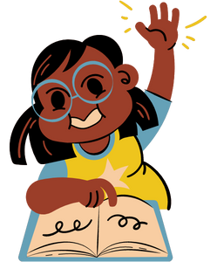
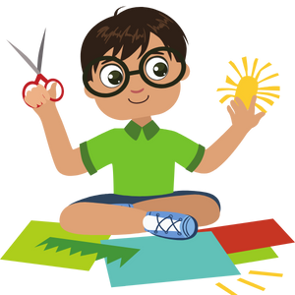
What is a Stereotype?
A stereotype is:
A belief about people or groups of people
Often unfair and untrue beliefs
Based on past assumptions (prejudice)
For example: People might make the assumption that a person is a nerd if they wear glasses
Notes:
General Information
A stereotype is an unfair, untrue/false belief about people or groups of people who get categorized because of past assumptions, which can often lead to prejudice.
The most common stereotypes are cultural, social, racial, gender, and religious stereotypes.
Background Information
Stereotype: A false or generalized, and usually negative, conception of a group of people that results in the unconscious or conscious categorization of each member of that group, without regard for individual differences. Stereotyping may be based on race, ancestry, place of origin, colour, ethnic origin, citizenship, creed, sex, sexual orientation, age, marital status, family status, or disability, as set out in the Ontario Human Rights Code, or on the basis of other factors. (OME, 2019)
“Stereotypes are usually formed when we do not have enough information and we make assumptions. They can also come from widely held societal beliefs. One way we can start to address stereotypes is by finding out more about people. By being open-minded, observing and listening, asking questions, getting more information, and considering different perspectives, we can work to change stereotypes. We know that not all couples are male-female, and we show this by the words we use. For example, we could use a word like ‘partner’ instead of ‘husband’ or ‘wife’. We need to be inclusive and welcoming.” “If we have newcomers from another country in our class, we can try to find out more about them, their culture, and their interests.” “If we hear things that are sexist, homophobic, or racist, we can show our support for those who are being disrespected.” “If we hear someone using words like ‘crazy’ or ‘nuts’ to describe a person who has a mental illness, we can explain that having a mental illness is no different from having any other illness, and that we wouldn’t call someone names if they had any other illness.”
Reference:
Health and Physical Education Curriculum – Ontario Ministry of Education (2019) p. 315
Image from Canva

Slide 23
People might be stereotyped because of their…
Abilities
Age
Economic status
Ethnicity
Race
Family status
Religion
Sexual orientation
Gender identity or expression
Physical appearance
Mental health
National origin
Spirituality

Slide 24
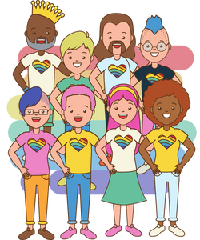
The History of Gender Roles and Stereotypes
Historical Female Stereotypes:
Petite or small
Cooks and cleans
Polite
Historical Male Stereotypes:
Strong and athletic
Don’t show emotion
Bold
Notes:
Teacher Prompt:
Why is labelling someone based on their gender identity inappropriate (and/or bad)? How would you feel if you were told/expected to act one way based on the historical gender role? For example, if you identify as female and like to play sports, how would you feel if someone told you that sports are only for boys?
There have traditionally been rigid and sometimes unfair roles for boys/men and girls/women. For example, females have often been told that they should look and act “feminine”, while males should look/act “masculine”.
General Information:
Assumptions are often made about what is ‘normal’ or expected for people based on their sex or gender. For example:
men take out the garbage;
nursing is a woman’s job;
boys play soccer at recess
girls skip rope or stand around and talk;
boys are good at weightlifting
girls are good at dancing.
Over time, society has created gender roles and expectations based on culture values/beliefs For example, if you were a boy, you may have been told not to cry and expected to be strong and athletic. If you were a girl, you may have been told you should be nice or be good at things like cooking and cleaning. These rules about how boys/men and girls/women should act are gender role stereotypes. While some girls might like to care for people or some boys might like sports, gender role stereotypes can prevent people from doing those things they enjoy.
It is all right for people to be interested in things that are not associated with traditional gender roles, because each person is an individual who has their own interests. Assumptions based on traditional gender roles can make people who do not fit into the expected norms feel confused or bad about themselves, damaging their self-concept, and can lead them to stop doing the things they love. Such assumptions can also cause people to discriminate against and exclude those who are seen as ‘different’.
Assumptions about sexual orientations, learning disabilities, mental illnesses, or cultural differences are harmful in similar ways, leading to homophobia and other prejudices based on fear, hatred, and mistrust. Everyone needs to feel accepted in school and in the community.
Traditional European worldviews saw gender as male and female with structured roles. Indigenous groups had a more complex view about gender identity and the related roles. Two-spirit is a modern umbrella term that refers to a diversity of LGBTQ identities, social roles, sexual orientations, and culture unique to Indigenous people.
Background Knowledge - Additional Information for the Teacher:
Possible Question: Why do you think such stereotyped assumptions come about? What can be done to change or challenge them?”
Historical and Societal Beliefs, Opinions and Prejudice (Stereotypes and Assumptions)
Social identities are socially constructed, so we often apply general labels to people based on common assumptions about social groupings. Minority groups and groups that have been historically marginalized by society are subject to more negative bias and group assumptions than other groups. Some examples of the ways groups have been affected by marginalization, bias, and group assumptions include: slavery, restricted voting rights for women, residential schools and the effects of colonization on First Nations, Métis, and Inuit people, criminal laws against homosexuality, etc.
Gender Binary: This is the classification of sex and gender into two distinct and separate states of masculine and feminine. It’s a social boundary that discourages people from crossing or mixing gender roles.
Heteronormative Language: Language that assumes everyone is heterosexual and cisgender (e.g., using the terms boyfriend or girlfriend instead of partner, or using mother and father instead of parent).
Heterosexism: Discrimination based on the belief that all people are heterosexual and cisgender. Believe that these are the normal and/or superior sexual orientation and gender identity. It’s often shown in more subtle ways than homophobia, biphobia or transphobia.
Reference:
Amaze – Gender Identity: Gender Roles and Stereotypes
https://amaze.org/video/gender-identity-gender-roles-stereotypes/
Image from Canva

Slide 25
Discrimination and Prejudice
Discrimination is when someone acts on prejudiced beliefs
Prejudice is when someone has a belief (usually negative) about a person or group based on a stereotype
Discrimination can have a negative impact on a person’s self-esteem or self-confidence
Can you think of a time when you were discriminated against?
Notes:
Teacher Prompt
What does the word “discriminate” or “discrimination” mean? What does the word “norms” mean? When we say: “assumptions may make people who do not fit typical norms feel confused”, why/how is this stereotyping?
Discrimination is an action
Discrimination is when someone acts on their prejudiced beliefs. It can also be systemic, like the policies and practices put in place to assimilate First Nations, Inuit and Métis peoples. Examples of discrimination include:
a manager promoting a cisgender employee over a transgender employee whose performance is stronger
a racialized youth being monitored without cause while shopping in a store
a health-care provider refusing to treat/diagnose a patient who is part of a particular racial/ethnic group
Prejudice is a belief
Prejudice is when someone has a belief (usually negative) about a person or group based on a stereotype. The belief is usually based on a person’s membership (or assumed membership) in a certain group. Prejudice also divides people based on stereotypes. Examples include:
Ableism: negative attitudes based on physical and/or mental abilities.
Cissexism: negative attitudes toward people who don’t identify with the sex they were assigned at birth.
Homophobia: negative attitudes toward members of the 2SLGBTQ+ community.* (Will be covered later on in the presentation)
Racism: negative attitudes based on race, ethnicity and/or culture.* (Will be covered later on in the presentation)
Sexism: negative attitudes based on gender identity, gender expression and/or sex assigned at birth.
Xenophobia: negative attitudes based on national origin/country
Discrimination can have a negative impact on a person’s sense of self, self-esteem, and/or self-concept.
Background Knowledge:
Discrimination. Unfair or prejudicial treatment of individuals or groups on the basis of grounds set out in the Ontario Human Rights Code (e.g., race, sexual orientation, disability) or on the basis of other factors. Discrimination, whether intentional or unintentional, has the effect of preventing or limiting access to opportunities, benefits, or advantages that are available to other members of society. Discrimination may be evident in organizational and institutional structures, policies, procedures, and programs, as well as in the attitudes and behaviours of individuals.
Reference:
Health and Physical Education Curriculum – Ontario Ministry of Education (2019) p. 205
Kids Help Phone (Published 2018, June 19; Updated 2022, May 5). Understanding stereotypes, prejudice and discrimination. https://kidshelpphone.ca/get-info/understanding-stereotypes-prejudice-and-discrimination/

Slide 26
Video: Gender Stereotypes and Education
After the watching the video, answer the following question:
What are a few of the stereotypes that were discussed?
Notes:
To access video you must be in present mode to play OR open the hyperlink in a separate Internet browser.
Video link: https://youtu.be/nrZ21nD9I-0
Also hyperlinked in the title.
Length of Video: 1:23
For another great video on gender stereotypes, consider watching the following: A Class That Turned Around Kids' Assumptions of Gender Roles! → https://youtu.be/G3Aweo-74kY
*This video might be more age-appropriate depending on your class and student profiles.
Other interesting videos related to Gender and Sexual Diversity – Stereotypes → Bryce – Pflag Stories: https://www.youtube.com/watch?v=StcJOXA56_I&t=35s
Image from Canva

Slide 27
Race, Culture, Ethnicity
Race:
A group of people with a common ancestry that is different from others
Culture:
The beliefs, values, and traditions held by people who share a similar background
Ethnicity:
Belonging to a group of people with shared cultural traits, such as language, ancestry, and practices
Notes:
Background Knowledge:
Race refers to a group of people with common ancestry who are considered different from other groups by physical traits such as skin colour, eye shape, hair texture or facial features.³
These phenotypic descriptions of people and groups have little scientific validity - there are no significant biological differences between different 'races' of people. However, racial differences have been assigned meaning and significance. They are used to categorize people in ways that shape assumptions about groups' traits and capacities such as intelligence, work ethic and values. Creating racial categories is one way to ‘other’, which can lead to stigma and discrimination of marginalized racial groups, while providing access to social, economic and political power to dominant groups.
Culture is the “mix of ideas, beliefs, values, behavioural and social norms, knowledge and traditions held by a group of individuals who share a historical, geographic, religious, racial, linguistic, and/or social context”.¹
Culture is the shared characteristics of people including values, norms, social roles and behaviour. This training focuses on culture as it relates to the shared characteristics of people with common race or nationhood.
'Culture' is used to describe many different groups including family, teen, popular, sports and work culture. Here, we focus on culture as it relates to the shared characteristics of people with a common ethnicity or nationhood.
Ethnicity is “the multiplicity of beliefs, behaviours and traditions held in common by a group of people bound by particular linguistic, historical, geographical, religious and/or racial homogeneity".² While the word ‘ethnic’ has been inaccurately used to categorize Canadians who are non-Indigenous and do not have European ancestry, for example, Chinese-Canadians or Japanese-Canadians, everyone has an ethnicity.
'Race' is often confused with ethnicity. While racialized categories are often based on appearance (phenotype), ethnicity is based on ancestry and cultural practices. Groups (e.g. racial, ethnic, religious and regional) are rarely mutually exclusive, and the degree of discrimination any group may experience can vary from place to place, and over time.⁴
Here is an additional resource that can be used to address racism and race.
Resource: PBS Teachers Lounge (2022). 10 Tips on Talking to Kids About Race and Racism. https://www.pbs.org/education/blog/10-tips-on-talking-to-kids-about-race-and-racism
References:
Canada Race Relations Foundation (2010). Glossary of terms: Culture.
Canada Race Relations Foundation (2010). Glossary of terms: Ethnicity.
Canada Race Relations Foundation (2010). Glossary of terms: Race.

Slide 28
What are Racism and Transphobia?
Racism
Is when people are treated unfairly because of their race or ethnicity
Transphobia:
Discriminating against people who identify as a gender that is not the same as their sex assigned at birth
Notes:
General Information
Racism: is when people are treated unfairly because of their race, skin color, cultural background, ethnicity. It is a kind of discrimination, and it causes great harm to people (Britannica Kids)
Transphobia: is when people are discriminated against because they identify as a gender different than their biological sex (sex assigned at birth)
Microaggression: is something someone may say or do that causes unintentional harm (meaning it may not have been meant that way), to people that belong to a specific group. This often happens with people who identify as part of the 2SLGBTQ+ community. (Note: The teacher will need to explain what unintentional means)
Harassment: The term harassment is also important to know about because there have been times when people have experienced transphobia, homophobia, and/or biphobia and harassment was also involved (although this isn’t always the case).
Sometimes people can be discriminated against because of biased assumptions or negative stereotypes about their social identities. These stereotypes or assumptions might be centered around gender roles and expectations in society or around an individual’s sexual orientation, gender expression, religion, race, ethnicity or culture, mental health, or abilities. Stereotypes can lead to destructive social attitudes including racism and homophobia/biphobia/transphobia.
Most often, people do not realize that what they said or did has caused harm (i.e. is a microaggression). If we see or hear this happening, it is important to stop and educate the person right away. The term harassment is also important to know about because there have been times when people have experienced transphobia, homophobia, and/or biphobia and harassment was also involved (although this isn’t always the case).
Background Knowledge
*Reminder: This section is for teacher-use only. The definitions and information included is not for the students, only what is provided on the slide is for students.*
Negative phrases can invalidate a queer person’s identity and promote erasure. What makes them micro is that they don't seem to sound like something that would be offensive, as they're subtle remarks, that are usually not supposed to be offensive. They're usually quite brief and commonplace, and it's difficult to challenge them because sometimes, it's hard to figure out why they're offensive to begin with. Microaggressions could be described as a way for homophobia and transphobia manifest in acceptable, everyday language.
Definitions:
Transphobia. According to the Ontario Human Rights Commission, “the aversion to, fear or hatred or intolerance of trans people and communities.” (From Policy on Preventing Discrimination because of Gender Identity and Gender Expression.)
Discriminating against people who identify as a gender different than their biological sex (sex assigned at birth)
It is a term used to describe the intense hatred, fear, violence, and dislike towards trans or those who are thought to be trans people.
It is a type of discrimination close to racism and sexism that subjects trans people of colour to all forms of discrimination.
Microaggression. “A microaggression is a statement, action, or incident regarded as indirect, subtle, or unintentional discrimination against members/people of a marginalized or specific group. In the queer community, there are a variety of phrases and popular sayings that can be considered unintentionally offensive or discriminatory.” (CCGSD)
Harassment. A form of discrimination that may include unwelcome attention and remarks, jokes, threats, name-calling, touching, or other behaviour (including the display or sharing of images) that insults, offends, or demeans someone because of their identity. Harassment involves conduct or comments that are known to be, or should reasonably be known to be, offensive, inappropriate, intimidating, and hostile. (Health and Physical Education Curriculum – OME, 2019, p. 308).
Harassment is not acceptable and has repercussions (if reported).
For a supplementary video on Microaggressions, check out: Microagressions (Clean) – YouTube (https://youtu.be/nQ9l7y4UuxY) created by TheTeacherColeman. The original video was created by Fusion Comedy: How microaggressions are like mosquito bites • Same Difference. It can be accessed here: https://www.youtube.com/watch?v=hDd3b....
Reference:
Britannica Kids (2022). Racism. https://kids.britannica.com/kids/article/racism/632495
Human Rights Campaign (2022). Bisexual FAQ. https://www.hrc.org/resources/bisexual-faq
Teaching Sexual Health (2022}. Sexual & Gender Diversity: Words You May Hear. https://teachingsexualhealth.ca/parents/information-by-topic/sexual-diversity/
The Canadian Centre for Gender and Sexual Diversity (CCGSD): Homophobic and Transphobic Microaggressions. https://ccgsd-ccdgs.org/wp-content/uploads/2020/09/Microaggressions-3.pdf
The 519. (n.d.). Education and Training – The 519 Glossary of Terms. https://www.the519.org/education-training/glossary
Image from Canva

Slide 29
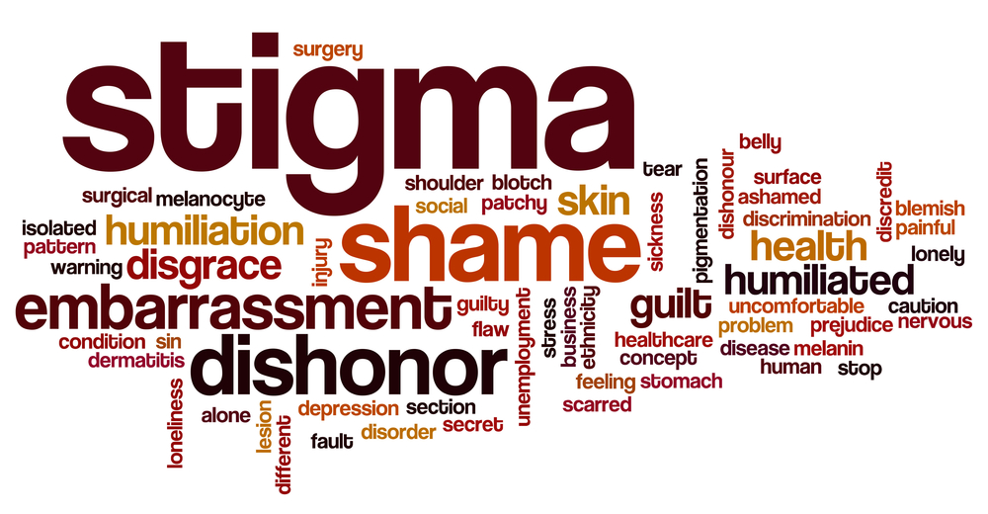
What is Homophobia and Biphobia?
Homophobia:
Disliking a person because of who they like or their gender identity
Biphobia
Negative attitudes, feelings, and fear or hate towards people who identify as bisexual
Notes:
Background Knowledge
*Reminder: This section is for teacher-use only (It is up to their discretion what information they want to expand on). The definitions and information included is not for the students, only what is provided on the slide is for students.*
Homophobia. According to the Ontario Human Rights Commission, “the irrational aversion to, fear or hatred of gay, lesbian or bisexual people and communities, or of behaviours stereotyped as ‘homosexual’.” (From Teaching Human Rights in Ontario: A Guide for Ontario Schools.)
→ Discriminating against people because of who they are attracted to, or what gender they identify with (i.e., male, female, both, or neither)
Biphobia: “Biphobia is prejudice, fear or hatred directed toward bisexual people. It can include making jokes or comments based on myths and stereotypes that seek to undermine the legitimacy of bisexual identity, like "bisexuality is a phase.” Biphobia occurs both within and outside of the LGBTQ community.” (HRC, 2022)
References:
Health and Physical Education Curriculum – Ontario Ministry of Education (2019) p. 308 and p. 316
Teaching Sexual Health (2022}. Sexual & Gender Diversity: Words You May Hear. https://teachingsexualhealth.ca/parents/information-by-topic/sexual-diversity/
Njoroge, S. (2022). LGBTQ+ and ALL: What is Transphobia? https://www.lgbtqandall.com/what-is-transphobia/
Photo Reference:
Shutterstock_510500239

Slide 30
Homophobia and Transphobia
What homophobia and transphobia might look and sound like:
Name-calling
Bullying and violence
Not using a persons proper pronouns
Discriminating people from the 2SLGBTQ+ community
Excluding people because of their gender identity or who they like
Notes:
General Information
Homophobia and Transphobia can be manifested in many ways including:
name-calling
negative attitudes
discrimination against trans people
intense hatred
bullying and violence
using the wrong names
not being sensitive to pronouns
References:
Njoroge, S. (2022). LGBTQ+ and ALL: What is Transphobia? https://www.lgbtqandall.com/what-is-transphobia/
Teaching Sexual Health (2022}. Sexual & Gender Diversity: Words You May Hear. https://teachingsexualhealth.ca/parents/information-by-topic/sexual-diversity/

Slide 31
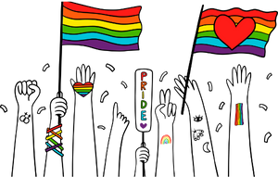
How You Can Respond to Harmful Assumptions
Develop responses that will work at different times
“What you’ve said is hurtful”
“That offends me”
“I don’t find that funny”
Have questions to interrupt negative comments
“What do you mean by that?”
“Why would you say something like that?”
Notes:
General Information
Everyone needs to feel accepted in school and in the community.
It is important to remember that individuals of different sexual orientations, race, ethnicity, culture, etc., might be impacted by stereotypes and assumptions, like biphobia, transphobia, homophobia, microaggressions. These can and will negatively impact a persons mental health and abilities on their self-concept, social inclusion and relationships with others. These lead to discrimination, harassment or violence against people who identify as part of the LGBTQ+ community.
Teacher Prompt
“What do you think we can do to challenge stereotypes?”
Find out more about people
Be open minded, observe, listen and ask questions, consider different perspectives
Can happen when we don’t have enough information and we make assumptions from beliefs that aren’t accurate
Inclusive language
Ex. Not all couples are male-female, so can use words like partner
Inclusive and welcoming actions
Ex. With newcomers to this country/class
Try to find out more about them, their culture, their interests
Show support for those being disrespected
If we hear things that are sexist, racist, homophobic
Words like crazy/nuts to describe mental illness – explain mental illness like having any other illness
Respect each other’s differences
And right to be who they are
A next step is to develop ready responses that will work in a variety of moments
Simple questions are also a good way to interrupt everyday bigotry.
Reference:
Learning for Justice (n.d.). Speak Up At School: How to Respond to Everyday Prejudice, Bias and Stereotypes. https://www.learningforjustice.org/sites/default/files/2019-04/TT-Speak-Up-Guide.pdf
Image from Canva

Slide 32
Final Activity: Stereotype Scenario
At recess you’re hanging out with some of your friends. Your one friend who identifies as a girl, privately tells you that she likes one of the other the girls in the friend group.
When one of your classmates overhears, he approaches and says
“girls can’t like girls, that’s weird!”
If you are in this situation, what could you say to stand up for your friend?
Notes:
General Information
Bullying will happen. It is important to stand up for our friends when someone is trying to put them down, especially when it is to do with self-concept, sexual orientation, gender identity, and gender expression. Remind students that we should always accept people for who they are and that these qualities are what make each of us unique and different (in good ways).
Comments that could be said:
“It’s not weird, anyone can like who they want.”
“It doesn’t matter, it’s their choice who they like”
“They’re allowed to like whoever they want”
“My sister dates a girl and she’s cool”
Optional Teacher Prompt:
Everyone should feel accepted in school and in the community. What can you do to change or challenge stereotypes in school? What can you do to create a safe and inclusive school?
Propose appropriate ways of responding to and changing harmful assumptions and stereotypes that can lead to destructive social attitudes including homophobia and racism.
Possible Extension:
Everyone needs to feel accepted in school and in the community. Using an Exit Card strategy, students could respond to the following questions:
What can you do to change or challenge stereotypes in school?
What can you do to create a safe and inclusive school?
Image from Canva

Slide 33
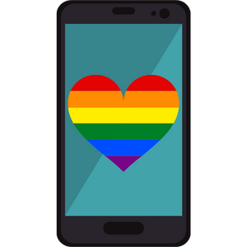
Support
Quest Community Health Centre
145 Queenston Street, St. Catharines
905-688-2558
Niagara Falls Community Health Centre
4790 Victoria Ave, Niagara Falls
LGBTQ2S+ Support Coordinator
Call/Text 289-321-0588
Notes:
Support
Niagara Falls Community Health Centre. You can reach out to Celeste, a LGBTQ2+ Support Coordinator. They offer 1-on-1 support, group programming, and family education. You can call or 289-321-0588, or email them at cturner@nfchc.ca.
Quest Community Health Centre, Rainbow Niagara 2SLGBQT+ Services. Offers primary care, trans specific healthcare, assessment and referral, mental health counselling, and much more. https://questchc.ca/participate-at-quest/rainbowniagara
Image from Canva.

Slide 34
Support
LGBT Youthline (youthline.ca)
Confidential peer support line
Call or Text: 905-688-2558
Niagara-on-the-Lake Regional Native Centre:
905-688-6484
Fort Erie Native Friendship Centre: 905-871-8931
Notes:
LGBT Youthline. Confidential, non-judgmental, and informed peer support through text, phone, and chat services. They can be reached at 647-694-4275 or through their website, https://www.youthline.ca/
Niagara Region Friendship Centres:
Fort Erie Native Friendship Centre → https://www.fenfc.org/
Phone #: 905-871-8931
796 Buffalo Road, Fort Erie, Ontario
Niagara Regional Native Centre (Niagara-on-the-Lake) → https://ofifc.org/friendship-centre/niagara-regional-native-centre-niagara-on-the-lake/
Phone #: 905-688-6484
382 Airport Road R.R.#4, Niagara-on-the-Lake, Ontario L0S1J0
Niagara Regional Native Centre → https://nrnc.ca/
Main Centre
382 Airport Road
Niagara-on-the-Lake, ON L0S 1J0
Phone: 905-688-6484
Fax: 905-688-4033
Literacy and Employment
15B-140 Welland Avenue
St Catharines, ON L2R 2N6
Phone: 905- 685-8547
Indigenous Community Justice Programs
18-140 Welland Avenue
St. Catharines ON L2R 2N6
Phone: 905-685-5246
Soaring Eagles Elementary and Secondary Alternative Schools
3024 & 3054 Orchard Hill
Fonthill, ON L0S 1E6
Phone: 905-892-3578 / 905-892-9111
Image from Canva.

Slide 35
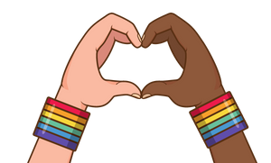
Final Thoughts
We are all different and can learn from one another
It is harmful to exclude others when they don’t fit into what society considers “normal”
There are many forms of discrimination
Schools should be a safe place for everyone to come and learn, regardless of our differences
Notes:
Background Knowledge
Diversity is all the ways we are different from each other. It includes things like race, religion, culture, physical ability, mental ability, family make-up, socio-economic status and sexual and gender diversity
Gender and sexual diversity is the way we are unique and different from each other, such as with sexual orientation, gender identity, gender expression, etc.
Stereotyping and making assumptions may cause people to discriminate against and exclude others who are seen as “different” and do not fit into what society considers normal
People might be stereotyped based on their sexual orientation, gender identity, gender expression, and more
There are many forms of discrimination, such as racism, homophobia, transphobia, biphobia, microaggressions, colour blindness, etc.
Homo/Bi/Trans Phobia: Fear and/or hatred of people who are gay, bisexual or transgender. Often shown through prejudice, discrimination, intimidation or acts of violence.
Schools should be a safe place for everyone to come and learn, regardless of their differences (i.e., sexuality, race, beliefs, mental abilities, family status, etc.)
Review of the Definition → Stereotype:
A false or generalized, and usually negative, conception of a group of people that results in the unconscious or conscious categorization of each member of that group, without regard for individual differences. Stereotyping may be based on race, ancestry, place of origin, colour, ethnic origin, citizenship, creed, sex, sexual orientation, age, marital status, family status, or disability, as set out in the Ontario Human Rights Code, or on the basis of other factors.
References:
Health and Physical Education Curriculum – Ontario Ministry of Education (2019) p. 315
Teaching Sexual Health (2022}. Sexual & Gender Diversity: Words You May Hear. https://teachingsexualhealth.ca/parents/information-by-topic/sexual-diversity/
Image from Canva

Slide 36
More Questions? Talk With Someone:
Parents/ Guardian
Teacher/ Principal
Doctor or Health Care Provider
School Health Nurse
Child and Youth Worker
Kids Help Phone
Friendship Centre
Notes:
General Information
There are many people and places you can reach out to in order to get help or ask questions about relationships and sexual health. If you ever have questions/concerns, need help or know someone who needs help, you can always talk to someone. There are many options out there available to you.
Among these are:
A trusted adult (such as a parent or teacher)
A health care provider (such as a doctor or nurse)
A child and youth worker
The school health nurse
The school social worker
Kids Help Phone
Friendship Centres
Services for Youth - Niagara Region, Ontario → https://www.niagararegion.ca/health/schools/youth-services.aspx
Other community resources:
Kids Help Phone: Call 1-800-668-6868 or https://kidshelpphone.ca/
Additional Niagara Region Sexual Orientation and Gender Identity Resources: https://www.niagararegion.ca/living/health_wellness/sexualhealth/orientation.aspx
Egale → https://egale.ca/ (https://egale.ca/awareness/supporting-gender-diverse-child/)
Rainbow Health Ontario → https://www.rainbowhealthontario.ca/
Pflag Niagara Region → https://sites.google.com/pflagcanada.ca/pflagniagara/
Transgender Niagara → http://www.transgenderniagara.com/
OUT Niagara → https://www.outniagara.org/
Rainbow Niagara → https://www.queerevents.ca/community-resources/community-resources/rainbow-Niagara
Image from Canva.

Slide 37
Kids Help Phone
Notes:
Kids Help Phone: Canada’s only 24/7, national support service. They are a confidential service that offers professional counselling, information and referrals, and volunteer-led support to young people in both English and French. You can call Kids Help Phone at 1-800-668-6868, or text and live chat at https://kidshelpphone.ca/.
Photo Reference: Jack.org (2022). Educational Social Media Posts: Kids Help Phone Social Media Pack. https://jack.org/Resources/COVID-19-Youth-Mental-Health-Resource-Hub?lang=en-ca

Slide 38
Questions?
Notes:
Image from Canva

