Slide 1
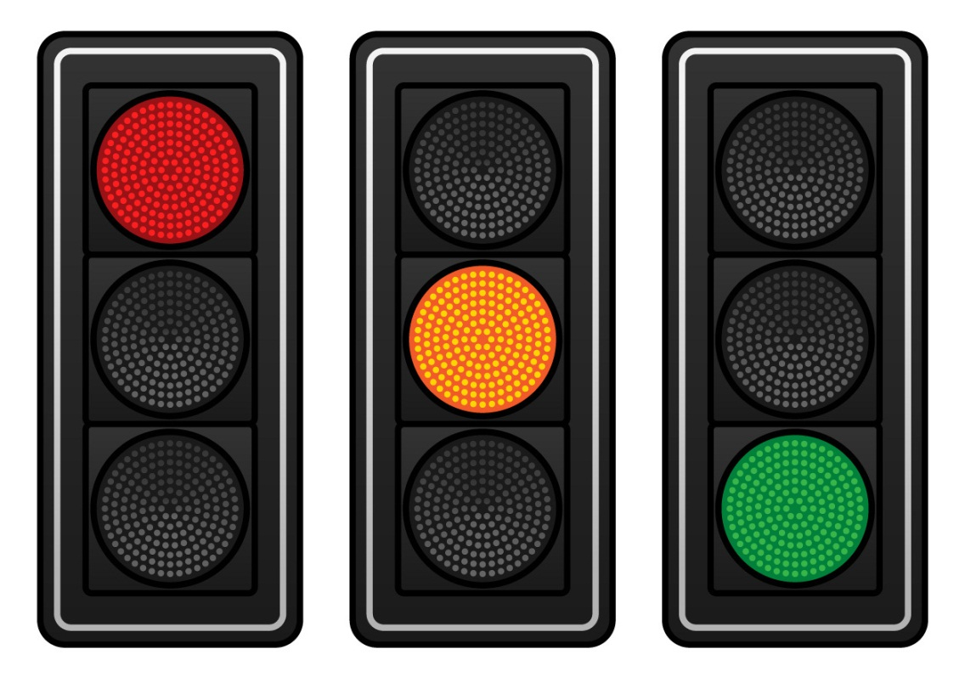
What’s the Risk?
Grade 7 STIs
Notes:
Complete the PowerPoint Presentation on STIs before completing this activity.
Review all of the activity slides here beforehand to ensure appropriateness level for the class***
The activity presents different choices/behaviours and the students need to determine if the choice/behaviour is high risk, some risk or no risk for getting an STI or what is known as STI transmission.
Divide the class into two teams. Tell the students that they will be presented with a choice or behaviour and that they must determine the level of risk for getting an STI.
Explain that the traffic light represents points along the risk continuum: red as high risk, yellow as some risk and green as no risk. The first team to correctly identify the risk of each behaviour will receive a point. In order to gain more knowledge from the activity, the person/team would give the reason for their choice of risk.
The presentation must be shown as a slide show in order for the answers to be hidden while the students respond. Once they have responded, click on the slide or the arrow to go next to reveal the answer.
(Refer to activity instructions for further details, including variations of game play)

Slide 2
What’s the Risk?
HIGH
LOW
NO
Always choosing to use a condom with an uninfected partner.
Notes:
Low risk:
You have reduced the number of sexual partners and you are using protection
The partner may think they are uninfected because they have no symptoms/feel fine but cannot be sure unless tested.
It is advised that clients be retested several months later to ensure they are truly uninfected.
Mutually monogamous means that both people agree to have sex/relationship with only each other.

Slide 3
What’s the Risk?
HIGH
LOW
NO
Getting bitten by a mosquito.
Notes:
No risk:
You cannot get an STI from a mosquito, this is a myth.

Slide 4
What’s the Risk?
HIGH
LOW
NO
Having many sexual partners.
Notes:
High Risk:
The more sexual partners a person has, the greater the chance of getting an STI.

Slide 5
What’s the Risk?
HIGH
LOW
NO
Using condoms for oral sex.
Notes:
Some risk:
Although it is good to use the condom, they are not 100% effective from preventing an STI and the person performing oral sex can still get an STI in their (his/her/they) mouth. Using condoms correctly and every time greatly reduces a persons chance of getting an STI.
Dental dams should be recommended in this case.

Slide 6
What’s the Risk?
HIGH
LOW
NO
Sharing drinks, food, lip gloss.
Notes:
No risk:
You can get other illnesses, but you cannot get an STI from these activities.
However, you can get herpes simplex, the herpes that cause a “cold sore” from sharing lip gloss or lipstick from an infected person.
It is always advisable not to try on make-up, particularly lipstick/lip gloss in a department store or for school plays/theatre productions as you do not know who has sampled the lipstick/ lip gloss before you. Wiping the lip products with a tissue between users will not kill the virus.

Slide 7
What’s the Risk?
HIGH
LOW
NO
Only having intimate sexual contact with someone who looks healthy.
Notes:
High Risk:
You cannot tell if someone has an STI just by looking at them.
One may look healthy and not have any symptoms even though they have an STI. Use a condom every time you have sex with someone.

Slide 8
What’s the Risk?
HIGH
LOW
NO
Having unprotected vaginal or anal sex.
Notes:
High Risk:
Sex without using a condom puts you at a high risk of getting an STI.
Using a condom correctly and every time reduces your risk of contracting an STI

Slide 9
What’s the Risk?
HIGH
LOW
NO
Sharing razors, nail clippers or toothbrushes.
Notes:
Some risk:
Personal items may have blood on them and you would have to get this blood into your bloodstream.
There is a low risk of transmission of Hepatitis B virus via personal care articles. There is almost no risk for HIV transmission. It is good hygiene practice not to share personal items with friends or family members.

Slide 10
What’s the Risk?
HIGH
LOW
NO
Having any type of sexual contact but using a condom correctly and every time.
Notes:
Some risk:
Condoms help to lower the risk but are not 100% effective in preventing STIs – because they do not cover the genital/pubic area and some STIs are spread by skin to skin contact only.
Abstinence (not having sex) is 100%, no risk of an STI.

Slide 11
What’s the Risk?
HIGH
LOW
NO
Drinking from a water fountain.
Notes:
No risk:
There is no risk for an STI from drinking from a fountain, and it is a myth.

Slide 12
What’s the Risk?
HIGH
LOW
NO
Waiting until you know a person before you decide to have sex.
Notes:
High Risk:
Just because you think you know the person you may not know your partners sexual history so there is a high risk of getting an STI.
Do you know them well enough to trust them?
Discuss with partner the need for both of you to be tested before becoming sexually active and the importance of using condoms.
A rule of thumb is …if you cannot talk to your partner about wearing a condom, you are NOT mature or emotionally ready to be engaging in sexual behaviour.

Slide 13
What’s the Risk?
HIGH
LOW
NO
Sharing needles (drug use, piercing, tattooing)
Notes:
High risk:
All of these activities there is an exchange of body fluids (i.e., blood) making all high risk activities.

Slide 14
What’s the Risk?
HIGH
LOW
NO
Holding hands or hugging.
Notes:
No risk:
Holding hands has no risk for getting an STI. You do not have any exchange of body fluids by holding hands. Holding hands with your partner is a way to tell your partner that you care.

Slide 15
What’s the Risk?
HIGH
LOW
NO
Tongue (French) kissing.
Notes:
No risk:
Almost no chance of getting STI from saliva however, you can get herpes simplex, the herpes virus that causes “cold sores” if you tongue kiss with someone who is infected.

Slide 16
What’s the Risk?
HIGH
LOW
NO
Having sexual intercourse after both partners have been tested and told they are free of infection.
Notes:
Some Risk:
Testing is only good for the day it is done and could be “false negative” results. May be recommended to retest months later.
Still recommended to use condoms to prevent unplanned pregnancy and decrease the risk for STI’s

Slide 17
What’s the Risk?
HIGH
LOW
NO
Communicating and making the decision to be abstinent in your relationship.
Notes:
No risk:
For most, being abstinent means not having any type of sexual contact (i.e., sexual intercourse; vaginal, oral or anal; sexual touching)
It is important to always communicate with your partner on how you feel and discuss being prepared to talk about and use protection against STIs and/or pregnancy.
The purpose of this activity was to look at the different levels of risks linked with certain behaviours/choices and understand that any activity that is not risk-free puts a person at risk of getting an STI.

