Slide 1
Let’s See What You Remember
Notes:
This is the beginning of the review activity, Let’s see what you remember about puberty (see instructions in Teaching Tool)

Slide 2
Question 1
What is puberty?
Notes:
A term used for the time when one’s body begins to change as you move from a child to an adult.

Slide 3
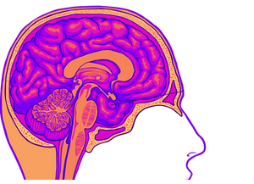
Question 2
What is the name of the gland in your brain that releases hormones to start puberty?
Notes:
Pituitary gland

Slide 4
Question 3
What is the name of the hormone that starts the changes during puberty for people with a penis?
Notes:
Testosterone

Slide 5
Question 4
What is the name of the hormone that starts the changes during puberty for people with a vagina?
Notes:
Estrogen

Slide 6
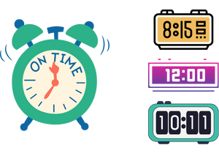
Question 5
Around what age does puberty start in people assigned female?
Notes:
8 – 16… Remind students that these are age ranges, some start sooner and some finish later

Slide 7
Question 6
Around what age does puberty start in people assigned male?
Notes:
10 – 18… Remind students that these are age ranges, some start sooner and some finish later

Slide 8
Question 7
Name some changes that happen to people during puberty.
Notes:
Acne
Oily skin
Perspiration
Body odour
Hair growth
Grow taller
Mood swings

Slide 9
Question 8
Name one change that happens only to a person assigned male at birth during puberty.
Notes:
Shoulders and chest broaden
Genitals grow larger
Muscles develop more in males than in females – this shouldn’t be one of the changes because it assumes that females don’t develop muscle
Adam’s apple
Voice deepens

Slide 10
Question 9
Name one change that happens only to a person assigned female during puberty.
Notes:
Breasts develop
Hips widen
Menstruation

Slide 11
Question 10
Why do people sweat?
Notes:
To regulate body temperature
Everybody sweats, even children, but during puberty different glands develop that start to produce a sweat that causes body odour

Slide 12
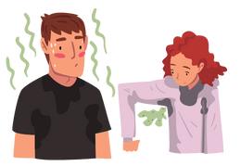
Question 11
Name some things that you can do to help with body odor.
Notes:
Shower/bathe daily to reduce the bacteria that can lead to odour
Deodorant/antiperspirant
Clean clothes - socks, underwear, shirt; perfumes, body sprays, etc. are not necessary (refer to school policy re: scent free environment)

Slide 13
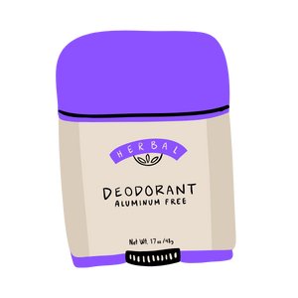
Question 12
What is the difference between deodorants and antiperspirants?
Notes:
Deodorants are perfume for the underarms – it doesn’t stop sweat but makes it smell nicer;
Antiperspirants control odour and wetness by decreasing the amount of sweat produced

Slide 14
Question 13
What happens to your skin when your pores get clogged?
Notes:
Acne/pimples/zits
(Talk about increased sebum production)

Slide 15
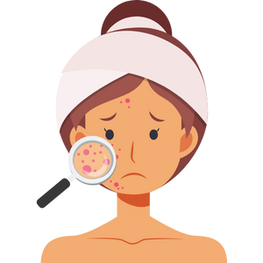
Question 14
What can you do to look after acne / blemishes?
Notes:
Wash face daily
Don’t pick pimples
Keep hands away from face
Keep hair off face
Limit amount of stress
Headbands, sports equipment and backpack straps rubbing on the skin can lead to skin irritation and acne
Use of over the counter medicated acne products
Visit to a health care professional is necessary in some cases

Slide 16
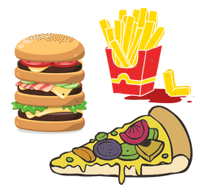
Question 15
Can chocolate and greasy foods cause pimples?
Notes:
No, but it’s still important to eat healthy and some people may be more likely to develop acne due to hereditary factors

Slide 17
Question 16
What are some things you should do to look after your skin when outside in the sun?
Notes:
Slip on proper clothing
Slap on a hat
Slop on sunscreen SPF 30 min
Seek shade; slide on sunglasses

Slide 18
Question 17
Why do voices change during puberty.
Notes:
Larynx/voice box is getting bigger; it is more noticeable in males and some males may even develop an Adam’s apple

Slide 19
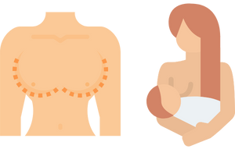
Question 18
True or False: The purpose of breasts for a person assigned female at birth is for breastfeeding.
Notes:
True - they’re to breastfeed their young if they choose to
Briefly discuss how the media has sexualized breasts making them embarrassing for some to discuss

Slide 20
Question 19
True or False: Some people assigned male at birth might have some temporary breast growth during puberty.
Notes:
True – is related to hormones regulating themselves early in puberty

Slide 21
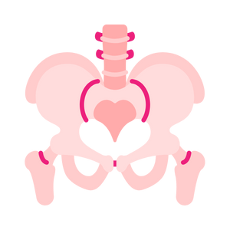
Question 20
Why do the hips widen in a person assigned female at birth as they go through puberty?
Notes:
Preparation for childbirth

Slide 22
Question 21
True or False: During puberty you may experience stronger feelings of wanting to be liked and fitting in may become important.
Notes:
True; briefly discuss peer pressure

Slide 23
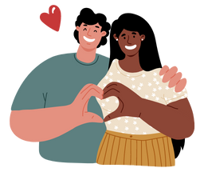
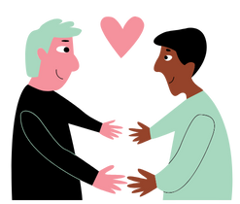
Question 22
True or False: People might start to have romantic feelings for someone.
Notes:
True, they may be surprised as to who they are attracted to
Stress the importance of differing family values; and that there are different types of relationships

Slide 24
Question 23
You may find you are starting to feel more grown-up. What is one thing you can do to show your parents/teacher that you’re ready for more independence?
Notes:
Offer to help with chores
Follow through on commitments you’ve made

Slide 25
Question 24
Mood swings are a part of puberty. Name some different feelings that you may experience.
Notes:
Happy, sad, angry, scared, confused, lonely

Slide 26
Question 25
Feeling lonely and confused at times is a normal part of puberty. What are some things you could do to help you feel better?
Notes:
Take some time to consider why you might be feeling this way
Talk to someone you trust
Do something you enjoy
Put the screens down and go spend time with people you enjoy
Journal
Play/listen to music
Spend time with your pet

Slide 27
Question 26
Too much stress is not healthy. What are some things you can do to manage your stress?
Notes:
We all have stress in our lives
Make the point that some stress is healthy but when it gets too much then:
Exercise
Read
Listen to music
Spend time with pets
Spend time with friends
Talk to someone

Slide 28
Question 27
What can you do if you are feeling sad or unhappy, or are in a bad mood sometimes?
Notes:
Smile
Get active
Do something they like to do
Listen to music
Spend time with a pet
Journal
Talk to a friend

Slide 29
Question 28
What could you do if you find you are feeling sad or angry for several weeks at a time?
Notes:
Tell an adult- parents, teachers, counselors, school nurse, clergy etc.

Slide 30
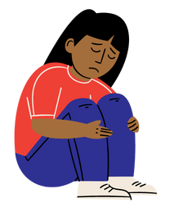
Question 29
What could you do if your friend comes to you and says they feel really sad or depressed?
Notes:
Be a good friend by listening and going together to a trusted adult for help
Talk about the importance of getting help and not keeping it ‘secret’
If your friend won’t go then consider going alone to talk to someone you trust

Slide 31
Question 30
What are some ways to make sure your body stays as healthy as possible as you grow up?
Notes:
Eat healthy foods
Drink water when thirsty and have milk at meal times
Be physically active – no need to join the gym
Limit stress; get enough sleep/rest – between 9 & 11 hrs./night
Say no to smoking, alcohol and drugs
Incorporate refusal skills as time permits

