Slide 1
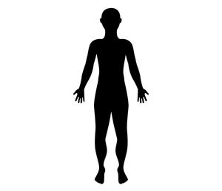
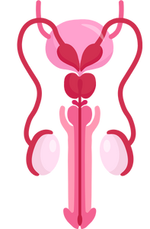
The Reproductive Systems
Grade 5
Notes:
**The following slides (1-6) are for teacher use only**
The speaker’s notes are also intended for teacher use only. The notes include general information, background knowledge, questions and/or prompts. The information included in these notes should not be read word for word. Teacher’s should review the notes before using the presentation to become familiar with the content, as it is to supplement what is on the slide.
**Important** The language of “boys” and “girls” or “male” and “female” is gender interpreted, and often assigned based on a person’s biological sex at birth. It excludes individuals who are intersexed and/or whose gender identity does not align with their assigned biological sex. It is more accurate to talk about anatomy rather than gender and use “bodies with” or “people with” language when referring to developments and changes in puberty. Using this language supports an inclusive classroom in which diversity is recognized and provides a strong model to help students understand that bodies are unique, come in all shapes, sizes, types, and all bodies are good bodies.
This presentation will use the term people assigned female at birth/ people assigned male at birth to refer to individuals who are born with certain sex organs, hormones and/or chromosomes. However, it’s important to note that some people may have a different gender identity than the sex assigned to them at birth.
Language is complex, evolving, and powerful. In these lessons, gender-neutral language is used to be inclusive of all students, including those with diverse gender identities and sexual orientations. This includes the use of ‘they’ as a singular gender-neutral pronoun. The lesson plans use the terms ‘male’ and ‘female’ when referring to biological sex (sex assigned at birth), such as when discussing reproductive anatomy. A person’s reproductive system can be male, female or intersex (not clearly defined as either male or female).
People are assigned a sex at birth based on their reproductive anatomy. Sex assigned at birth is independent of gender identity. Gender identity is a person’s internal sense of identity as female, male, both or neither, regardless of their biological sex assigned at birth.
For many people, their gender matches the sex they were assigned at birth (cisgender). Others may identify as being transgender or gender diverse if their gender identity does not match the sex they were assigned at birth. A person’s gender identity can be girl, woman, boy, man, transgender, gender fluid, gender queer, agender or others. The intention in this material is to use language that reflects these many possibilities.
Reference:
Teaching Sexual Health (n.d.). Grade 6 Growing a Baby Lesson. https://teachingsexualhealth.ca/app/uploads/sites/4/Grade-6-LP2-Growing-Baby-Oct11.pdf
Image from Canva
Last Updated: December 7th, 2022

Slide 2
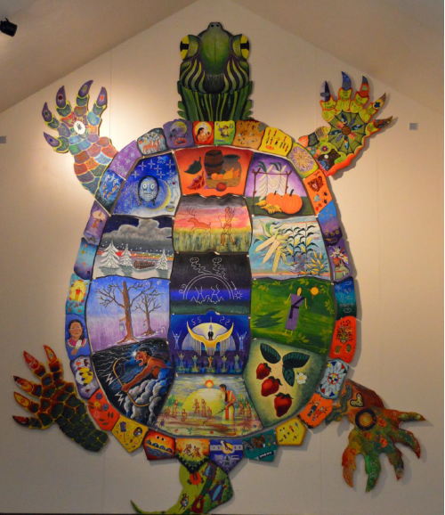
Land Acknowledgement
Notes:
Niagara Region is situated on treaty land. This land is steeped in the rich history of the First Nations such as the Hatiwendaronk (Hat-i-wen-DA-ronk), the Haudenosaunee (Hoe-den-no-SHOW-nee), and the Anishinaabe (Ah-nish-ih-NAH-bey), including the Mississauga's of the Credit First Nation. There are many First Nations, Métis, and Inuit peoples from across Turtle Island that live and work in Niagara today. The Regional Municipality of Niagara stands with all Indigenous peoples, past and present, in promoting the wise stewardship of the lands on which we live.
*Disclaimer: In the Spirit of Truth and Reconciliation, Niagara Region Public Health acknowledges that people are gathered on the customary and traditional lands of the Indigenous Peoples of this territory. We recognize that the land on which you are situated will vary depending on where you are located in Ontario. It is advised that you reach out to your school’s principal or school board for the school-specific treaty land. If you have already done a land acknowledgement on the same day you are presenting this lesson, you are welcome to skip this slide. However, it is always encouraged to complete a land acknowledgement before continuing on with this presentation.*
Information about the image on the left:
There are seven objects that have been purposely selected and included in the design of the artwork: an Inukshuk, an eagle feather, two drums, a Métis sash, an embroidered flower, and wampum belt. Each object reflects the diversity of First Nations, Métis and Inuit in North America. The iconic stone monument, the Inukshuk, is used as a marker identifying important sites and as a navigational tool to communicate direction. The eagle feather is significant to the spiritual beliefs of some Métis and First Nations peoples. Its symbolism includes honour, wisdom, and courage among many others. It is considered an honour to be given an eagle feather. The two drums include the Inuit drum and the Métis and First Nations drum. The drum is symbolic of the heartbeat of Mother Earth and is often played at various traditional gatherings and ceremonies. The embroidered flower is woven into many traditional garments and various objects through beadwork, painting, or etchings. It is also considered one of Canada’s first art forms. The Métis sash was once a tool of the voyageurs and fur traders. It is also a symbol of knowledge and the relationship between the Métis, the First Nations, and Europeans. At the top of the poster are four lines reminiscent of the traditional beaded wampum belt. There are many types of wampum belts with different significant meanings, including agreements made between two groups/nations, knowledge sharing, and storytelling. The four lines in this wampum belt represent the equality and diversity of the four peoples (First Nations, Metis, Inuit, and European settlers) and to acknowledge the journey of living together peacefully (ETFO, 2022).
For more information on Indigenous Education and First Nations, Metis and Inuit (FNMI), check out the following resources:
https://www.otffeo.on.ca/en/learning/indigenous-education
https://www.etfo.ca/socialjusticeunion/first-nation,-metis-and-inuit-(fnmi)
Photo References:
Image on the Left: Elementary Teacher Federation of Ontario (ETFO). (2022). ETFO Land Acnowledgements. https://www.etfo.ca/about-us/governance/etfo-land-acknowledgement
Image on the Right: Creating Our Way Forward: Recommendations for Improving Niagara Region Public Health & Emergency Services’ Indigenous Engagement (2019). https://www.niagararegion.ca/health/equity/pdf/indigenous-engagement-report.pdf
Mural of Turtle Island → Cover photo: Oneida nation artist, Sharon Sarnowski (deceased) This is a picture taken of the mural in the Boardroom of the Oneida Tribal Council office, Oneida, Wisconsin.

Slide 3
Presentation Format
Guiding Questions: Big idea questions that students can brainstorm and share previous knowledge or new information with.
Think, Pair, Share: Opportunity for students to work with partner or group and share ideas based on a prompt.
Notes:
Images from Canva

Slide 4
Presentation Format
Videos: Students will watch a short video clip that connects with topic. Discussion can follow before or after videos.
Final Activity: Activity that concludes the presentation.
Notes:
Images from Canva

Slide 5
Curriculum Expectations – Grade 5
D1.3 - Identify the parts of the reproductive system, and describe how the body changes during puberty.
Notes:
Image from Canva

Slide 6
The Reproductive Systems
Grade 5
Notes:
The presentation begins here.
This presentation should be taught before the pregnancy presentation.
**Note: The reproductive system has been divided into two lessons: The content for a person with a penis (person assigned male at birth) (part 1) and then the content for a person with a vagina (person assigned female at birth) (part 2)**. Learning about the reproductive system for a person assigned female at birth second might help ease the students into talking about menstruation, pregnancy, conception and fertilization.
Reproductive and sexual anatomy includes your genitals and your internal sex and reproductive organs. Everyone’s reproductive and sexual anatomy looks a little different.
Image from Canva

Slide 7
Learning Objectives
At the end of this presentation, you will be able to identify the parts of the reproductive system. You will also:
Learn how the body changes during puberty
Understand the changes you might be going through
Learn that everyone has differences and this makes us unique
Understand how to support your classmates as they grow and change
Learn how to create a safe space for your peers
Notes:
General Information
The information we are going to talk about today is important for many reasons.
We want to ensure that you learn that everyone is unique and the things that make you unique is what makes you interesting and special.
We want you to feel good about your body, how it is changing, and how you approach different types of relationships you may have with people.
It is important that everyone feels safe, accepted and included at school and understand that differences are ok. This will help to reduce bulling and feelings of loneliness or isolation.
Background Knowledge
Students will learn and understand about themselves and their bodies as they grow and mature
Students need to understand that everyone has different qualities that make up their self-concept; this makes them unique
There needs to be an emphasis on feeling safe, included and accepted in the school community
Empathetic towards others…

Slide 8
Making Decisions About Your Health
Notes:
General Information
When it comes to your health, there are many decisions you will have to make throughout your life as you mature and grow. Making decisions about your health is important because you need to know the different parts of the reproductive system and how you will experience changes to your body during puberty that might impact your well-being.
When deciding what is best for you and your health, you should understand and be well informed about the choices available. It is important that information comes from a trusted source that is current and accurate.
There is a lot of great information available on the internet and social media, but sometimes there is a lot of misinformation as well, this is why we recommend talking to a trusted adult, as they can offer information to help you make the best decisions for you and your health.
Images from Canva

Slide 9
Feelings about the Reproductive Systems
It’s Okay…
To feel embarrassed or uncomfortable
To ask questions
To not already know about this
For us to learn about each others bodies
Notes:
General Information
Things to remember…
4 Okays
Today we’re going to be talking about what makes us different and what makes us the same. We understand that for some of you, this may be the first time you’re learning about this topic, and for others this may be something you know a lot about. It may feel uncomfortable to talk about your body and puberty with your parents or friends, but it’s important we all understand puberty so we can be supportive and respectful of others.
So let’s review the 4 OKs. It is perfectly OK:
If you feel embarrassed or uncomfortable. The only way for us to overcome this uncomfortable feeling is to learn and grow. We can often feel uncomfortable about things we don’t fully understand. But if we take the time to learn about a topic and understand it, we become more educated and comfortable. Which creates a supportive environment for everyone!
It’s okay to be curious and to ask questions.
It’s okay if you don’t know this information already. We’re all going to learn this together.
And… It is okay for us to know about each other’s bodies and experiences. This helps us to understand one another better, and be respectful of each individual person regardless of our similarities and differences.
Teacher Prompts:
Instead of male and female reproductive systems, we use the terms “person with a penis” and “person with a vagina” and/or “person assigned female at birth” and “person assigned male at birth”
Explore why students might find this topic difficult to discuss
Discuss why parents or other trusted adults might also feel embarrassment (think children are too young, no one ever talked to them, it is a private topic, not used to discussing it, or think they should have all the answers)
General Comments for the Topic of Puberty:
Embarrassment
Embarrassment is common; giggling or blushing, and wiggling in chairs is expected (the topic can also be uncomfortable for some students)
Most people want to know about their bodies and those of the opposite assigned sex
Knowing the information helps youth to feel more comfortable and prepared as they go through puberty
Knowing/Not Knowing
Is important to learn about puberty; helps to understand the changes that are/will happen
Some students have very limited knowledge and others might know more
For some, this may be the first opportunity to explore the changes of puberty
For those with some knowledge, it is important to continue talking about puberty and to make sure that the information they have is correct
Students may have learned about these topics from friends or the media. However, those sources are not always accurate
It is important that everyone gets to know and learn about each other (and everyone)
Discuss respect of each other and of the topic
We spend a lot of our lives relating to people of the opposite assigned sex (fathers, brothers, sons, mothers, sisters, daughters). If we learn about them and their concerns, perhaps we can understand them better and can improve our relationships with them
It may be more difficult to discuss these topics in the co-ed setting, but it is a good introduction to understanding and communicating in a respectful way
Asking questions…
If a student has a question, it’s likely other students have the same question
Introduce the question box (if using)
Images from Canva

Slide 10
Guiding Question #1
Review from last class.
What reproductive parts does a person assigned male at birth have?
Notes:
Teacher Prompt
“What do you remember about the human reproductive systems?”
→ A number of organs and structures are needed in order for the process of human reproduction to occur. These are called the reproductive organs and genitals. Human reproduction is when an egg cell from a person with a vagina and a sperm cell from a penis unite and develop to form a baby… A fertilized egg is implanted in the uterus and grows into a baby. (This will be further expanded on in the Conception and Fertilization PowerPoint presentation).
What reproductive parts (or sex organs) does a person assigned male at birth have?” (Should have learned something in Part 1 – Focus on Person Assigned Male at Birth)
For people assigned male at birth, the body parts that develop may include the testicles, scrotum, epididymis, vas deferens, seminal vesicles, prostate gland, urethra, and penis.
For today’s class: Discuss the reproductive parts for people assigned female at birth (ovaries, ovum, fallopian tubes, uterus, cervix, and vagina).
Background Knowledge
Sometimes there are individuals born with both of these reproductive sex organs, or neither. A person’s reproductive system can be male, female or intersex (not clearly defined as either male or female).
People are assigned a sex at birth based on their reproductive anatomy. Sex assigned at birth is independent of gender identity.
Gender identity is a person’s internal sense of identity as female, male, both or neither, regardless of their biological sex assigned at birth.
For many people, their gender matches the sex they were assigned at birth (cisgender). Others may identify as being transgender or gender diverse if their gender identity does not match the sex they were assigned at birth. A person’s gender identity can be girl, woman, boy, man, transgender, gender fluid, gender queer, agender or others. The intention in this material is to use language that reflects these many possibilities.
Image from Canva

Slide 11
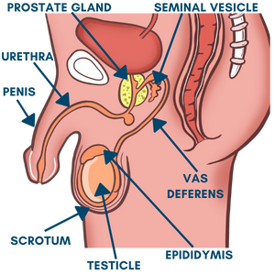
Review: Reproductive System – Person Assigned Male at Birth
There are two reproductive systems that are needed for human reproduction. For a person assigned male at birth, their reproductive system includes:
Penis, testicles, scrotum, epididymis, vas deferens, prostate gland, and seminal vesicles
Notes:
General Information
The reproductive system has organs, or genitals, that are both inside and outside the pelvis of a person assigned male at birth.
The body parts that develop may include the penis, scrotum, testicles, urethra, prostate gland, seminal vesicles, and vas deferens. They may also become more muscular, get deeper voices, grow facial and body hair, and their penis and testicles may grow larger.” (Adapted from: Region of Peel, Healthy Sexuality Program. (2011). Growing Up! A handbook on puberty and maturing.) (OPHEA – Grade 5 Lesson 1: Our Changing Bodies)

Slide 12
Reproductive System for a Person Assigned Female at Birth
Ovaries
Ovum
Fallopian Tubes
Uterus
Cervix
Vagina
Notes:
General Information
For people assigned female at birth, the body parts that develop may include the vulva, vagina, cervix, uterus, ovaries, fallopian tubes, endometrium, and clitoris.
They may also develop breasts and menstruate for the first time. An increase in weight and an increase in body fat sometimes occurs and is normal.” (Adapted from: Region of Peel, Healthy Sexuality Program. (2011). Growing Up! A handbook on puberty and maturing.) (OPHEA – Grade 5 Lesson 1: Our Changing Bodies)
Image from Shutterstock: Shutterstock_264739313 (https://www.shutterstock.com/image-vector/man-woman-reproductive-system-vector-illustration-264739313)
Reference:
Sex & U. (2022). The Human Body: Female Body. https://www.sexandu.ca/your-body/the-human-body/#tc2

Slide 13
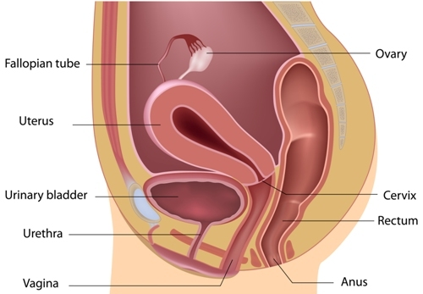
Reproductive System – Side View
Ovary
Fallopian tube
Uterus
*Urinary bladder
Cervix
*Urethra
Rectum
Vagina
Anus*
Notes:
General Information
The genitals for a person assigned female at birth include: fallopian tubes, uterus, vagina, ovaries, cervix
Teacher Prompt
Tell students to take a look at this image for a person with a vagina. On the next slide, ask students to label the internal organs for a person with a vagina. The image displayed on the next slide is a frontal view.
**If you’d prefer to show the Female Reproductive System Video that was created by our team at Niagara Region Public Health, please use the following link: https://youtu.be/UU3ctz-jan0
Image from Shutterstock: Shutterstock_126432638 (https://www.shutterstock.com/image-vector/female-reproductive-system-median-section-126432638) → Labels were created/added by a school health nurse on the team
Reference:
Sex & U. (2022). The Human Body: Female Body. https://www.sexandu.ca/your-body/the-human-body/#tc2

Slide 14
Reproductive System – Front View
Fallopian tube
Uterus
Ovary
Egg (ova)
Cervix
Vagina
Notes:
Teacher Prompt
Where do you think all of the reproductive organs go for a person with a vagina?
Using an overhead projector or smart board, ask students to try and label the image on the left-side. When finished, click the enter button on the keyboard to move forward, which will start to show the correct terms overtop of the areas on the right side image for the reproductive system for a person with a vagina.
The labels will appear in the following order: ovary, egg (ovum), fallopian tube, uterus, cervix, and vagina
Remember, this is from a frontal view.
Image from Shutterstock: Shutterstock_1525692728 (https://www.shutterstock.com/image-vector/male-female-reproductive-system-organs-realistic-1525692728) → Labels were created/added by a school health nurse on the team
Reference:
Sex & U. (2022). The Human Body: Female Body. https://www.sexandu.ca/your-body/the-human-body/#tc2

Slide 15
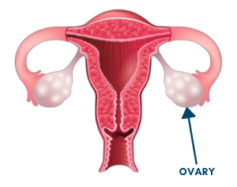
Reproductive System – Ovaries
There is one ovary on each side of the lower abdomen, beside the hip bones
The ovaries are the size and shape of an almond
The ovaries have two functions: they produce hormones (estrogen and progesterone) and they store eggs (ovum)
Notes:
General Information
Ovaries
Ovaries are the main reproductive organs of a person with a vagina/ a person assigned female at birth
One ovary on each side of the lower abdomen, size and shape of an almond
They have two functions: production of hormones and store ovum (eggs) / ova (egg)
The ovaries produce eggs (ovum). There are 2 of them, deep in the pelvis, one on each side of the uterus (womb), close to the ends of the fallopian tubes. The ovaries at birth contain all the eggs they will ever have.
Each month during ovulation, one egg matures and is released from an ovary. The egg travels down the fallopian tube toward the uterus to be fertilized.
The sex hormones for a person with a vagina are estrogen and progesterone. The ovaries are the main source of these hormones. When puberty begins, the pituitary gland in the brain signals the ovaries to make and release the estrogen and progesterone, which are necessary for reproduction.
References:
The Society of Obstetricians and Gynaecologists of Canada. (2022). Sex & U: The Human Body. https://www.sexandu.ca/your-body/the-human-body/
Canadian Cancer Society (2022). Female Sex Organs and Reproductive System. https://cancer.ca/en/cancer-information/what-is-cancer/female-sex-organs-and-reproductive-system

Slide 16
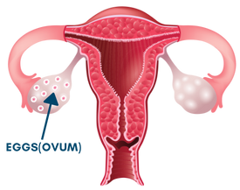
Reproductive System – Ovum (Eggs)
Inside the ovaries are ovum (also known as eggs)
These tiny eggs are about the size of a dot you make with your pencil
Even though the eggs are small, they can join with a sperm cell to become fertilized and can create a fetus
Notes:
General Information
Ovum
Also called an egg cell, much tinnier than a chicken egg, about the size of a dot that you make with your pencil or the head of a pin
Eggs are called ovum (more than one egg cell), while one egg cell is called an ova
When an egg cell joins with a sperm cell, this is called fertilization and creates a fetus. As pregnancy continues the fetus will become a baby.
A person with a vagina (person assigned female at birth) is born with a supply of about 250,000 immature ova or eggs in each ovary!
Puberty is when the process of ovulation begins. Ovulation is usually the release of one ovum, once a month.

Slide 17
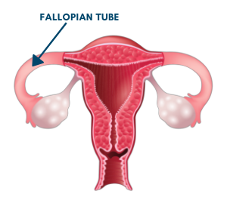
Reproductive System – Fallopian Tubes
Close to the ovaries are the fallopian tubes
When an egg is released from an ovary it travels through the fallopian tube to the uterus
The fallopian tubes connect the ovaries to the uterus
Notes:
General Information
Fallopian Tubes
Two narrow hollow tubes on either side of the uterus with a diameter about the size of strand of spaghetti
Fallopian tubes connect the ovaries to the uterus, creating a passageway for the egg to be transported from the ovaries to the uterus
If a sperm fertilizes the egg, it is at this point that pregnancy can occur
This passageway from the ovary to the uterus is about 8 – 10 cm long and is where the egg travels when released from the ovary

Slide 18
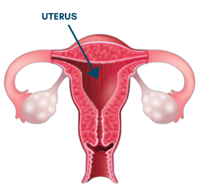
Reproductive System – Uterus
The uterus sits very low in the abdomen
It is the size and shape of a clenched fist
It forms a thick nutrient-rich lining of blood and tissue each month to get ready for pregnancy
This is where a baby grows
Notes:
General Information
Uterus
Connects all the female organs
It is very low in the abdomen, nowhere near the stomach
The uterus is the size and shape of a clenched fist
It is the place where a baby grows/develops during pregnancy
Pregnancy lasts 280 days on average, or approximately 9 months
Prepares for a pregnancy each month by forming a thick, nutrient-rich lining of blood and tissue
The uterus, is the part of the reproductive system for a person assigned female at birth where a baby grows. It is above the vagina, between the bladder and rectum
Every month, except during pregnancy or after menopause, the lining of the uterus grows and thickens in preparation for pregnancy.
The lining of the uterus is called the endometrium
During pregnancy, the uterus holds and nourishes the baby. The uterus contracts to push the baby out of the body during birth.
If you are not pregnant, every month or so the lining is shed through the cervix into the vagina and out of the body. This is called menstruation (also called a period)
Note: This topic will be discussed further in-depth in the Pregnancy PowerPoint Presentation
References:
The Society of Obstetricians and Gynaecologists of Canada. (2022). Sex & U: The Human Body. https://www.sexandu.ca/your-body/the-human-body/
Canadian Cancer Society (2022). Female Sex Organs and Reproductive System. https://cancer.ca/en/cancer-information/what-is-cancer/female-sex-organs-and-reproductive-system

Slide 19
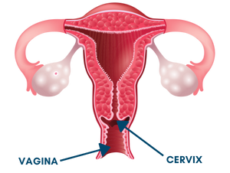
Reproductive System – Cervix
The cervix is located at the bottom of the uterus
It is the opening of the uterus located in the vagina
It opens a tiny bit each month to allow for menstrual blood to leave the body
It also opens during labour to allow for the baby to be born
Notes:
General Information
Cervix
The lower part of the uterus (or at the bottom)
The cervix connects the body of the uterus to the vagina
It also opens a tiny bit each month to allow for blood from your period to leave the body… this is referred to as menstrual blood (or a period)
It is normally in a nearly closed or collapsed state but opens/dilates to 10cm during labour to allow the baby to be born vaginally
Part of the lining of the cervix contains glands that make and release mucus. For most of the menstrual cycle and during pregnancy, the mucus is thick and stops sperm from entering the uterus.
The thick mucus also helps to protect the uterus and the upper reproductive organs from harmful bacteria.
During ovulation, the mucus changes and becomes thinner. The thinner mucus allows sperm to pass through the cervix into the uterus.
During childbirth, the cervix widens (dilates), allowing the baby to pass through the birth canal.
“The neck of the vagina”
References:
The Society of Obstetricians and Gynaecologists of Canada. (2022). Sex & U: The Human Body. https://www.sexandu.ca/your-body/the-human-body/
Canadian Cancer Society (2022). Female Sex Organs and Reproductive System. https://cancer.ca/en/cancer-information/what-is-cancer/female-sex-organs-and-reproductive-system

Slide 20
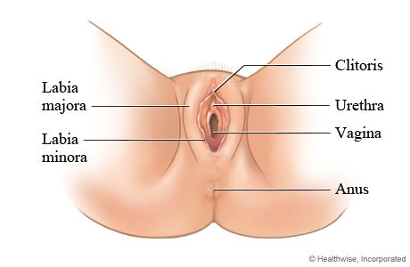
Reproductive System – External Genitals
A person assigned female at birth has three openings.
What are the names of the three openings?
Notes:
General Information
People assigned female at birth have 3 openings between their legs –
First, there is the urethra, which is the tube where urine (or pee) leaves the body. It is the opening just above the vagina. It is not part of the reproductive system, but a part of the urinary system.
Next, the vagina is the opening between the urethra and the anus. This is where a baby comes out! This is also where menstrual blood leaves the body.
Lastly, the opening at the end of the digestive tract where feces (or poop) leaves the body is called the anus. It is not part of the reproductive system, but instead is part of the digestive system.
The external genitalia for a person with a vagina include:
The opening of the vagina (also called the birth canal). The vagina is part of the reproductive tract and extends from the uterus (womb) to outside the body.
The lips, also referred to as the vulva (labia majora and labia minora) around the vagina
A small bump of tissue (clitoris) covered with a thin flap of tissue. The clitoris is the main source of sensations during sexual activity.
For a video that explains “how many holes do we have down there, and what are they for?, check out the following video from Planned Parenthood: https://youtu.be/rCnKwI5J-wc
Reference:
Healthwise Staff (2021, February 11). Government of Alberta - My Health Alberta: Female External Genitalia (Vulva). https://myhealth.alberta.ca/Health/Pages/conditions.aspx?hwid=tp9815

Slide 21
Reproductive System – Vagina
The vagina is located inside of the body
It is the passageway between the uterus and the outside of the body
It can expand to allow for the delivery of a baby
Each month, menstrual blood leaves the body from the vagina (also called “a period”)
Notes:
General Information
Vagina
A muscular tube leading from the external genitals to the cervix
Flexible passageway between uterus and outside the body
Lined with tissue called mucous membrane
The vagina is a muscular, hollow tube that extends from the vaginal opening to the uterus. Because it has muscular walls, the vagina can expand and contract. This ability to become wider or narrower allows the vagina to accommodate something as slim as a tampon and as wide as a baby. The vagina's muscular walls are lined with mucous membranes, which keeps it protected.
The vagina has nerves, blood and lymph vessels. Glands of the cervix and glands near the opening of the vagina secrete mucus to keep the vagina moist.
The vagina is a passageway that connects the cervix, which is the opening of the uterus, to the outside of the body. Similar to the cervix, the passageway is able to expand to accommodate the delivery of a baby (thus sometimes called the birth canal). The vaginal walls are usually collapsed and touch each other. The walls have many folds, which let the vagina expand during sexual intercourse or the birth of a baby.
Allows menstrual blood and lining to leave the body each month during “a period” or menstrual flow
This is where sperm can be release so it can travel towards an ovum (egg), to fertilize it and begin the process of pregnancy
The vagina has three main functions/purposes:
It provides a passageway for blood and mucosal tissue from the uterus during your monthly period. It's the route through which menstrual blood leaves the body during periods.
It is the birth canal through which a baby leaves a woman's body during childbirth
It is where the penis is inserted during sexual intercourse and holds the sperm until it passes into the uterus. This will be expanded on in the Pregnancy PowerPoint Presentation.
References:
Canadian Cancer Society (2022). Female Sex Organs and Reproductive System. https://cancer.ca/en/cancer-information/what-is-cancer/female-sex-organs-and-reproductive-system
Hirsch, L. (2019, June). Nemours TeensHealth: Female Reproductive System. https://kidshealth.org/en/teens/female-repro.html
The Society of Obstetricians and Gynaecologists of Canada. (2022). Sex & U: The Human Body. https://www.sexandu.ca/your-body/the-human-body/
Image from Shutterstock: Shutterstock_11855014 (https://www.shutterstock.com/image-vector/illustration-human-vagina-118550104) → Labels were created/added by a school health nurse on the team

Slide 22
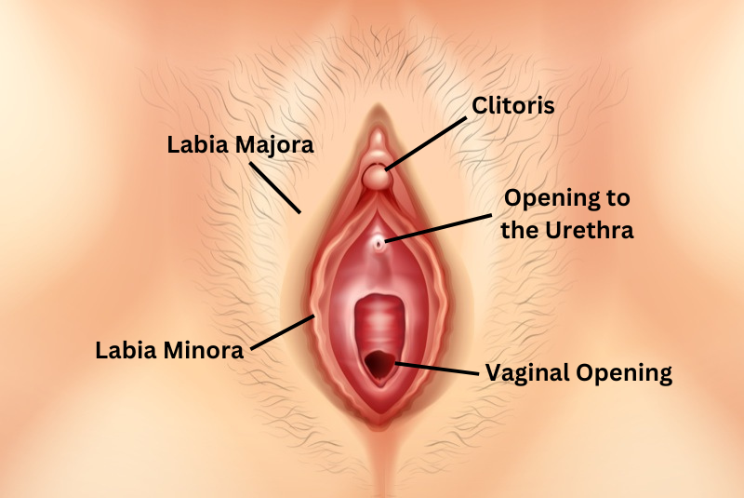
Reproductive System – Vulva
It is the visible parts of the genitals found between the legs
The vulva helps to protect the internal parts of the reproductive system
Notes:
General Information
The vulva is the visible parts of the genitals, located outside of the body, and is the area of soft skin found between a person’s legs.
The vulva comes in all shapes and sizes. The lips may not actually cover the clitoris or openings; they come in all different colours, shapes, and sizes.
There is an outer and inner fold of skin. The outer fold is called the labia majora and the inner fold is called the labia minora. These folds are meant to protect the internal reproductive organs.
The vulva protects the internal sex organs and gives sexual pleasure.
The vulva is made up of several organs:
The labias
labia majora are 2 outer skin folds that look like lips. They cover and protect the other external organs. During sexual stimulation, the labia majora may become swollen with blood.
labia minora are 2 smaller skin folds just inside the labia majora. They cover the vaginal and urethral openings.
The clitoris is a small organ in front of the labia minora. It has many nerve endings. When you are sexually stimulated, the clitoris becomes swollen and erect with blood.
The urethral opening is the opening of the urethra. The urethra is the tube that connects to the bladder and allows urine (pee) to leave the body. The urethral opening is found just under the clitoris.
The Bartholin glands are found just inside the vulva. They produce a thick fluid, which acts as a lubricant during sexual intercourse.
References:
Canadian Cancer Society (2022). Female Sex Organs and Reproductive System. https://cancer.ca/en/cancer-information/what-is-cancer/female-sex-organs-and-reproductive-system
Hirsch, L. (2019, June). Nemours TeensHealth: Female Reproductive System. https://kidshealth.org/en/teens/female-repro.html
Planned Parenthood. (n.d.). What are the parts of the female sexual anatomy? https://www.plannedparenthood.org/learn/health-and-wellness/sexual-and-reproductive-anatomy/what-are-parts-female-sexual-anatomy
The Society of Obstetricians and Gynaecologists of Canada. (2022). Sex & U: The Human Body. https://www.sexandu.ca/your-body/the-human-body/
Image from Shutterstock: Shutterstock_11855014 (https://www.shutterstock.com/image-vector/illustration-human-vagina-118550104) → Labels were created/added by a school health nurse on the team

Slide 23
Reproductive System – Clitoris
The clitoris is located outside of the body toward the front of the vulva and meets where the folds of the labia join
It is a small sensory organ
It is considered the pleasure center of the vulva
Notes:
General Information
The clitoris is an interesting body part for the reproductive system for a person with a vagina. It plays a key role in sexual pleasure.
It can be found right at the top of the vulva, where the inner labia meet and form a little hood (also known as the clitoral hood). It doesn’t have a central role in the reproduction system like a vagina, but it is just there to make a person feel good (the main source of sensations during sexual activity).
References:
Gray, J. (2021, January 20). Natural Cycles - Reproductive Health: 5 Clitoris Facts You Should Know. https://www.naturalcycles.com/cyclematters/5-facts-about-the-clitoris
Hirsch, L. (2019, June). Nemours TeensHealth: Female Reproductive System. https://kidshealth.org/en/teens/female-repro.html
Image from Shutterstock: Shutterstock_11855014 (https://www.shutterstock.com/image-vector/illustration-human-vagina-118550104) → Labels were created/added by a school health nurse on the team

Slide 24
Changes in the Reproductive System
It is normal for there to be some fluid (discharge) from the vagina. The fluid:
Can be thin and sticky
Is usually white or clear
Should not have a strong odour (smell)
Notes:
General Information
Changes during puberty in the reproductive organs for a person assigned female at birth:
Vaginal Discharge:
People with a vagina may experience vaginal discharge (or fluid) after the start of puberty
Vaginal discharge is a bodily fluid that comes from the vagina.
This might been seen on toilet paper when you wipe, or in your underwear
Vaginal discharge (or fluid) has several purposes: cleaning and moistening the vagina, and helping to prevent and fight infections.
Normal vaginal discharge (fluid) can be somewhat thin, sticky, and elastic; thick and gooey.
This will change at different times of the month and/or during a menstrual cycle
Changes in Smell
During puberty there are many types of changes that occur, including how your body looks and even the way you think it might smell. These changes are a normal part of growing up.
“Do I Smell?” – May people born with a vagina are curious to know if they smell “down there” or if people will notice when they have their period because of a smell. (Menstruation will be described further in the conception and fertilization PowerPoint).
Typically, when everything is normal and general hygiene practices are followed, no one can smell any odors coming from someone’s vagina.
If you notice an unusual smell, you should see a doctor in case of any type of infection.
Vaginal Yeast Infections
Vaginal yeast infections are common infections caused by yeast (a type of fungus).
These usually happen in warm, moist parts of the body, such as in the vaginal area.
Tips to reducing vaginal yeast infections:
Wear breathable underwear
Cotton is the best choice for underwear
Change out of wet clothes as soon as possible
Keep the area dry
When in the bathroom, wipe from front to back
Vaginal yeast infections are common in young people with a vagina, but are not an sexually transmitted infection (STI)
*Note: As the teacher, you might not want to mention STI as it is not part of the curriculum expectations until Grade 7*
Vaginal yeast infections can cause:
itching and irritation in the vagina
redness, swelling, or itching of the vulva (the folds of skin outside the vagina)
a thick, white discharge that can look like cottage cheese and is usually odorless, although it might smell like bread or yeast
pain or burning when urinating (peeing) or during sex
If you have any of these symptoms, see your doctor or gynecologist. It's easy to confuse the symptoms of a yeast infection with those of some STI and other vaginal infections. Your doctor can make sure you are treated for the right type of infection.
If you have a vaginal yeast infection, your doctor can recommend treatment to clear up the symptoms and cure the infection quickly
Tips for Hygienic Practices:
As far as periods (mensuration) and daily hygiene go, change your pad and tampons frequently, shower or bathe daily, and wear clean clothes.
Do not use any douches, wipes, or feminine sprays.
Douches, feminine sprays, deodorants, and wipes that are meant to keep a vaginal area smelling fresh and clean can actually do more harm then good!
Tampons and pads should be changed every 4-6 hours. This information will be expanded on in the Pregnancy presentatin**
Reference:
Hirsch, L. (2021, January). Nemour TeensHealth: Feeling Fresh. https://kidshealth.org/en/teens/feminine-hygiene.html#catbody-basics
Hirsch, L. (2020, June). Nemours TeensHealth: Vaginal Yeast Infections. https://kidshealth.org/en/teens/yeast-infections.html#catbody-basics
Miller, R. R. (2018, October). Nemours TeensHealth: Vaginal Discharge: What’s Normal, What’s Not
Image from Canva

Slide 25
Video: Every Body Curious - The Vulva
What is something you learned in this video that you didn’t know before?
Notes:
General Information
To access video you must be in present mode to play OR open the hyperlink in a separate Internet browser.
Video link: https://youtu.be/Mn4Ii4gAFyA
Also hyperlinked in the title.
Video Length: 15:02
The teacher should review the video before attempting to play it in their class. They can decide what parts of the video they find relevant and pertinent to share with the students.
What’s the difference between a vulva and a vagina? Is it normal to have hair on my vulva? How does a clitoris work? In this episode we explore how each vulva is unique in appearance — features such as pubic hair, labia size and symmetry, and skin colour all vary from person to person. We also learn that there’s a lot more to the clitoris than meets the eye! The kids compete in a Vulva Relay, a special guest asks a question that’s on everyone’s lips and the teens make some new discoveries about the vulva!
Special Guest: Amy Lang, MA https://birdsandbeesandkids.com/
Every Body Curious is a fun and illuminating web series for young people that explores the birds and the bees with ease in today’s digital landscape. There’s no new normal when it comes to conversations about sexuality and healthy relationships with youth, ages 9-12 – just normal and that’s what Every Body Curious aims to bring about. It's a safe setting where leading sex educators answer real questions from real kids, and open and honest conversations about sexuality, bodies and healthy relationships are encouraged.
Visit https://everybodycurious.com The Every Body Curious website is certified by the kidSAFE Seal Program. To learn more go to https://kidsafeseal.com/ We understand that not every family will interact with this content the same way, and that’s ok. Every Body Curious is for those families interested in evidence-based material to help facilitate these sorts of conversations with their kids.
Image from Canva

Slide 26
Final Activity: Anatomy Matching Game
As a class, in pairs or on your own, try to match the labels with the correct definition for the reproductive systems.
Notes:
General Information
Refer to the reproductive anatomy matching game handout in our Grade 5 Puberty and Reproductive Systems teaching tool for further instructions…
This activity can be done individually, in pairs or as a class.
The teacher can put up and display the anatomy definition cards around the room. Then the teacher will distribute the anatomy label cards to the students. Have students decide the definition under which each word belongs and then post the word under that definition.
Person assigned male anatomy → Review their choices in logical sequence (testicles, sperm, scrotum, vas deferens, seminal vesicles, prostate gland, urethra, penis) while using the male anatomy diagrams on previous slides to show the structures and explain their function.
Person assigned female anatomy → Review their choices in a logical sequence (ovaries, fallopian tubes, uterus, cervix, vagina) while using the diagrams of the female anatomy on previous slides to show the structures and explain their function including ovulation and menstruation.
Images from Canva

Slide 27
More Questions? Talk to Someone:
Parents/ Guardians
Teacher/ Principal
Doctor or Health Care Professional
School Health Nurse
Child and Youth Worker
Kids Help Phone
Notes:
Teacher Prompt:
Where or who do you reach out to if you need help or have questions regarding puberty and/or reproductive systems?
General Information
There are many people and places that you can reach out to in order to get help or ask questions about relationships and sexual health. Some types of supports include: social supports (family, friends); school supports (counselors, teachers); and community supports (school nurses, health care providers, doctors, faith leaders, kids help phone, etc.) If you ever have questions/concerns, need help or know someone who needs help, you can always talk to someone. There are many options out there available to you.
*Note: Students might reach out for puberty support through social media… Be aware that this may not always provide the most accurate information, so remind students that it is important to reach out to adults*
Among these are:
A trusted adult (such as a parent or teacher)
A health care provider (such as a doctor or nurse)
A child and youth worker
The school health nurse
The school social worker
Any of the Niagara Region Sexual Health Centres
Kids Help Phone
Services for Youth - Niagara Region, Ontario → https://www.niagararegion.ca/health/schools/youth-services.aspx
Other community resources:
Kids Help Phone: Call 1-800-668-6868 or https://kidshelpphone.ca/
Image from Canva

Slide 28
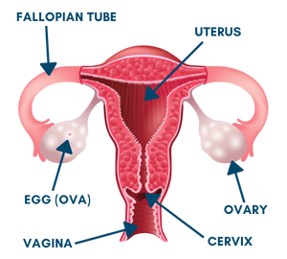
Final Thoughts
For a person assigned female at birth
The internal reproductive system includes: ovaries, eggs (ovum), fallopian tubes, uterus, cervix, and the vagina
The external reproductive system includes: vulva, clitoris, labia majora, labia minora, the vaginal opening and urethral opening
Notes:
General Information
For people assigned female at birth, the body parts that develop may include the ovaries, ovum, fallopian tubes, uterus, cervix, vagina, vulva, clitoris, labia majora, labia minora, urethral opening and vaginal opening.
For people assigned male at birth, the body parts that develop may include the testicles, scrotum, epididymis, vas deferens, seminal vesicles, prostate gland, urethra, and penis.

Slide 29
Questions?
Notes:
Ask students if they have any questions. Inform students that they will continue learning about puberty in subsequent lessons.
Optional: If a question box or envelope has been created, close the lesson by reading and responding to/discussing some of the questions submitted by students. ***It is very important to review the questions prior to reading them to the class. Do not read any questions aloud that are inappropriate. If inappropriate questions have been submitted, inform the class that if a student submitted a question that is not answered during this period, that they are welcome to discuss it directly with the teacher another time.
Image from Canva

