Slide 1
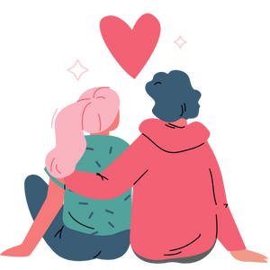
Sexual Health
Grade 7
Notes:
**The following slides (1-6) are for teacher use only**
The speaker’s notes are also intended for teacher use only. The notes include general information, background knowledge, questions and/or prompts. The information included in these notes should not be read word for word. Teacher’s should review the notes before using the presentation to become familiar with the content, as it is to supplement what is on the slide.
Image from Canva
Last Updated: January 2023

Slide 2
Land Acknowledgement
Notes:
Niagara Region is situated on treaty land. This land is steeped in the rich history of the First Nations such as the Hatiwendaronk (Hat-i-wen-DA-ronk), the Haudenosaunee (Hoe-den-no-SHOW-nee), and the Anishinaabe (Ah-nish-ih-NAH-bey), including the Mississauga's of the Credit First Nation. There are many First Nations, Métis, and Inuit peoples from across Turtle Island that live and work in Niagara today. The Regional Municipality of Niagara stands with all Indigenous peoples, past and present, in promoting the wise stewardship of the lands on which we live.
*Disclaimer: In the Spirit of Truth and Reconciliation, Niagara Region Public Health acknowledges that people are gathered on the customary and traditional lands of the Indigenous Peoples of this territory. We recognize that the land on which you are situated will vary depending on where you are located in Ontario. It is advised that you reach out to your school’s principal or school board for the school-specific treaty land. If you have already done a land acknowledgement on the same day you are presenting this lesson, you are welcome to skip this slide. However, it is always encouraged to complete a land acknowledgement before continuing on with this presentation.*
Information about the image on the left:
There are seven objects that have been purposely selected and included in the design of the artwork: an Inukshuk, an eagle feather, two drums, a Métis sash, an embroidered flower, and wampum belt. Each object reflects the diversity of First Nations, Métis and Inuit in North America. The iconic stone monument, the Inukshuk, is used as a marker identifying important sites and as a navigational tool to communicate direction. The eagle feather is significant to the spiritual beliefs of some Métis and First Nations peoples. Its symbolism includes honour, wisdom, and courage among many others. It is considered an honour to be given an eagle feather. The two drums include the Inuit drum and the Métis and First Nations drum. The drum is symbolic of the heartbeat of Mother Earth and is often played at various traditional gatherings and ceremonies. The embroidered flower is woven into many traditional garments and various objects through beadwork, painting, or etchings. It is also considered one of Canada’s first art forms. The Métis sash was once a tool of the voyageurs and fur traders. It is also a symbol of knowledge and the relationship between the Métis, the First Nations, and Europeans. At the top of the poster are four lines reminiscent of the traditional beaded wampum belt. There are many types of wampum belts with different significant meanings, including agreements made between two groups/nations, knowledge sharing, and storytelling. The four lines in this wampum belt represent the equality and diversity of the four peoples (First Nations, Metis, Inuit, and European settlers) and to acknowledge the journey of living together peacefully (ETFO, 2022).
For more information on Indigenous Education and First Nations, Metis and Inuit (FNMI), check out the following resources:
https://www.otffeo.on.ca/en/learning/indigenous-education
https://www.etfo.ca/socialjusticeunion/first-nation,-metis-and-inuit-(fnmi)
Photo References:
Image on the Left: Elementary Teacher Federation of Ontario (ETFO). (2022). ETFO Land Acnowledgements. https://www.etfo.ca/about-us/governance/etfo-land-acknowledgement
Image on the Right: Creating Our Way Forward: Recommendations for Improving Niagara Region Public Health & Emergency Services’ Indigenous Engagement (2019). https://www.niagararegion.ca/health/equity/pdf/indigenous-engagement-report.pdf
Mural of Turtle Island → Cover photo: Oneida nation artist, Sharon Sarnowski (deceased) This is a picture taken of the mural in the Boardroom of the Oneida Tribal Council office, Oneida, Wisconsin.

Slide 3
Presentation Format
Guiding Questions: Big idea questions that students can brainstorm and share previous knowledge or new information with.
Think, Pair, Share: Opportunity for students to work with partner or group and share ideas based on a prompt.
Notes:
Images from Canva

Slide 4
Presentation Format
Videos: Students can watch a short video clip that connects with topic. Discussion can follow before or after videos.
Final Activity: Activity that concludes the presentation.
Notes:
Images from Canva

Slide 5
Curriculum Expectations – Grade 7
D1.3 explain the importance of having a shared understanding with a partner about the following: delaying sexual activity until they are older; the reasons for not engaging in sexual activity; the concept of consent; the legal age of consent, and how consent is communicated; and in general, the need to communicate clearly with each other when making decisions about sexual activity in a healthy, loving relationship.
Notes:
Image from Canva

Slide 6
Curriculum Expectations Continued – Grade 7
D2.4 demonstrate an understanding of physical, emotional, social and cognitive factors that need to be considered when making decisions related to sexual health.
D3.3 explain how relationships with others and sexual health may be affected by the physical and emotional changes associated with puberty.
Notes:
Image from Canva

Slide 7
Sexual Health
Grade 7
Notes:
The presentation begins here.
Disclaimer (Trigger Warning): Before starting a classroom conversation, be aware that some students may have experienced situations related to the topic, either directly or indirectly, in the past or present.
Image from Canva

Slide 8
Learning Objectives
At the end of this presentation, you will understand factors needed to make decisions related to sexual health. You will also:
Understand how changes that happen during puberty might affect your relationships with others
Learn the importance of delaying sexual activity until you are older
Understand that everyone is on their own journey. The decisions you make about your sexual health may be different from your peers and occur at different times and that is okay!
Notes:
General Information
The information we are going to talk about today is important for many reasons.
We want to ensure that you learn that everyone is unique and the things that make you unique is what makes you interesting and special.
We want you to feel good about your body, how it is changing, and how you approach different types of relationships you may have with people.
It is important that everyone feels safe, accepted and included at school and understand that differences are ok. This will help to reduce bullying and feelings of loneliness or isolation.
Background Knowledge
Students will learn and understand about themselves and their bodies as they grow and mature
Students need to understand that everyone has different qualities that make up their self-concept; this makes them unique
There needs to be an emphasis on feeling safe, included and accepted in the school community
Empathetic towards others…

Slide 9
Making Decisions About Your Health
Notes:
General Information
When it comes to your health, there are many decisions you will have to make throughout your life as you mature and grow. Making decisions about your health is important because sexual health can impact your well-being. Also, taking care of your sexual health today will be important for your overall health and wellness in the future. You have the right to access sexual health care services that are free of discrimination and are respectful to you as a young person.
When deciding what is best for you and your health, you should understand and be well informed about the choices available. It is important that information comes from a trusted source that is current and accurate.
There is a lot of good information available on the internet and social media, but there can be misinformation as well. This is why we recommend talking to a trusted adult, as they can offer information to help you make the best decisions for you and your health.

Slide 10
Feelings about Sexual Health
It’s Okay…
To feel embarrassed or uncomfortable
To ask questions
To not already know about this
To learn about sexual health
Notes:
General Information
Things to remember…
4 Okay’s
Today we’re going to be talking about what makes us different, and what makes us the same. We understand that for some of you, this may be the first time you’re learning about this topic, and for others this may be something you know a lot about. It may feel uncomfortable to talk about sexual health with your parents or friends, but it’s important we all understand sexual health so we can make safe decisions.
So let’s review the 4 OK’s. It is perfectly OK:
It’s okay if you feel embarrassed or uncomfortable. The only way for us to overcome this uncomfortable feeling is to learn and grow. We can often feel uncomfortable about things we don’t fully understand. But if we take the time to learn about a topic and understand it, we become more educated and comfortable, which creates a supportive environment for everyone!
It’s okay to be curious and to ask questions.
It’s okay if you don’t know this information already. We’re all going to learn this together.
And… It is okay for us to know about sexual health and each other’s experiences.
Images from Canva

Slide 11
Before We Begin…
We need to remember to:
Respect each other
Use inclusive language
Use correct terms for sexual health
Respect personal boundaries
Notes:
Background Knowledge
**Important** The language of “boys” and “girls” or “male” and “female” is gender interpreted and often assigned based on a person’s biological sex at birth. It excludes individuals who are intersexed and/or whose gender identity does not align with their assigned biological sex. It is more accurate to talk about anatomy rather than gender and use “bodies with” or “people with” language when referring to developments and changes in puberty. Using this language supports an inclusive classroom in which diversity is recognized and provides a strong model to help students understand that bodies are unique, come in all shapes, sizes, types, and all bodies are good bodies.
Image from Canva

Slide 12
Guiding Question #1
What is health?
What does being healthy mean to you?
Notes:
Teacher prompts
“What does the term health mean to you? What does being healthy mean to you?”
Ask students to write their own definitions of health and then turn to their elbow part to share. After a few minutes, bring students back and ask for them to share their definition with the larger group.
Image from Canva

Slide 13
What is Health?
Health includes your physical, mental and social well-being
Physical is about the body
Mental is about how people think and feel
Social is how people interact with other people
To be healthy, it is important to eat a variety of foods with nutrients and be active
To be healthy also means to not be sick
Notes:
General Information
Health is a state of physical, mental, intellectual, social and emotional well-being and not merely the absence of disease or infirmity.
In order for the body to function properly, it needs nutrients. Nutrients are provided by food in the form of proteins, carbohydrates, fats, minerals, vitamins, and water. For more information about food and nutrient recommendations, check out Canada’s food guide: https://food-guide.canada.ca/en/
Exercise/activity/physical fitness helps the body stay healthy by being active. Physical fitness strengthens the heart and other muscles. Remind students that being active involves many different types of physical activities, it doesn’t always have to be working out or high intensity training. It can be in the form of walking, biking or rolling to school, going for a hike, swimming, canoeing, kayaking, paddle boarding, etc.
Reference:
Britannica Kids (n.d.). Healthy living. https://kids.britannica.com/kids/article/healthy-living/609707#:~:text=To%20be%20healthy%20means%20to,minerals%2C%20vitamins%2C%20and%20water.
Kiddle (n.d.). Kids Encyclopedia Facts: Health facts for kids. https://kids.kiddle.co/Health

Slide 14
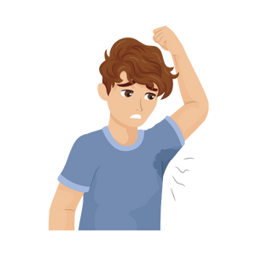
Physical Changes
Physical:
You may become more aware of your body and how it changes as you go through puberty
You may begin to notice physical changes
Erections may happen
Menstruation (periods) begins
Notes:
Background Knowledge
Students will experience physical changes while growing up and going through puberty (already discussed in Grade 4 and 5).
Sexually, students main attachments are still often with those of the same sex (friends/peers); however, they may begin developing feelings and emotions for others. Also, they may masturbate, sometimes for pleasure (i.e., to orgasm).
Physical
Become more aware of their body as they enter puberty.
Begin to notice the physical changes of puberty (e.g., the penis grows, breasts develop, and pubic hair appears).
For example, some people might have nocturnal emissions (wet dreams)
May gain weight before they start to grow taller.
May have a growth spurt (starting at about 11 years in females and about 13 years in males). This period of fast growth usually starts just before or during puberty.
May begin to menstruate (usually 2 to 2½ years after the breasts begin to grow). Menstruation is a sign a pregnancy can happen.
Begin to sweat more so may have body odour.
Reference:
Teaching Sexual Health (n.d.). 10, 11 and 12 Year Olds - Understanding Your Child’s Development. https://teachingsexualhealth.ca/parents/information-by-age/10-11-and-12-year-olds/
Image from Canva

Slide 15
Changes of the Brain
Mental (Thinking):
You might have feelings about the changes that are happening in your body
As you get older, you will learn to understand how certain actions have consequences
You may start to question why and how things are happening to you
Notes:
Background Knowledge
Students will experience changes to their brain while growing up and going through puberty (already discussed in Grade 4 and 5).
Learning & Thinking (Cognitive/ Mental)
Students need to understand that their actions may have consequences related to sexual health
Students might feel guilty, confused or embarrassed about changes during puberty. They may talk less, which can mean they don’t get the support they need
Kids will have a variety of feelings when this is happening, and some might be positive, while others might experience negative feelings during these changes.
Kids will have lots of questions and often need to understand the rationale and reasoning behind the answers more than when they were younger
Kids will start to question why and how things are happening to them:
For example: Parents may ask you to shower more and when you were younger you usually asked “well why”. Parents would usually tell you “because I said so”. Now, parents will usually explain that it is for hygiene purposes and being clean as you go through the changes during puberty.
Reference:
Teaching Sexual Health (n.d.). 10, 11 and 12 Year Olds - Understanding Your Child’s Development. https://teachingsexualhealth.ca/parents/information-by-age/10-11-and-12-year-olds/
Image from Canva

Slide 16
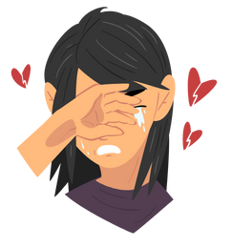
Emotional Growth
Emotional:
You may continue to develop personal beliefs and values
You may become more sensitive to emotions and may understand emotions better
You may feel intense, strong feelings like fear, frustration and rejection
You will learn how to respond to the feelings of people around you
Notes:
Background Knowledge
Students will experience emotional changes while growing up and going through puberty (already discussed in Grade 4 and 5).
You might have deeper connections and more feelings because of continual brain development and the hormones that are being activated during puberty.
Your brain is learning how to better express and control emotions while you are a teen, so there may be times when you may feel more self conscious.
Emotional
Continue to develop their personal values, and leadership skills.
Show that they understand how others feel (empathy).
Learn to express their ideas and thoughts in a better way – starting to handle emotions like fear, frustration and rejection better.
Start to define themselves through things like their environment, friends, clothes, culture, and TV.
Learning to accept and value other points of view.
Continue to become more independent, such as often given more responsibility around the home
Reference:
Teaching Sexual Health (n.d.). 10, 11 and 12 Year Olds - Understanding Your Child’s Development. https://teachingsexualhealth.ca/parents/information-by-age/10-11-and-12-year-olds/
Image from Canva

Slide 17
Social Growth
Social:
You may start to form stronger relationships and friendships
You might be influenced by friends and feel more peer pressures
You will learn to value differences in your friendships
You may look for new experiences and become more independent
Notes:
Background Knowledge
Students will experience social changes while growing up and going through puberty (already discussed in Grade 4 and 5).
Social
Kids will start to form stronger and more complex friendships and peer relationships
Kids are starting to feel more peer pressures and will likely be influenced by their friends
Kids will learn that friends can have different ideas, practices and beliefs and still be their friend
Friends and children around them have more influence on their self-image
You will search out new experiences, but be careful, as you are developing better impulse control as you grow up
You will likely want to be more independent, which may affect your decisions and change some relationships
Reference:
Teaching Sexual Health (n.d.). 10, 11 and 12 Year Olds - Understanding Your Child’s Development. https://teachingsexualhealth.ca/parents/information-by-age/10-11-and-12-year-olds/
Image from Canva

Slide 18
Guiding Question #2
What does the term sexual health mean to you?
Why do you think it important to talk about sexual health?
Notes:
General Information
Over the next few classes we will be discussing sexual health, sexual activity, and sexual relationships.
Teacher prompts:
When we talk about sexual health, what does that mean? Why do you think it is important to talk about sexual health?
From healthy relationships to healthy behaviours and attitudes, understanding your sexual health is an important part of your overall well-being.
Sexual health isn’t just about preventing sexually transmitted infections. It’s about being aware of your body, and your overall health. It’s also about making the right decisions, and having respect for others.
Understanding your sexual health is an important part of your well-being. It also involves taking a positive and respectful approach to sexuality and sexual relationships. That includes being in control of your body, feeling empowered to make your own choices, and never being pressured - so you can have satisfying and safe sexual experiences.
Sexual health includes sexuality, sexual activity(ies), as we all physical, mental, and spiritual health.
Additional Activity (Optional):
Write the words “physical”, “emotional”, “social”, and “psychological” on the board. Share with students that when making decisions related to sexual health, they need to consider whether the factors they listed above affect their physical, emotional, social, and/or psychological well-being. Consider brainstorming definitions for each of these headers as a class, posting the definitions on chart paper for reference throughout the lesson.
Reference:
OPHEA (n.d.). Sexual Health and Safety. https://teachingtools.ophea.net/lesson-plans/hpe/grade-8/understanding-healthy-development/sexual-health-and-safety
Sexual Health Ontario (n.d.). Sexual health and you. https://sexualhealthontario.ca/en/sexual-health
Image from Canva

Slide 19
What is Sexual Health?
Sexual health is a big part of life. It can affect and is affected by other aspects of health. This includes physical, mental, emotional, and social health.
To be in good sexual health means you are well informed, careful, and respectful to yourself and others.
Embrace your sexuality in a way that makes you feel safe and comfortable.
Notes:
General Information
Sexual health is influenced by many factors. Sexual health includes your physical, mental, emotional, social and spiritual wellbeing. Traditional knowledge and values support healthy sexuality, healthy relationships, identity, adulthood, and rites of passage. These values and traditions also help keep people and communities healthy and strong.
There are times when relationships with others and sexual health may be affected by the physical and emotional changes associated with puberty. Changes at puberty may include: physical changes (e.g., voice changes, body growth), emotional changes (e.g., increased intense feelings, new interest in relationships, confusion and questions about changes), and social changes (e.g., changing social relationships, increasing influence of peers).
Sexual health includes having a positive approach to sexuality and sexual relationship. Sexual health is having safe sexual experiences with consent and without violence, coercion or discrimination.
Background Knowledge (Definition for Educator):
Sexual Health → “A state of physical, emotional, mental, and social well-being in relation to sexuality; it is not merely the absence of disease, dysfunction, or infirmity. Sexual health requires a positive and respectful approach to sexuality and sexual relationships, as well as the possibility of having pleasurable and safe sexual experiences, free of coercion, discrimination, and violence. For sexual health to be attained and maintained, the sexual rights of all persons must be respected, protected, and fulfilled. Sexual health is influenced by a complex web of factors ranging from sexual behaviours, attitudes, and societal factors to biological risk and genetic predispositions. (Health and Physical Education, 2019, p. 313).
Sexual health is defined as “…a state of physical, emotional, mental and social well-being in relation to sexuality; it is not merely the absence of disease, dysfunction or infirmity. Sexual health requires a positive and respectful approach to sexuality and sexual relationships, as well as the possibility of having pleasurable and safe sexual experiences, free of coercion, discrimination and violence. For sexual health to be attained and maintained, the sexual rights of all persons must be respected, protected and fulfilled.” (WHO, 2006a)
“Sexual activity” refers to all types of sexual activity including genital-on-genital contact, vaginal and anal intercourse, and oral-genital contact.
Could also include sexual petting, body on body contact, and/or physical sexual contact.
References:
Family Doctors - American Academy of Family Physicians (2020, June 17). Importance of Sexual Health. https://familydoctor.org/importance-of-sexual-health/
First Nations Health Authority (FNHA). (2021, Feb 08). Youth-friendly sexual health care: know your rights! https://www.fnha.ca/about/news-and-events/news/youth-friendly-sexual-health-care-know-your-rights
World Health Organization (WHO). (n.d.). Health topics: Sexual health. https://www.who.int/health-topics/sexual-health#tab=tab_2

Slide 20
Positive and Safe Sexual Health Experiences
Educate yourself, ask questions and make informed decisions
Practice safe sex by learning how to protect yourself against STIs
Respect yourself and respect the choices of others; don’t judge
Understand the importance of consent and seek help if you are being forced into sexual activity
It is important to talk to your partner about sexual limits and boundaries
Notes:
General Information
Sexual health should be maintained as you would any other aspect of your health. Consider the following:
Educate yourself, ask questions and make informed decisions
Learn how to protect yourself against infections; Practice safer sex
Respect yourself and respect the choices of others; don't judge;
Understand the importance of consent
Seek help if you are being forced into sexual activity
Have regular medical check-ups and, if you're a woman, pap smears
Find out if you are at risk for sexually transmitted infections and get tested
Stay current with new knowledge and research (for health professionals)
References:
World Health Organization (WHO). (n.d.). Health topics: Sexual health. https://www.who.int/health-topics/sexual-health#tab=tab_2

Slide 21
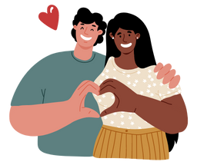
Types of Sexual Activities
Touching
Kissing
Masturbation
Oral Sex
Anal Sex
Sexual Intercourse
Notes:
General Information
People will define “sex” in different ways. The word ‘sex’ is used to distinguish between male and female biological sex, as described in the section your body (http://www.sexandu.ca/your-body/), but also describes any type of sexual activity that you have with yourself or with other people.
Here are some types of sex and sexual activities:
Touching: Touching becomes a sexual activity if it involves touching or fondling the breasts, buttocks, anus, or genitals of another person. Touching yourself in any of these ways to arouse sexual feelings is called masturbation.
Kissing: Small kisses on the cheek or hand and even pecks on the mouth may be normal to exchange between family and friends, and are not usually considered sexual. But longer kissing on the mouth and other intimate parts of the body, including the neck, chest, abdomen, and genitals is considered sexual activity.
Masturbation: For many people, masturbation is their first sexual activity. This involves touching yourself through stimulation of your breasts, buttocks, anus, or genitals. Sex toys are sometimes used to enhance masturbation.
Sexual intercourse: Sexual intercourse is the penetration of a penis into the vagina, also known as “vaginal sex” or “sex”. Fingers or sex toys can also be used to penetrate the vagina for sexual pleasure.
Oral sex: Using your mouth or tongue to stimulate another person’s genitals is considered sex.
Oral sex does pose a risk of contracting sexually transmitted infections.
Anal sex: Anal sex involves penetration of the penis into the anus.
Anal sexual activity can also involve using the fingers or sex toys to penetrate the anus for sexual pleasure. Some people find anal sex very pleasurable, and some people do not enjoy it, maybe even finding it to be very painful. It’s important to communicate to your partner whether you feel comfortable with anal sex or not.
When engaging in any of these activities, they can all take place with another individual. However, it is important to make sure both partners have consented to the activities before they take place.
Just because there is no risk or low risk of pregnancy, it doesn’t mean it is not sex (Anal sex is still sex; Oral sex is still sex)
Reference:
Sex & U. (2022). STIs. https://www.sexandu.ca/stis/
Sex & U. (2022). Sexual Activity: What is Sex? https://www.sexandu.ca/sexual-activity/what-is-sex/

Slide 22
Think, Pair, Share
What does the term consent mean to you?
Why do you think consent is important?
Notes:
Teacher prompt:
“Being in a committed relationship with someone and making decisions together includes having a good understanding of the concept of consent. Do you know what consent means? Why is consent so important? What is sexual consent?”
Definition: The voluntary agreement (to engage in the sexual activity in question)
Highlight for students that consent is continuous. You can change your mind or stop at any time. Consenting at one place and time does not necessarily mean consent remains in another place or time. Consent is a “whole body” agreement that is verbal, physical, and emotional, and it only happens without manipulation or threats. More than just a verbal “yes” or “no”, consent involves paying attention to other individuals involved and checking in with physical and emotional cues. Only “yes” means yes – and yes should come from an engaged and enthusiastic partner. Emphasize explicitly that all partners have a role/responsibility.
Sexual consent is defined in Canada’s Criminal Code in s. 273.1(1), as the voluntary agreement to engage in the sexual activity in question. Consent means partners agree to the sexual activity; everyone understands what they are engaging to; and all parties affirmatively communicate their enthusiasm, whether through words or conduct. Silence or passivity does not equal consent.
Consent and respectful behaviour is an important part of relationship skills
Reference:
OPHEA (n.d.). Sexual Health and Safety. https://teachingtools.ophea.net/lesson-plans/hpe/grade-8/understanding-healthy-development/sexual-health-and-safety
Image from Canva

Slide 23
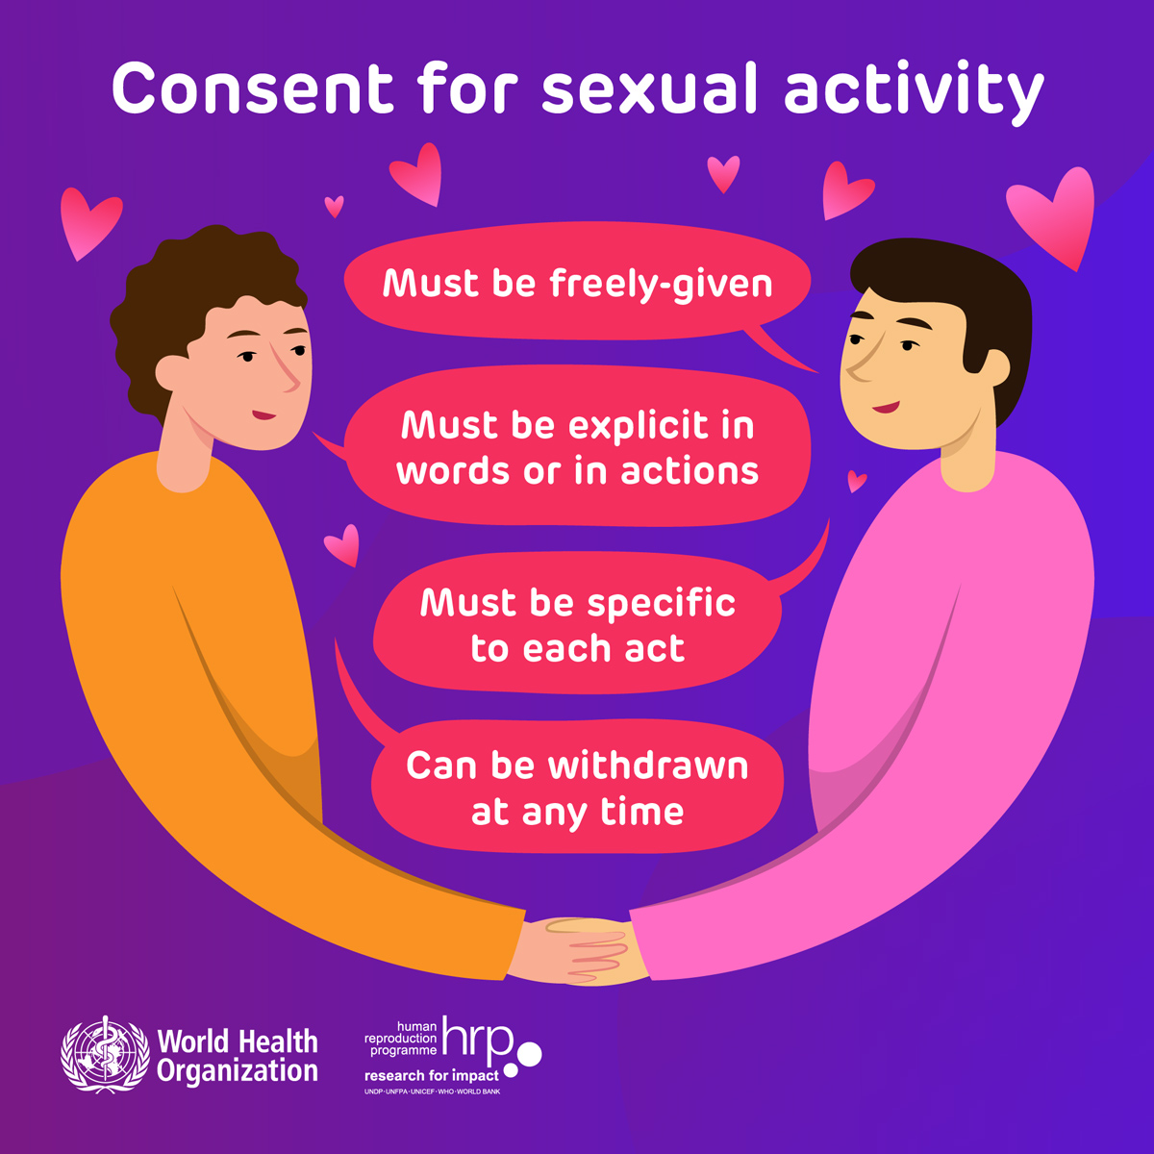
What is Consent?
Consent…
Is giving permission to another person
Is given verbally and freely, never forced
Cannot be given in advance
Is required for all types of sexual activities
Notes:
*Note: Reminder that this presentation is related to sexual health. So in this case, when talking about consent it is sexual consent.
General Information
Consent means giving permission for something to happen or entering into agreement to do something. The person initiating sexual activity needs to take reasonable steps to establish consent and seek it actively during sexual activity.
Consent for any act, including kissing, sexual acts (intimacy or sexual intercourse) must be freely given
Consent cannot be given by someone who is intoxicated, unconscious or otherwise incapable of giving consent
Consent cannot be given in advance and can be withdrawn at any time
Consent is legally required for all sexual acts, including sexual touching, intercourse, etc.
The absence of no does not mean yes!
FRIES Acronym for Consent:
F: freely given
All partners have the freedom to say yes or no without pressure, force, or manipulation
R: reversible
Anyone can change their mind and ask to stop, even if in the middle of the sexual act
I: informed
All partners need to know exactly what they are consenting to, every time
E: enthusiastic
All partners should be engaged an excited
If not stop immediately
S: specific
Each act requires consent, even if it was done before
References:
Government of Alberta (n.d.). Sexual Violence prevention – Sexual consent. https://www.alberta.ca/sexual-violence-prevention-sexual-consent.aspx
Image from World Health Organization (WHO). (2022, February 13). Multimedia item: Consent for sexual activity must be freely-given. https://www.who.int/multi-media/details/consent-for-sexual-activity-must-be-freely-given

Slide 24
All About Consent
When do we need to ask for consent?
Borrowing items/objects
Giving hugs
Kissing
Touching another person
Notes:
Other Possible Answers:
Sharing Secrets
Image from Canva

Slide 25
Communicating Consent
What does consent sound like?
“Yes”
“Sure!”
“Yes please”
Just because someone doesn’t say no, doesn’t mean they are saying yes!
Notes:
General Information
When giving consent (permission), the answer should and must always sounds positive and enthusiastic.
Remember:
Consent must be freely-given
It must be explicit in words or in actions
It must be specific to each act
It can be withdrawn at any time
Consent is feeling…
Willing
Certain
Comfortable
Sober
Informed
Respected
Consent is not feeling…
Pressured
Confused
Scared
Drunk or High
Ignored
Disrespected
Photo Reference:
Royal Canadian Mounted Police (2018, July 23). Brochure: Respect Sexual Consent. https://www.rcmp-grc.gc.ca/en/brochure-respect-sexual-consent
World Health Organization (WHO). (2022, February 13). Multimedia item: Consent for sexual activity must be freely-given. https://www.who.int/multi-media/details/consent-for-sexual-activity-must-be-freely-given

Slide 26
What to Say…
Here are ways to say that you do not give consent:
“No” or “No thank you”
“I don’t feel like it right now”
“Maybe another time”
“I don’t like that” or “I don’t want that”
Notes:
General Information
Sometimes people will also say:
“Nah, I’m good right now”
“Maybe ask me again later”
Image from Canva

Slide 27
Videos: Cycling Through Consent
Questions to keep in mind while watching:
What does consent sound like?
What does consent look like?
What does consent not look like?
Notes:
*Note: The teacher can decide which video they want to play for their class. On the slide there is the cycling through consent. Depending on the class profile, the teacher might find one video more applicable and/or relevant, as well as appropriate compared to the other.
To access video you must be in present mode to play OR open the hyperlink in a separate Internet browser.
Video links:
First Video: Cycling Through Consent https://youtu.be/-JwlKjRaUaw
Second Video: Tea – Consent https://youtu.be/fGoWLWS4-kU
Also hyperlinked in the title.
The following videos will discuss the importance of consent in relationships.
Background Knowledge
First Video (on slide) – Cycling Through Consent:
"Only 1 in 3 Canadians fully understand what sexual consent is." So let's talk about it. This animated video takes on a fun and simple approach to looking at consent; exploring what consent is and what it does and does not look like. Everyone should understand consent, so share this video and start the conversation.
Second Video (in speaker’s notes) – Consent is Tea:
The tea video has been popular and well received the past few years.
You can supplement the videos with the following OPHEA Activity: https://teachingtools.ophea.net/activities/ideas-action/consent-tea-party?parent=growth-and-development&activities=&connected-community
Image from Canva

Slide 28
Age of Sexual Consent
In Canada, the legal age of consent is 16 years of age
Exceptions:
A 12 or 13 year old can consent with a partner only if the partner is less than 2 years older
A 14 or 15 year old can consent with a partner only if the partner is less than 5 years older
Notes:
The legal age of consent in Canada is 16 years old.
Exceptions: Persons under 16 years can have consensual sex with someone close in age.
12-13 year olds (two-year age difference)
14-15 year olds (five-year age difference)
These exceptions only apply if the older person is not in a position of authority or trust and there is no exploitation or dependency.
Examples of people in a position of authority or trust:
Coach/ Athletic Trainers
Teacher
Pastors/Minister
Friends parents
Friends older siblings
Older cousins
Aunts/uncles
Although these are the legal ages of consent, it is important to delay sexual activity until you are older, and feel physically and emotionally ready and mature, as well as understand the risks associated with sexual activity (i.e., STIs, unplanned pregnancy)
Background Knowledge
Close in age exceptions (More detailed)
A 14 or 15 year old can consent to sexual activity as long as the partner is less than five years older and there is no relationship of trust, authority or dependency or any other exploitation of the young person. This means that if the partner is 5 years or older than the 14 or 15 year old, any sexual activity is a criminal offence.
There is also a "close in age" exception for 12 and 13 year olds. A 12 or 13 year old can consent to sexual activity with a partner as long as the partner is less than two years older and there is no relationship of trust, authority or dependency or any other exploitation of the young person. This means that if the partner is 2 years or older than the 12 or 13 year old, any sexual activity is a criminal offence.
References:
Government of Alberta (n.d.). Sexual Violence prevention – Sexual consent. https://www.alberta.ca/sexual-violence-prevention-sexual-consent.aspx
Government of Ontario (2017, August 08). Age of Consent to Sexual Activity. https://www.justice.gc.ca/eng/rp-pr/other-autre/clp/faq.html
Royal Canadian Mounted Police (2018, July 23). Brochure: Respect Sexual Consent. https://www.rcmp-grc.gc.ca/en/brochure-respect-sexual-consent

Slide 29
Think, Pair, Share
With a partner, do you agree, disagree or are you unsure with the following statements?
You need to learn about sexual health before engaging in sexual activity
Family or religion can change how you think about sexual health
Some types of sexual activity have more risks than others
Grade 7 is the right age to start dating
Notes:
Teacher Prompt
Refer to the following additional questions to also ask your students:
You need to learn about sexual health before engaging in sexual activity
Family values or religious beliefs might influence how you think about sexual activity/ sexual health
Some types of sexual activity have more risks than other types.
Grade 7 is the right age to start dating.
If someone doesn’t like you, there are things you can do to make them change their mind and you should persist until they feel the same way.
A person should not have sex if their partner is unsure.
Oral-genital contact is not “having sex”.
If someone agrees to engage in sexual activity, but passes out, it is OK to still engage in sexual activity with them.
Religious beliefs should influence how you think about sexual activity.
People don’t need a vaccination for HPV if they are not sexually active.
People of all gender identities and sexual orientations need to learn how to stay safe and healthy in relationships.
Activity adapted from: OPHEA (n.d.). Making Informed Choices about Sexual Health. https://teachingtools.ophea.net/lesson-plans/hpe/grade-7/understanding-sexual-health-and-decision-making/making-informed-choices-about-sexual-health
Image from Canva

Slide 30
Pressures Around Sexual Activity
People might feel pressures around sexual activity.
A person should not feel they need to have sex to please their partner or be accepted by peers
A person might feel pressure when peers are engaging in sexual activity
Not wanting to engage in sexual activity is okay and normal
Notes:
General Information
Pressures Around Sexual Activity:
Remind Students:
“People should not feel that they need to engage in sexual acts in order to please their partner or to gain social acceptance. A person should not have sex if they are feeling pressured, if they are unsure, if they are under the influence of drugs or alcohol, or if their partner is not ready or has not given consent. It is also important to remember that a person is free to change their mind about any type of activity at any time, and that their boundaries must be respected.”
There are times when pressures will exist for some people who are not engaging in sexual activity, but their friends are because there is this fear of missing out (I.e., FOMO)
Not wanting to engage in sexual activity because of the risks of STIs or pregnancy is alright, it’s okay and allowed, and normal. Most of your peers around you are not engaging in sex, even if it might seem like they are.

Slide 31
Relationship with Self
Before entering into a relationship with others, it is important to…
Take responsibility for your own actions
Accept the choices you make
Practice positive sexual health
Know the risks when engaging in sexual activity
Understand the consequences of your actions
Recognize feelings of peer pressure to become sexually active
Notes:
General Information
Relationship with Self:
Appreciates your own body:
understands changes that happen during puberty, and views them as normal
practices positive health-promoting behaviors, such as abstinence from alcohol and other drugs, and getting regular check-ups
Takes responsibility for their own actions/behaviours:
accept the choices that they make regarding sexual health
identifies own values and acts on those values
understands the consequences of their actions
understands that media messages can create unrealistic expectations related to sexuality and intimate relationships
This could be a good place to discuss sexually explicit media and/or portrayals of relationships in the media and of casual sexual relationships/encounters. However, sexually explicit media should have been covered in Grade 6. Overall this is up to the teacher’s discretion.
is able to tell the difference between personal desires from that of their peer group
understands how alcohol and drugs can affect making decisions
Knows about sexual health issues:
understands the consequences of sexual behaviors/ sexual decisions
makes decisions about masturbation that fits with personal values
makes decisions about sexual behaviors with a partner that fits with personal values
understands their own gender identity and sexual orientation
understands the effect of gender role stereotypes and makes choices about the best roles for themselves
understands peer and cultural pressure to become sexually involved
accepts people with different values and experiences
Teacher Prompt
“Thinking about your sexual health is important. It’s important to have a good understanding of yourself before you get involved with someone else. It’s not just about making a decision to have sex or waiting until you are older. It’s also about things like your physical and emotional readiness; having safer sex and avoiding consequences such as becoming a parent before you want to or contracting an STBBI; your sexual orientation and gender identity; your understanding of your own body, including what gives you pleasure; and the emotional implications of sexual intimacy or being in a relationship. Some people can experience anxiety and a range of other emotions after the breakup of a relationship that has had strong physical and emotional components. People can seek help or counselling if they feel that they are caught in a cycle of unhealthy relationships. Thinking about your sexual health can also include thinking about religious, cultural, or spiritual beliefs. Moral and ethical considerations are involved as well, including the need to respect the rights of other people. Can you explain what is meant by a moral consideration?”
Student: “A moral consideration is what you believe is right or wrong. It can be influenced by your personal, family, religious, cultural, or spiritual values. Every person in our society should treat other people fairly and with respect. It is important to take this into account when we think about our relationships, sexual behaviour, and activities.”
Reference:
Teaching Sexual Health (n.d.). Sexual Decision Making – Relationship with Self. https://teachingsexualhealth.ca/parents/information-by-topic/sexual-decision-making/
Image from Canva

Slide 32
Considerations for a Romantic Relationship
When becoming involved in a healthy relationship…
You are with someone who respects you and your values and beliefs
You decide when and if you are ready for a sexual relationship
You both understand the concept of consent
You openly discuss sexual limits and boundaries with your partner
You might choose to show love and intimacy in different ways
Notes:
Possible teacher prompts:
“When/How do you know if you are ready for an relationship?”
“When considering the level of intimacy that is appropriate in a relationship, what does a person need to think about?”
“How could a person begin a discussion about intimacy in a relationship and talk about what’s comfortable, safe, and — most importantly — consensual?”
Intimacy doesn’t always have to be in sexual relationships or romantic relationships. A person can have a feeling of closeness with a friend/friends, which can also a form of intimacy.
General Information
Relationships with Intimate Partners
Shows love and intimacy in a way that’s appropriate for their age:
believes that everyone has equal rights and responsibilities for love and sexual relationships
can say ‘no’ and accepts when a partner says ‘no’
tries to understand (empathize) how a partner feels
Has the skills to decide how ready they are for mature sexual relationships:
talks with a partner about sexual behaviours before they happen
is able to communicate and negotiate sexual behaviors
if they choose to have sex, protects self and partner from unplanned pregnancy and sexually transmitted infections (STIs) by using birth control, condoms, and other safer sex practices
How do you know you’re ready for a romantic relationship:
You can communicate openly and honestly with the person
You can talk about boundaries
You feel ready emotionally
Can you handle if a person breaks up with you?
Can you appropriately break up with the person and feel emotionally okay?
You make mature decisions together (with your partner), as well as individually
You determine if the relationship is healthy and is successful
Reference:
Teaching Sexual Health (n.d.). Sexual Decision Making – Relationship with Intimate Partners. https://teachingsexualhealth.ca/parents/information-by-topic/sexual-decision-making/

Slide 33
Communication
In a healthy relationship…
Communication is important
Partners should talk about boundaries and limits
Consent is needed
Notes:
Teacher prompt
“What communication skills can help you send information, receive information, and interpret information in an effective way in a relationship?”
Possible Student Responses or Answers: “Being respectful but clear about your ideas and feelings; listening actively; interpreting body language, tone of voice, and facial expressions; respecting signals of agreement or disagreement and consent or lack of consent – all these are important skills. A clear, specific, and enthusiastic ‘yes’ that is ongoing and given freely is a signal of consent. A response of ‘no’, an uncertain response, or silence needs to be understood as no consent. It is important to remember that a person can change their mind and say no at any time to something that they said yes to before.”
The need to communicate clearly with each other when making decisions about sexual activity in a healthy loving, relationship is necessary and needed.
Even if someone is in a strong, healthy and loving relationship, two consenting partners still need to discuss their boundaries, prior to engaging in any sexual activities/behaviours.
A consent conversation includes asking, answering and negotiating your boundaries and limits.
Consent is agreed upon by both partners, and with a clear understanding of what they’re agreeing to.
Image from Canva

Slide 34
Healthy, Unhealthy and Abusive Relationships
Notes:
General Information
Communication plays an important role in relationships, including sexual relationships. Communication is essential when giving consent.
The image on the slide provides a brief idea of healthy, unhealthy and abusive communication in relationships.
These are signs when a person can determine if a relationship is working for them, or is not healthy.
Examples of healthy, unhealthy & abusive relationships… Refer to: Teaching Sexual Health. (n.d.). Relationships – Healthy, Unhealthy & Abusive Relationships. https://teachingsexualhealth.ca/parents/information-by-topic/relationships/
**As noted on the resource, *Adapted from myhealth.alberta.ca*

Slide 35
Sexual Decision Making
Abstinence generally means making the choice not to engage in sexual activities
Some people choose to wait to be sexually active for personal reasons
If you do not engage in any type of sexual activity, there is no risk of an STI or pregnancy
Notes:
General Information
Abstinence:
Abstinence from all sexual activities is the only safe and effective practice in preventing pregnancy or an STI
It is best to wait until you are old enough to engage in any form of sexual activity because you need to be emotionally ready
If decisions about having sex are made quickly and without thinking about the risks, you need to be ready (emotionally) to deal with and/or respond to any consequences
For some people, abstinence might mean making the choice not to have any sexual contact including:
self-touch (masturbation)
direct touching of your partner’s genitals (i.e., sexual touching)
vaginal sex (penis to vagina)
anal sex (penis to anus)
oral sex (mouth to penis or mouth to vagina)
kissing
For some people, abstinence may include certain types of sexual contact. Abstinence (from all sexual activities, including sexual touching) prevents pregnancy and the spread of sexually transmitted infections (STIs) and HIV. If a person chooses not to partake in any of the sexual activity listed above, it means they’re protected from STIs, pregnancy and HIV and don’t need to use birth control.
Some people choose to or are encouraged to wait to be sexually active for personal, cultural or religious reasons
The benefit from abstaining from sex is that you don’t have to worry about STIs or pregnancy
Sexual Decision Making
Teacher prompt: “The term abstinence can mean different things to different people. People can also have different understandings of what is meant by having or not having sex.”
Be clear in your own mind about what you are comfortable or uncomfortable with.
Being able to talk about these boundaries with a partner is an important part of sexual health.
Having sex can be an enjoyable experience. It can also be an important part of a close, loving, and committed relationship, such as marriage or a long-term, healthy relationship, when you are older.
Some people may think that sex is the best way to express love, but there are many other important and meaningful ways in which it can be expressed.
Having sex has risks too, including the possibility of getting sexually transmitted and blood-borne infections (STBBIs) or becoming a parent when you don’t want to.
There are also emotional and other considerations to think about.
Remind Students:
“It’s best to wait until you are older to have sex because you need to be emotionally ready, which includes being able to talk with your partner about how you feel, being prepared to talk about and use protection against STBBIs or pregnancy, and being prepared to handle the emotional ups and downs of a relationship, including the ending of a relationship.
“Some people see sex as little more than a physical act and do not realize the emotional impact it can have. Engaging in any type of sexual activity with a partner can make the relationship more emotional or more complicated.”
“Some people choose to or are encouraged to wait to be sexually active for personal, cultural, or religious reasons.”

Slide 36
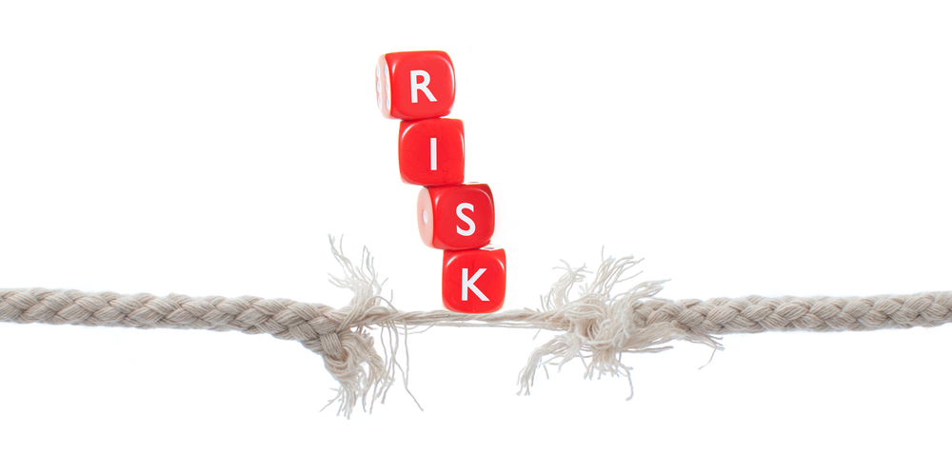
Potential Risks and Consequences
Potential risks related to engaging in sexual activities:
Regrets
Engaged in sex before you were ready
Pressure from peers or partner
Sexually transmitted infections
Pregnancy
Notes:
Teacher Prompts
“It is important to know that there are risks when making decisions related to sexual activity. You need to consider the pros and cons of any decision you are making, and how those decisions will affect both you and others”.
The teacher could ask students:
Do you feel pressured to become engaged sexually? What would you do if you feel pressured? Where might this pressure be coming from?
Why would you want to become sexually active? Why might your partner want to be sexually active?
Would you feel comfortable talking to your partner about sexually transmitted infections (STIs) and contraceptives, such as birth control, condoms, and/or other methods of protection?
Discuss the importance of sexual-decision making and the emotional maturity that is needed by both consenting partners, if they plan on becoming or being sexually active. Emphasize how students should delay sexual activity until they are older and more mature.
Risks of becoming sexually active:
Any type of sexual contact or activity involves some risk. These risks could be physical, social or emotional. Practicing safer sex can reduce the chance of getting an STI or unplanned pregnancy.
Physical
STIs
Pregnancy
Social:
Regret
Exclusion from a friend group if they find out
Pressure from other people to engage in sexual activity with them
Pressure if peer group is engaging in sexual activity and you are not (fear of missing out “fomo”)
If people find out, they might expose them on social media
Emotional:
Feeling regretful that you participated in sexual activity
Feeling physically unready afterwards
Turmoil and psychological distress
Abstinence—no sexual contact of any kind and at anytime, including intercourse or oral sex, skin-to-skin contact, sexual touching—is the only 100% effective and safe way to prevent an STI or pregnancy.
Remind students that you can still get an STBBI from blood. This will be discussed further in the STI presentation.
Abstinence might look different depending on your personal and/or religious values and beliefs.
**Talking to your students about sexual health, safer sex practices, and sexual decision-making will help them make healthy decisions so they don’t take part in any sexual activity that may put them and their health at risk.**
Reference:
Teaching Sexual Health (n.d.). Sexual Decision Making – Safer Sex Practices. https://teachingsexualhealth.ca/parents/information-by-topic/sexual-decision-making/
Photo Reference:
Shutterstock_103686428

Slide 37
Safe Practices – Be Prepared
If you have questions about sexual health, talk to a trusted adult
Learn about the risks of sexual activity before engaging in it
Discuss sexual history with your partner to identify any risk of STIs
Have regular medical check-ups and get tested for STIs if you are sexually active
Access the sexual health centre for information, contraceptives and testing, when needed
Notes:
Background Knowledge
To make sexual activity as safe as possible, make sure students know and have a plan:
Making sure that they talk about and understand each other’s limits around sexual activity and discuss what you are both comfortable with doing
Getting and giving consent for every sexual activity
Using condoms and dental dams
Using a condom to prevent STIs and as a backup form of birth control
Getting regularly tested and treated for STIs
Talking to their partner about their past sexual relationships and their history of STI testing and treatment
Reducing the chance of getting an STI by limiting sexual partners and using contraception methods
Understanding how drugs and alcohol make a person less inhibited, which makes them less likely to make good decisions
People who have sex while using alcohol or drugs are less likely to use condoms.
If you have questions… reach out to a trusted adult for help or advice, such as trusted adults, parents/guardians/caregivers, school health nurse, health care professionals
Important Safer Practices:
There are methods of protection (i.e., contraceptives) that can be used if a person plans on engaging in sexual activity.
If a person becomes sexually active, they should get tested for sexually transmitted infections (STIs).
Reference: Teaching Sexual Health (n.d.). Sexual Decision Making – Safer Sex Practices. https://teachingsexualhealth.ca/parents/information-by-topic/sexual-decision-making/

Slide 38
Final Activity: Standing up for your Beliefs
Student A wants to wait to engage in any form of sexual activity with their partner, but Student A’s friends are pressuring them to experiment.
What could Student A say?
How could Student A stand up for their own beliefs?
What would you do if you were Student A?
Notes:
General Information
Emphasize the concept of consent!!
Possible Scenarios - *adapt according to class profiles and maturity level*
Student A has been dating someone for a few months. Their partner wants to have sex, but they don’t feel emotionally ready. How do they talk to their partner about this?
Student A wants to wait until marriage to engage in any form of sexual activity with a partner, but Student A’s friends are pressuring them to experiment. How does Student A stand up for their beliefs?
Student A and Student B are sexually active together, but today Student A isn’t feeling up to it. How does Student A say no to their partner?
Student A and Student B have been engaging in sexual activity, when suddenly Student A gets nervous. How does Student A communicate that they want things to stop?
Scenarios adapted from: OPHEA (n.d.). Communicating Clearly. https://teachingtools.ophea.net/lesson-plans/hpe/grade-7/understanding-sexual-health-and-decision-making/communicating-clearly
Optional Activity: Have students complete a 3, 2, 1 Exit Card about consent, communication, and sexual health decision making.
Image from Canva

Slide 39
More Questions? Talk to Someone:
Parents/ Guardian
Teacher/ Principal
Doctor or Health Care Professional
School Health Nurse
Child and Youth Worker
Niagara Sexual Assault Centres (905-682-4584)
Niagara Region Public Health – Sexual Health Live Chat (Ask questions anonymously)
Notes:
General Information
There are many people and places that you can reach out to in order to get help or ask questions about relationships and sexual health. If you ever have questions/concerns, need help or know someone who needs help, you can always talk to someone. There are many options out there available to you.
Among these are:
A trusted adult (such as a parent or teacher)
A health care provider (such as a doctor or nurse)
A child and youth worker
The school health nurse
The school social worker
Any of the Niagara Region Sexual Health Centres
Kids Help Phone
Services for Youth - Niagara Region, Ontario → https://www.niagararegion.ca/health/schools/youth-services.aspx
Other community resources:
Kids Help Phone: Call 1-800-668-6868 or https://kidshelpphone.ca/
Niagara Sexual Assault Centre (CARSA) (http://niagarasexualassaultcentre.com/)
24 HOUR CRISIS & INFORMATION LINE: 905-682-4584
Niagara Region Public Health – Sexual Health Live Chat
https://vue.comm100.com/chatWindow.aspx?siteId=232657&planId=0066c5f6-364e-4017-9799-c08a1ef44d6b
Niagara Sexual Health Centre (https://www.niagararegion.ca/living/health_wellness/sexualhealth/sexual-health-centres.aspx)
905-688-3817
Sexual Heath Ontario – Live Chat: https://sexualhealthontario.ca/en/chat
Teaching Sexual Health (n.d.). 10, 11 and 12 Year Olds - Understanding Your Child’s Development. https://teachingsexualhealth.ca/parents/information-by-age/10-11-and-12-year-olds/
Kids Health: https://kidshealth.org/en/teens/sexual-health/
Image from Canva

Slide 40
Sexual Health Centre Information
Our Locations
Phone: 905-688-3817
Or call toll free: 1-800-263-5757
Niagara Falls Sexual Health Centre
7835 McLeod Road, Niagara Falls
St. Catharines Sexual Health Centre
277 Welland Avenue, St. Catharines
Welland Sexual Health Centre
200 Division Street, Welland
Hours of Sexual Health Centres vary.
Some of the confidential services offered are:
Birth control information
STI testing and treatment
Pregnancy testing
Birth Control at a lower cost (with doctor’s prescription)
Plan B (emergency contraceptive pills)
Free Condoms
Three Sexual Health Centres in the Niagara Region
Provide free, non-judgmental, and confidential services
Aim to enhance the sexual health of our community
Notes:
Niagara Sexual Health Centre: 905-688-3817
The hours for each of the sexual health centres are different and change depending on the times of the year. It is recommended that students call to inquire about the services offered and what they need so they can be directed to the closest and most appropriate centre.
For more information about the sexual health centres in the Niagara Region, use the following link: Sexual Health Centres - Niagara Region, Ontario → https://www.niagararegion.ca/living/health_wellness/sexualhealth/sexual-health-centres.aspx
https://www.niagararegion.ca/living/health_wellness/sexualhealth/sti.aspx

Slide 41
Final Thoughts
Sexual health can be affected by physical and emotional changes
Communication is needed in all types of relationships
Abstinence generally means you decide not to have sex
Getting and giving consent is always required
Consent is the act of giving permission and must be freely given
When you do engage in sexual activity, it should be enjoyable and safe
Notes:
General Information
Sexual health is affected by physical and emotional changes that happen during puberty.
Abstinence is the only method that is 100% effective and safe, when they abstain from all forms of sexual activity (i.e., sexual touching, sexual intercourse, etc.), which helps to prevent pregnancy and sexually transmitted infections (STIs).
Consent is always needed and required when two partners are discussing and/or plan on engaging in sexual activity(s). Consent must be informed. One should always know exactly what they are consenting to beforehand.
Students will learn more in grade 8 about what factors may or may not affect them when making decisions about their sexual health (internal and external factors) .
Image from Canva

Slide 42
Questions?
Notes:
Image from Canva

