Slide 1
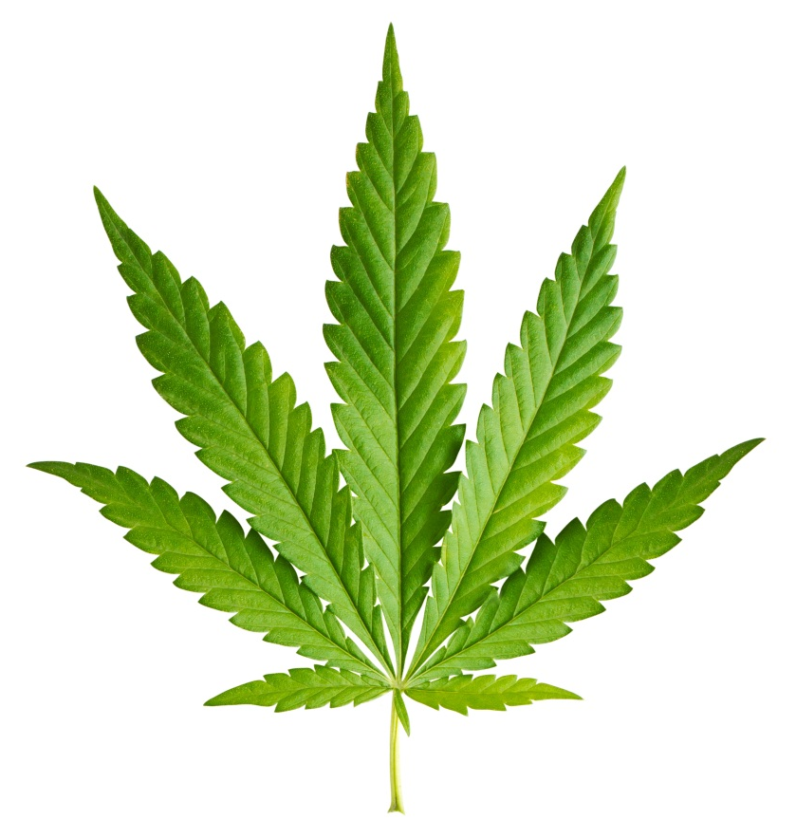
Cannabis

Slide 2
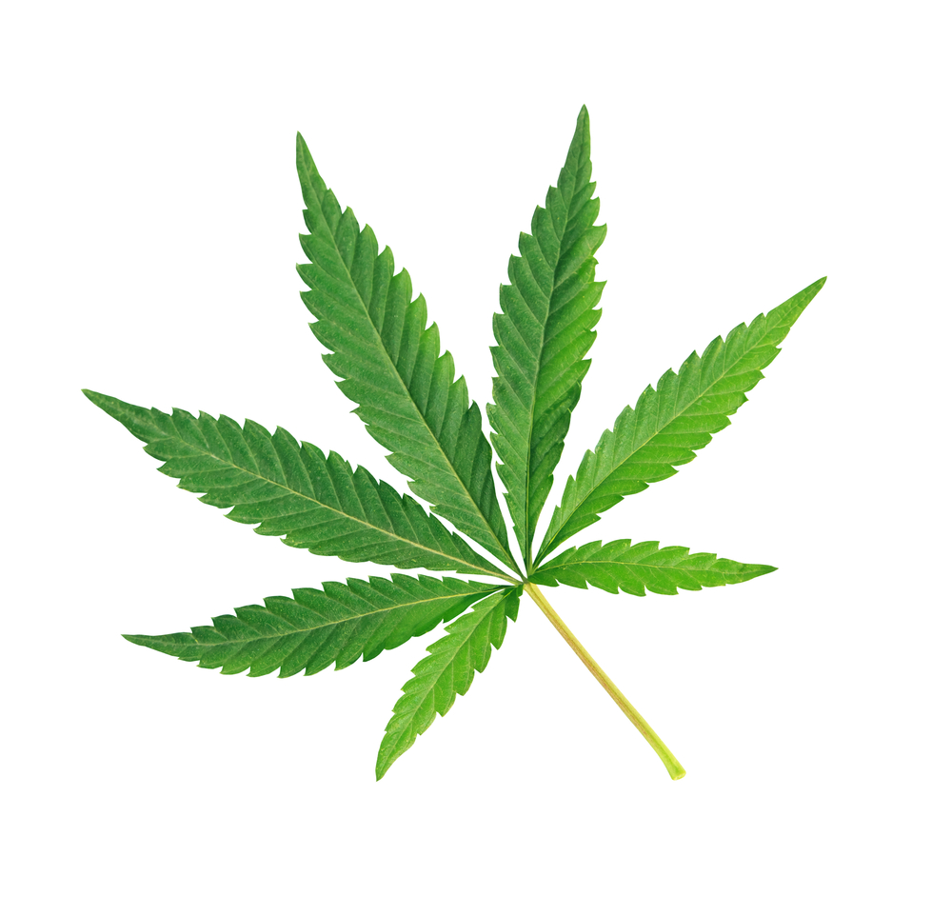
What is cannabis?
The most common form of cannabis is the dried flowers and leaves of the cannabis plant, however, it comes in many different forms
Also called: pot, weed, reefer, joint, grass, Mary Jane, hash, bud, marijuana
Contains hundreds of chemical compounds
Notes:
Cannabis is a product of the cannabis sativa plant. It comes in many forms, including as dried flowers and leaves; hash; extracts, such as oil and edibles
Youth have many nicknames for cannabis, such as: pot, weed, reefer, joint, grass, Mary Jane, hash, bud, marijuana
Ask the students: Are there any other names they have heard of that are not on this list?
Cannabis contains hundreds of chemical compounds called cannabinoids.

Slide 3
What is in cannabis?
The chemicals found in the cannabis plant are called cannabinoids. Two of the more commonly known chemicals in cannabis are THC and CBD.
THC | CBD
Responsible for the way the brain and body react to cannabis, including the “high” | Does not cause a “high”
The higher the level of THC, the more harm it can cause to the body | CBD is sometimes used as a treatment for people that suffer with chronic pain
Notes:
The two most commonly known cannabinoids found in cannabis are tetrahydrocannabinol (THC) and cannabidiol (CBD).
THC is responsible for changing your mood and state. It is responsible for giving the body a “high”. The level of THC can affect the body –the higher the level, the more harm it can cause to the body, both physically and mentally.
CBD does not produce a high or intoxication and can be used as a treatment for people that suffer with chronic pain conditions (such as arthritis and cancer-related symptoms).

Slide 4
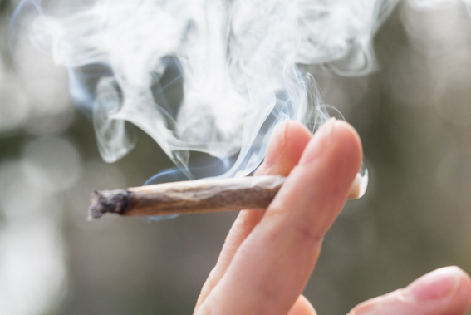
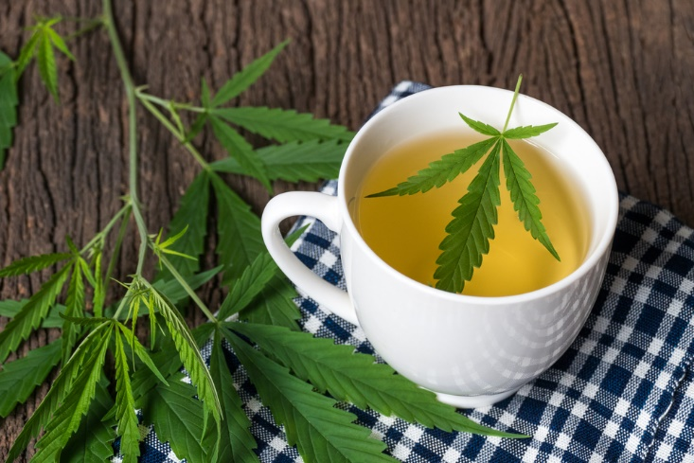
Cannabis can be:
Inhaled as a smoke or vapour
Consumed by adding it to food and beverages
Used as creams or oils
Notes:
Cannabis is most commonly smoked as a cigarette or joint. However, vaporizing and vaping is another way people use cannabis which involves breathing in dried/liquid cannabis vapours through a vaporizer or vaping device.
Cannabis can also be found in edible products such as brownies, candies and butters.

Slide 5
What does it do to the body?
Short-term effects:
Difficulty learning, remembering things and making decisions
Feelings of anxiety and panic
Increased appetite
Increased heart rate
Loss of coordination
Decreased concentration and focus
Delayed reaction time
Notes:
No matter how you use cannabis, there are some short- and long-term health risks. The only way to completely avoid all of the risks is to not use cannabis.
Makes it harder to learn and remember things:
Problems paying attention, remembering or learning things, and making decisions
Impacts academic performance and your grades
Can cause feelings of anxiety and panic
Increases appetite (munchies)
Increases heart rate
Loss of coordination
Decreases concentration
Delays reaction time
Note that many of these effects can impact you while playing sports or doing other activities.
Because of all of these effects, it is dangerous to drive or ride a bike after using cannabis.

Slide 6
What does it do to the body?
Long-term effects:
Harm to the lungs
Affects mental health
Addiction
*The impact of using cannabis can be more serious in youth than adults
Notes:
Using cannabis regularly (daily or almost daily) and over a long time (several months or years) can:
Hurt the lungs and make it harder to breathe
Cannabis smoke contains many of the same harmful substances as tobacco smoke.
Like smoking cigarettes, smoking cannabis can damage your lungs
Cannabis smoke contains carcinogens (cancer causing chemicals)
It can also make someone more likely to experience mental health problems (depression, anxiety, psychosis, and schizophrenia)
Contrary to popular belief, marijuana is addictive. Research suggests that those who start using at a younger age are at increased risk for addiction. Close to 1 in 10 adults who have ever used cannabis will develop an addiction to it. This goes up to 1 in 6 for people who started using cannabis as a teenager.
The risks of cannabis-related harms are increased if using:
Frequently
At a young age
High THC products
Large amounts
In combination with other drugs

Slide 7

Brain Development
The brain is still developing until around the age of 25
Notes:
Using cannabis when you’re younger can increase the risk of problems with your health, education and social life. The impact can be more serious in youth than adults because the teenage brain is still developing until mid 20s. The brain isn’t fully developed until around the age of 25.
Some of the damages caused by cannabis are irreversible.

Slide 8
Talking About Weed…And Your Brain

Slide 9
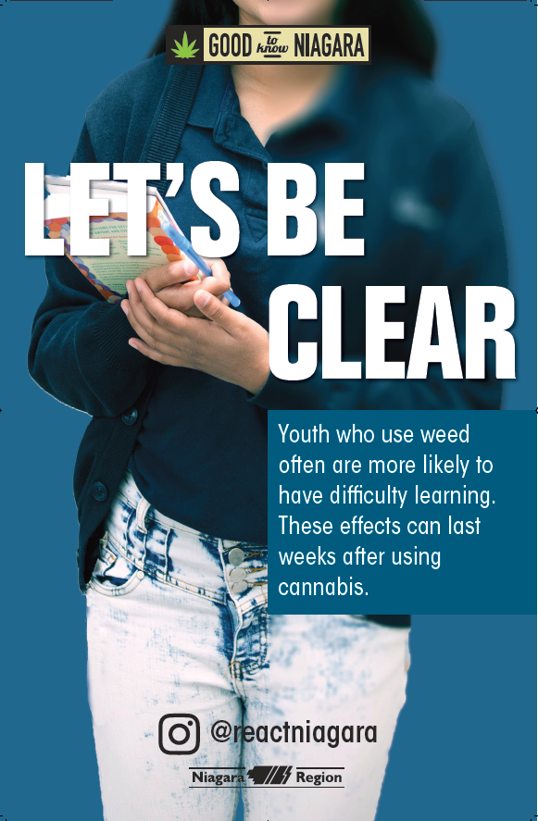
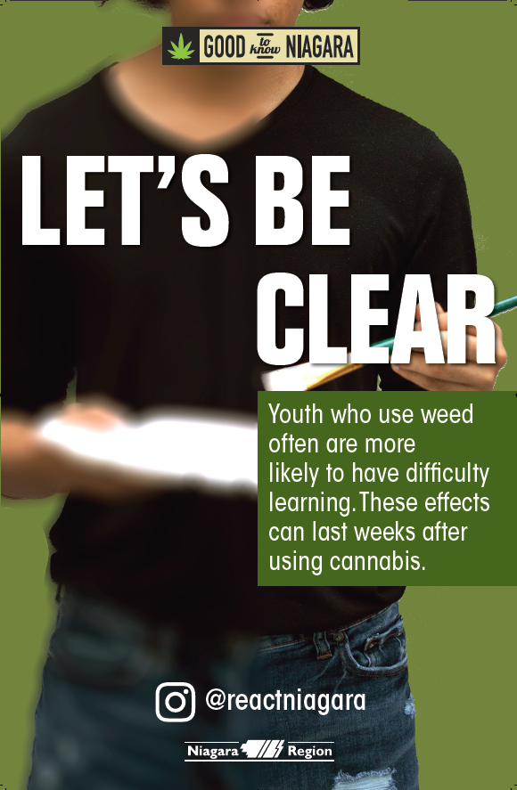
So, Let’s Be Clear
Youth who use weed often are more likely to have difficulty learning. These effects can last weeks after using cannabis

Slide 10
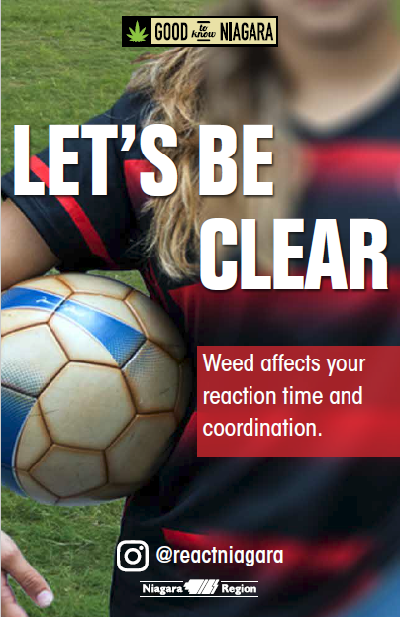
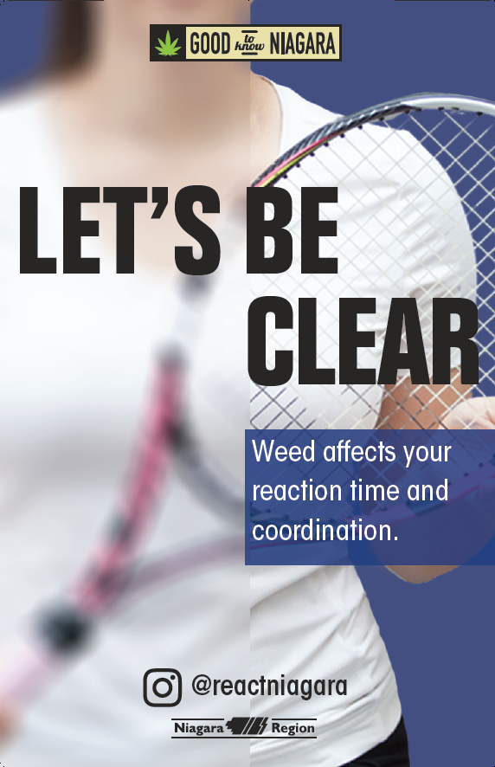
So, Let’s Be Clear
Weed affects your reaction time and coordination

Slide 11
Youth choose not to use cannabis because of:
The possible health effects
  Physical
  Mental
A lack of interest
Fear of judgement
The legal consequences
Notes:
Stress that less than one quarter (19%) of students in grades 7-12 report using marijuana in the last year. This means that about 80% of students do not use cannabis. (OSDUHS, 2017)
There are a variety of reasons youth choose not to use cannabis. Some fear the health consequences of using cannabis. They may not like the thought of being high or the thought of feeling ‘out of control’. Some youth are afraid of the fact that they might hurt themselves or someone else as a result of being high.
Others who do not use, or stop using after trying, do so because they lose interest or don’t enjoy the feeling of being high. Still others don’t use because of the legal consequences for using under age, or the risk of it interfering with their schooling, job, and extra-curricular activities like sports. Also, some don’t want to risk being labeled as a drug user.

Slide 12
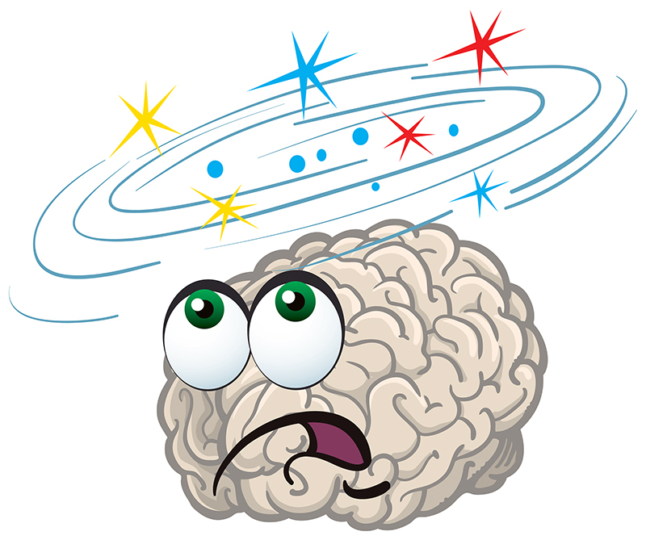
Some youth use cannabis:
To try to have fun
To try something new
They think it might help them fit in
They think it will help with stress and anxiety
Notes:
The most common reason given for using cannabis is for the enjoyment of it- the feeling of getting high is relaxing for some. Some youth are curious about the experience and want to try it for themselves- they think that it will help them fit in and be cool.
However, we know that youth tend to want to spend time with those that have similar interests. So, although some youth use cannabis because they feel pressured by their friends to do so, much of the time those who want to use cannabis choose to hang out with friends that are using cannabis already. Still, others use it in an attempt to cope with stress, tension, anxiety and other mental health issues. Maybe things at home are difficult and they feel there is no other way to deal with the situation. Some youth use it in an attempt to help them sleep better. On occasion, it might be prescribed as a pain reliever.

Slide 13

Refusal skills
Say “no”
Walk away
Broken record – keep repeating “no”
Say “no” different ways
Give an excuse or explanation
Offer an alternative activity
Reverse the pressure
Notes:
It can sometimes be difficult to say no to friends or peers without offending them or feeling singled out.
Your friend approaches you to offer you cannabis. How do you deal with your friend? How do you refuse?
Discuss different ways and tips for saying no:
Say “no”. Be assertive and clear.
Walk away
Broken record – You may be asked several times - keep repeating “no”.
Say “no” different ways. For example, “I’m not interested” or “I don’t want to”
Give an excuse or explanation if you want. For example, “I don’t want to smoke weed because I don’t want to become addicted.”
Offer an alternative activity. For example, “I don’t want to smoke weed; how about we go to the mall?”
Reverse the pressure. For example, “Why are you pressuring me?”
***Scenario Activity***
For further instructions, please review the teaching tool.

Slide 14

Legal Age
The legal age to buy, use, possess and grow cannabis is 19
This is the same legal age for the sale of tobacco and alcohol
Notes:
FYI for teachers if asked:
Edibles are now available for purchase from legal dispensaries if you are of legal age

Slide 15
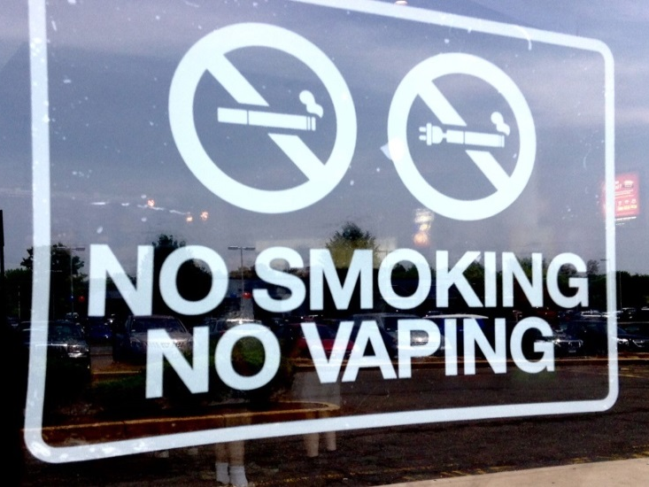
Smoke Free Ontario Act (SFOA)
Smoking or vaping any substance is NOT permitted on school property and additionally within 20m from the perimeter of the school
  Indoors and Outdoors
  Applies to all students, staff, visitors
Fine = $305 for first offence
Sale and Supply
Youth supplying (giving a tobacco product/vaping device/any vape component including e-juice) to those under 19 years- not permitted
Adults purchasing for those under 19 years- not permitted
Fine= $490 for first offence
Notes:
(NO possession law exists for tobacco and e-cigarettes → only to be shared with staff and parents**)
In Ontario, e-cigarettes, tobacco and cannabis are all controlled under the Smoke Free Ontario Act.
Under this legislation, vaping is prohibited on school property and an additional 20m from the school perimeter.
Those who break this law can be charged with a $305 fine for the first offence (this can increase for multiple offences).
In terms of sale and supply, Niagara Region Public Health is responsible for the day-to-day enforcement of the SFOA. This includes obtaining compliance through education and awareness to ensure that business owners are aware of the laws that apply to them.
Officers from Niagara Region Public Health conduct regular inspections of retailers to ensure compliance with the SFOA. Officers conduct “test shopping” to test a retailers willingness to sell an electronic cigarette device to a person who is less than 19 years old.
A person who sells or supplies an e-cigarette device to a person under 19, may be subjected to a fine of $490.00. (Includes retailers, adults or youth supplying to those under 19 years)
See Health Canada for more information
https://www.canada.ca/en/health-canada/services/smoking-tobacco/vaping.html
***Ask the principal for any school-specific disciplinary measures in terms of suspensions or expulsions***

Slide 16
Niagara Smoke and Vape-Free Outdoor Spaces Bylaw
Smoking tobacco, cannabis and vaping products is prohibited in the following public spaces:
  Beaches (new)
  Recreation trails (new)
  Within 9 metres of an entrance or exit of a publicly accessible place, building or workplace (new)
  Parks, playgrounds and sports fields
  Splash pads and outdoor pools
  Arenas and recreation centres
  Outdoor areas of municipal and regional buildings
  Bus shelters
Notes:
The newly updated Niagara smoke and vape-free outdoor spaces bylaw now prohibits tobacco, cannabis and vaping products from being smoked or vaped in several public spaces including:
- Beaches (new)
- Recreation trails (new)
- Within nine metres of an entrance or exit of a publicly accessible place, building or workplace (new)
- Parks, playgrounds and sports fields
- Splash pads and outdoor pools
- Arenas and recreation centres
- Outdoor areas of municipal and regional buildings
- Bus shelters

Slide 17
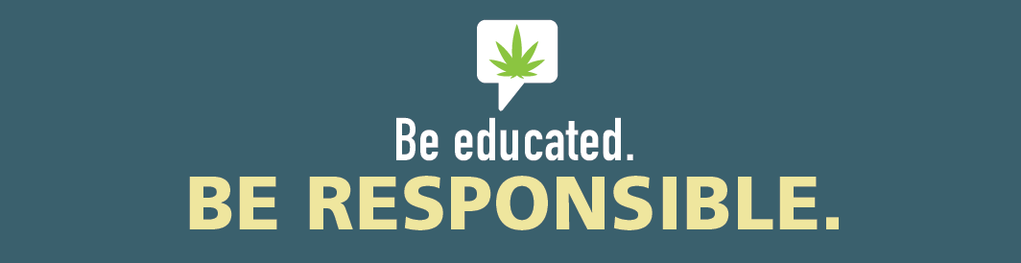
Take Home Messages
Not “everyone is using it”
It is illegal if you are under the age of 19
Smoke is smoke
Protect your brain, it is still developing until 25

Slide 18

If you need help:
Community Addictions Services of Niagara (CASON) (905) 684-1183 or www.cason.ca
Teacher/Principal/VP
Child and Youth Worker
Public Health Nurse
Parents
Doctor
Notes:
If you ever have questions/concerns, need help or know someone who needs help, you can always talk to someone. There are many options out there available to you.

